Slide 1
DBS Asian Insights 2025
Media Partner Brief
Jan 2025

Slide 2
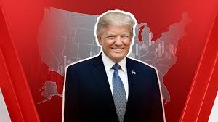


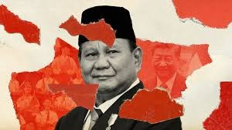
The Background
Politics
Economy
Sustainability
Return of Trump and Energy Tensions: Donald Trump’s presidency (from January 2025) may escalate global energy tensions through increased tariffs (up to 20%), a focus on fossil fuel expansion, and potential geopolitical moves
Indonesia Presidential Transition and Governance: Prabowo's administration has launched several initiatives, including a multi-billion-dollar free nutritious meal program targeting schoolchildren and pregnant women, aiming to reach 83 million recipients by the end of 2025. While this program has garnered public support, economists' express concerns about its fiscal sustainability, noting the need for an additional 100 trillion rupiah ($6.11 billion) to fully implement the scheme
Global Economic Slowdown: OECD forecasts a slowdown to 2.7% in 2024, down from 2.9% in 2023.
Governments, particularly the U.S., are adopting protectionist policies, including higher tariffs and subsidies for domestic industries.
Indonesia Economic growth is projected at 5% in 2024, below the government’s 6% target, partly due to weaker global demand affecting exports.
President Prabowo's ambitious social programs (e.g., free meals) face fiscal sustainability challenges, requiring an additional IDR 100 trillion ($6.11 billion).
At COP29 in Baku, Azerbaijan, Developed nations pledged to mobilize $300 billion annually by 2035 to support developing countries in mitigating and adapting to climate change.
COP29 finalized rules under Article 6 of the Paris Agreement, establishing a framework for international carbon credit trading. This mechanism allows countries and companies to trade emission reductions, creating opportunities for businesses specializing in carbon offset projects.
Indonesia Presidential Regulation No. 14/2024 provides a legal framework for CCS activities, covering exploration permits, storage operations, tax provisions, and economic incentives. This regulation aims to reduce carbon emissions and attract foreign investment in CCS technologies.

Slide 3


The Target Audience
Emerging Affluent
Affluent
A Health enthusiast; A young parent;
Young entrepreneurs/ Start-up owners
Social Activist
Social Role model
CBG
IBG - Large Ent.
Senior Leadership Roles
CxO Leadership Roles
IBG - SMEs
Owners; 2nd Gen
Owners
Meet Alex, a beacon of productivity, navigating the bustling urban life with a practical finesse that makes banking an effortless part of his day.
As a young tech entrepreneur, he embodies the spirit of ambition, his charismatic presence felt not only in boardrooms but also in his community where he’s seen as a forward-thinking leader.
Alex seeks banking services that keep pace with his dynamic lifestyle, allowing him to live confidently and seize every opportunity that comes his way.
For Alex, banking is not just about managing finances; it's a platform to build a promising future and to showcase his expertise in his field.
Sophia day begins with a sunrise yoga session, a testament to her commitment to a productive, balanced lifestyle. In her world, banking is seamlessly integrated into her life, a hassle-free experience that resonates with her practical approach to wealth management.
As a seasoned CEO, Sophia is the embodiment of confidence and ambition. Her active leadership extends beyond the corporate realm into philanthropy and community building, always seeking ways to grow personally and professionally.
Sophia is a progressive thinker, her strategies and decisions reflecting a drive to live larger than herself and to push the boundaries of innovation. With a storied career in international business, she needs banking partner not only as a client but as an expert in her field, crafting the future of her industry.
Productive and Practical individual (Live hassle-free)
Ambitious, charismatic, active and leaders in community, hungry for growth (live confidently, seize opportunities)
Progressive thinker, High desire to give back, transformer (live larger than yourself, Build Future, Live on the edge)
3

Slide 4

The Objectives
Business Objectives
To enhance and deepen existing client relationships, positioning DBS as a trusted business partner by delivering reliable, actionable insights.
To implement strategies and services that demonstrate DBS's in-depth understanding and foresight in the industry, reinforcing client trust and engagement.
To expand the client base by targeting potential prospects through impactful market outlook events that build confidence in DBS' role as a trusted partner.
Marketing Objectives
To position the Asian Insights Conference as a leading platform for market, political, and sustainability outlooks, solidifying DBS’ reputation as a trusted wealth and business partner in Indonesia.
To emphasize DBS’ trustworthiness, financial expertise, and commitment to delivering reliable insights that empower businesses and individuals to make informed decisions.
To showcase DBS’ comprehensive knowledge in market trends, political dynamics, and sustainable practices, underlining our value as a trusted partner for growth and success

Slide 5

The Event
Themes:
Towards a Resilient Economy: Fostering Self-Reliance and Inclusive Development
Date:
21 May 2025
1-5 PM
Venue:
Ballroom Hotel Mulia Jakarta
Event invitation:
400pax IBG clients & Prospects
100 pax CBG clients & prospect
Event format:
offline

Slide 6
Asian Insights Conference 2025:
Towards a Resilient Economy: Fostering Self-Reliance and Inclusive Development
TIME | ACTIVITY
13.00 – 14.00 | Registration
14.00 – 14.05 | Host Opening
14.05 – 14.10 | Opening Video
14.10 – 14.15 | Opening Remarks by Mr. Chu Chong Lim
14.15 – 14.35 | Keynote Speech A New Era for Indonesia: Accelerating Economic Growth – Prabowo Subianto, President Indonesia
14.35 - 16.00 | Economic Outlook 2025: Beyond The Numbers: Charting Indonesia’s New Economic Course Taimur Baig, Chief Economist Mari Elka Pangestu, Indonesian economist and former @WorldBank Managing Director of Development Policy and Partnerships and Minister of Trade in Indonesia.
16.00 – 16.30 | Political Outlook 2025: Power Shift for Economic Growth Burhanuddin Muhtadi, Direktur Eksekutif Indikator Politik Indonesia
16.30 – 17.00 | Closing Remarks A New Era for Indonesia: Accelerating Economic Growth – Erick Thohir, Minister of State-Owned Enterprises
17.00 – 17.05 | Host Closing
17.05 – 19.00 | Entertainment + Early Dinner

Slide 7
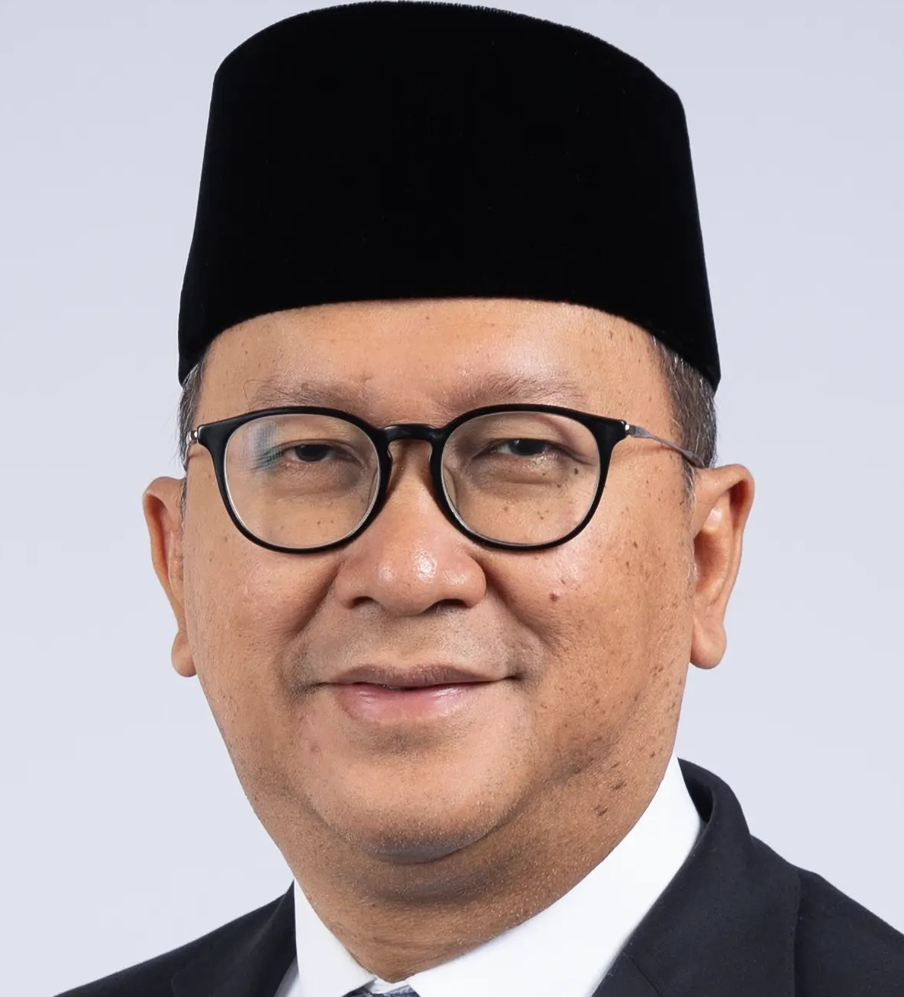
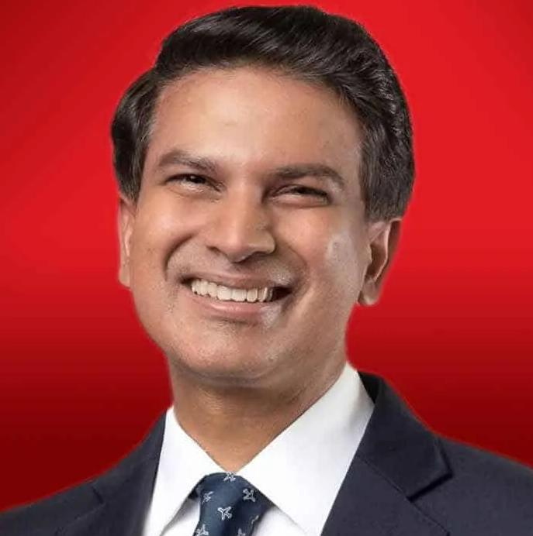
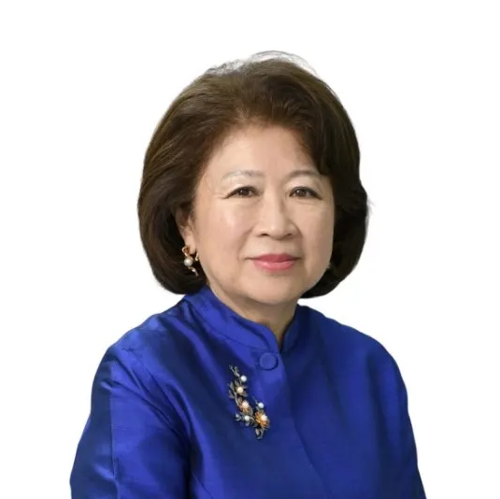
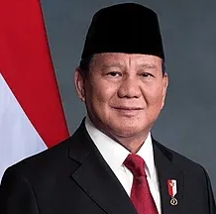
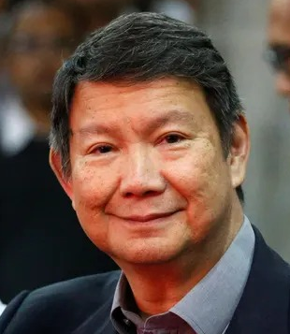
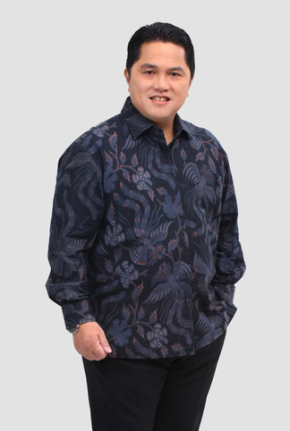
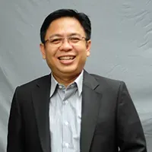
Asian Insights Conference 2025:
Towards a Resilient Economy: Fostering Self-Reliance and Inclusive Development
Keynotes
Economic Outlook 2025
Beyond The Numbers: Charting Indonesia’s New Economic Course
Exploring the new government's approach to balancing economic growth and sustainability in Indonesia
A New Era for Indonesia:
Accelerating Economic Growth
Highlight significant changes occurring in Indonesia and the vast opportunities for economic growth, while explaining the ongoing and future economic transformations, such as the development of the digital economy, Industry 4.0, and the green economy.
Backup keynote:
Taimur Baig
Chief Economist
Mari Elka Pangestu
Indonesian economist and former @WorldBank Managing Director of Development Policy and Partnerships and Minister of Trade in Indonesia.
Rosan Roeslani
Minister of Investment and Downstreaming
Prabowo Subianto
Political Outlook 2025:
Power Shift for Economic Growth
President of Indonesia
Burhanuddin Muhtadi
Direktur Eksekutif Indikator Politik Indonesia
Hashim S. Djojohadikusumo
Indonesia's Presidential Envoy on Climate and Energy
Erick Thohir
Minister of State-Owned Enterprises

Slide 8
Mandatory Key Message
Bank DBS merupakan mitra tepercaya untuk pengembangan bisnis dan investasi melalui jaringan kuat di kawasan Asia
- Bank DBS memberikan insight tepercaya untuk keputusan bisnis dan pengelolaan kekayaan Anda.
- DBS Asian Insights Conference merupakan konferensi tahunan Bank DBS Indonesia yang menyatukan para pemimpin dengan pemikiran global untuk membahas peluang dan tantangan perubahan di Indonesia. Konferensi ini diharapkan dapat mengubah kekhawatiran dan keraguan menjadi keyakinan untuk ambil peluang dengan dukungan pakar andal dari Bank DBS terkait arah bisnis dan pengelolaan investasi personal di masa depan.

