Slide 1


EXCLUSIVE SALES KIT
PT. Valbury Asia Futures
Menara Karya 8th Floor, JL. HR Rasuna Said Blok x-5 Kav 1-2.
Jakarta 12950
Tel. (021) 255 33 777, Fax. (021) 255 33 701

Slide 2
Who Are We?
Pioneer member of Jakarta Futures Exchange (BBJ)
No : SPAB-046/BBJ/06/02
Izin Usaha Pialang Berjangka
Nomor: 184/BAPPEBTI/SI/II/2003
Clearing member of The Indonesian Derivatives Clearing House (KBI)
Nomor: 13/AK-KBI/III/2003
Member of Alternative Trading System (SPA)
Nomor : 1147/BAPPEBTI/SP/3/2007
Providing investment services for individual/corporate, domestic/international
Leading Investment Company

Slide 3
OUR PRODUCTS
Foreign Exchange
Loco London Gold (Commodities)
Indices
Crude Oil (Commodities)
Silver (Commodities)
CFD

Slide 4


Investment Considerations
Return
Capital
Time
Liquidity
Safety
Transparancy

Slide 5
Investment Choices
 | Capital | Return | Liquidity | Time Frame | Risk
Bank Deposit | 100% | Low | Low | Long | Low
Property | 100% | High | Not Liquid | Long | Low
Mutual Fund | 100% | Low / High | Not Liquid | Long | Low / High
Stocks | 100% | High | Depends | Long | Medium
Margin Trading | 3% - 10% | High | High Liquidity | Short | High but Manageable

Slide 6
Margin Trading
“Good Faith” cash deposit required for investor to trade
Not as a down payment
Money management plays a very important role in determining success in margin trading

Slide 7
Benefits of Margin Trading
Low barrier of entry as clients do not need to have the full sum in order to trade as capital required is only 3% - 10% of the traded value
High fluctuation and liquid market thus generating ample opportunities for trading
2 ways trading, enter with a buy position and selling to settle at a higher price or enter with a sell position and buying to settle at a lower price
One of the few financial products where risk is manageable
Standard transaction cost for every trade

Slide 8
Margin Trading
PHYSICAL
MARGIN
Assuming:
Contract Size 100 Troy Ounce (3.1KG).
XAU/USD = 1,080.00
USD/IDR = 12,000
Price in IDR / grams =
Rp 418,064,50 / grams
100 Troy Ounce = Rp 418,064,50 / grams x 3100 grams = Rp 1,295,999,950,-
*Capital outlay for 100 troy ounce (3.1Kg) = Rp 1,295,999,950,-
Assuming:
Contract Size 100 Troy Ounce (3.1KG).
USD/IDR = 12,000
XAU/USD = 1,080.00
Margin for 100 Troy Ounce = $1000 (Rp. 12,000,000.00)
*Capital outlay for 100 troy ounce (3.1Kg) = $ 1,000 (Rp. 12,000,000.00)
Notes:
Please update the price of XAU in this sample.

Slide 9
What Is Index Futures?
An index based on a statistical compilation of the share prices of a basket of representative stocks
A tool for measuring the performance of an entire stock market or a group of related stocks
Stock index futures are thus futures contracts based on an index of securities prices
Level of fluctuations on a day to day basis offer opportunities for traders

Slide 10
Why Trade Index Futures?
Trading index futures is easier compared to individual stocks as you don’t have to analyze every company in the stock market
You only have to analyze the country’s economy as a whole, not just a single company or a single business sector
You are basically trading the economy as a whole rather than a single company
When a company declares bankrupt, the stock can be worthless while index futures will never be $0,-
It has a low barrier of entry, highly leveraged, low spreads and commission offering the client good opportunities
Trading hours of Asian indices suits Indonesian working hours
Unlike stocks, index futures offer high liquidity and no queing

Slide 11
Index VS Stock Market
ITEM | Index Futures | Stock Market
Capital | 3% - 10% | 100%
Place | International | Local
Portfolio | Portfolio of Stocks | Single Stock
Trade Limits | Depends on Market | Depends on Market
Position | Buy & Sell | Buy Only
Liquidity | Anytime | Sometime
Fees | Standard | Percentage

Slide 12
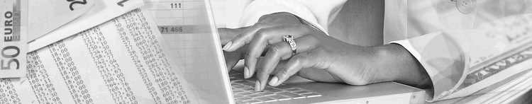
Stock Index Futures
Nikkei - Japan
Hang Seng - Hong Kong
Kospi - South Korea

Slide 13
Time Transaction
 |  | Nikkei | Hang Seng | Kospi
Trading Hours (WIB) | 1st | 06.45 - 13.30 | 08.45 - 11.30 | 07.00 - 13.05
 | 2nd | 14.30 - 18.00 | 13.30 - 15.30
Contract Months |  | March, June, September, December | Spot Month | March, June, September, December

Slide 14
Margin Requirement for Index
 | All Currencies
Contract Value (Per Pts) | $ 5,-
Day trading margin | $ 1,250.-
Overnight margin | $ 2,500,-
Spread | 5 Pts
* The rate is Rp12,000 fixed rate

Slide 15
Index Illustration
Investor A chooses $ 5 ‘Contract Value’, Hang Seng Index shows up trend, Investor A starts his transaction with 20 lots of buy position at 21,300.
Hang Seng Index goes up to 21,400, and the Investor A decides to sell / liquidate his buy position.
The result is :
Gross P/L = (Selling Price - Buying Price) x Contract Size (CS) x lot
= (21,400 - 21,300) x USD 5 X 20 lot
= USD 10,000.00
Net Profit after deducting 2 lots commission (1 lot = USD 15/way)
Net P/L = Gross profit - commission
USD 10,000 – USD 600
= USD 9,400
Notes:
The sample price is not up-to-date. I changed.

Slide 16
What Is Foreign Exchange(FX)
Price of one currency against another
24 hours a day, 5 days a week market
High level of volatility on a day to day basis
Largest and most liquid market in the world
Offers plenty of instruments to manage risk
Allows investors to trade in rising and falling market

Slide 17
Foreign Exchange History
Exchange-traded forex futures contracts were introduced in 1972 at the Chicago Mercantile Exchange and were the most actively traded futures contracts.
The foreign exchange (currency or forex or FX) market exists wherever one currency is traded against another. It is the largest financial market in the world, and includes trading among large banks, central banks, currency speculators, multinational corporations, governments, and other financial markets and institutions. The average daily trade in the global forex and related markets currently is over US$ 3 trillion.

Slide 18
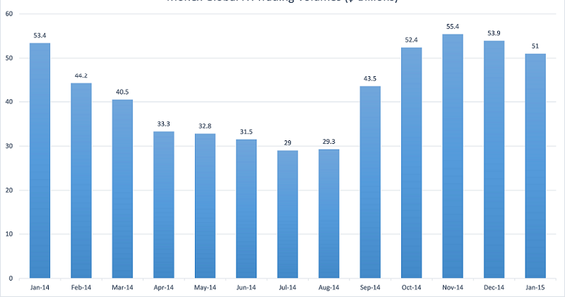
Foreign Exchange History
According to the BIS (Bank for International Settlements) average daily turnover in traditional foreign exchange markets is estimated at US $3.21 trillion. Daily averages in April for different years, in billions of US dollars, are presented on the chart below:
Notes:
This chart and data is not updated. Please change it.

Slide 19

Why Trade FX
Everyone is involved in the currency market one way or another
It is the biggest market in the world offering traders many opportunities to trade
The high leverage offers traders opportunities that has benefited big institutions and banks so far
Traders are offered a range of major currencies with guaranteed opportunities for trades
Low spreads and commission means a low barrier of entry making it easier for individual clients to participate in the largest market in the world
Flexible 24 hours trading hours allowing clients to trade whenever suits them
High liquidity and no queuing means client is able to trade more often

Slide 20
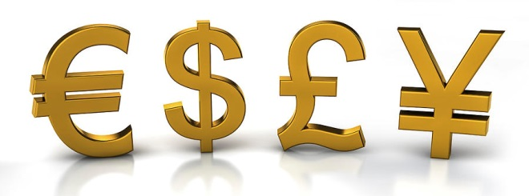

Currency Pairs
Euro / US Dollar
US Dollar / Japanese Yen
Great British Pound Sterling / US Dollar
US Dollar / Swiss Franc
Australian Dollar / US Dollar
Euro / Japanese Yen
And more,,

Slide 21
Online Margin Requirement for FX
Currency | EUR/USD | USD/JPY | GBP/USD | USD/CHF | AUD/USD | EUR/JPY
Contract Size | 100,000 EUR | 100,000 USD | 100,000 GBP | 100,000 USD | 100,000 AUD | 100,000 EUR
Margin Requirement | US$ 1,000 | US$ 1,000 | US$ 1,000 | US$ 1,000 | US$ 1,000 | US$ 1,000
* The rate is floating rate or fixed at US$/Rp12.000 or Rp 14.000
Notes:
Why the spreads are still 5 points? And the standard commission charge should be $15, right?

Slide 22

FX Illustration
Investor B sells 5 lots GBP/USD at 1.4800 level. On the same day, Investor B liquidate all of his position with buy position at 1.4700
The result is :
Gross P/L = (Selling Price–Buying Price) x Contract Size (CS) x lot
= (1.4800 – 1.4700) x 100,000 X 5 lot
= USD 5,000
Net Profit after deducting 5 lot commission (1 lot = USD 15/way),
Net P/L = Gross Profit – Commission
= USD 5,000 – USD 150
= USD 4,850
Notes:
The sample is not up-to-date, and the commission charge is wrong

Slide 23
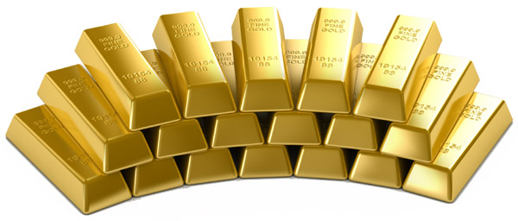
Gold
Gold is a very ductile, malleable and brilliant yellow precious metal
Loco London Gold symbol (XAU =) that means :
X = Symbol for precious metal
AU = Aurum (Gold)

Slide 24
Why Trade Loco London Gold
Everyone is involved in the commodity market one way or another
It is the biggest market in the world offering traders many opportunities to trade
The high leverage offers traders opportunities that has benefited big institutions and banks so far
Low spreads and commission means a low barrier of entry making it easier for individual clients to participate in the largest market in the world
Flexible 24 hours trading hours allowing clients to trade wherever and whenever
High liquidity and no queuing means client is able to trade
Loco is recognized as a safe haven commodities

Slide 25
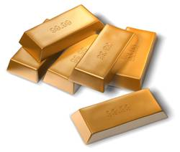
Trading Rules
Commodity | Contract Size | Margin Requirement | Rate
Loco London Gold | 100 Troy ounce 1 Troy ounce=31.1 gram | $ 1000/lot | Floating Rate Fix Rate Rp 12.000/USD Rp 14.000/USD
Notes:
Spread for On-line is floating, not 0.50 cents anymore

Slide 26
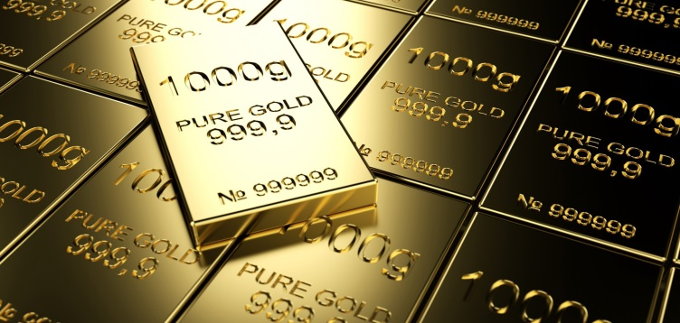
LOCO GROSS P/L
Gross P/L Calculation
(SELL – BUY ) x Contract Size x Lot
Example:
Client A invests USD100,000 with Valbury. With the expectation that LOCO will go up, He buys 30 lots at 1,100.50 in the morning. Several hours later the client liquidates his positions at 1,120.50. What is his Gross P/L?
Gross P/L = (1,120.50 - 1,100.50) x 100 x 30
= USD 60,000
Net P/L = 60,000 - (30 x $15 x 2)
= USD 59,100

Slide 27
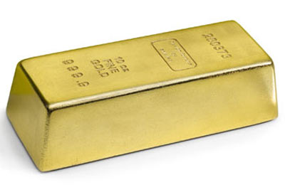
SWAP / Interest
All daily swap points amount will be debited or credited
to customer’s account as cash entry
SWAP = (OP x CS x SWAP x Lot x Day) / 360
Example :
OP Buy = 1,100
CS = 100 Troy Ounce
Swap point Buy = - 1.75 % & sell = -1.25%
Lot = 2
Open position on Monday and Liquidation on Tuesday
Swap = (1,100.00 x 100x-1.75% x 2 x1) / 360
= - USD 10.69

Slide 28
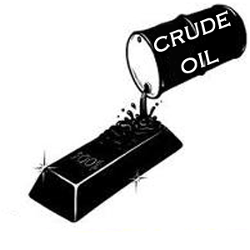
Crude Oil
Crude Oil is a fossil fuel that is used to form various important products: such as petroleum
Crude Oil symbol (LSE) that means :
E = Symbol for Energy
LS = Light Sweet Crude Oil

Slide 29
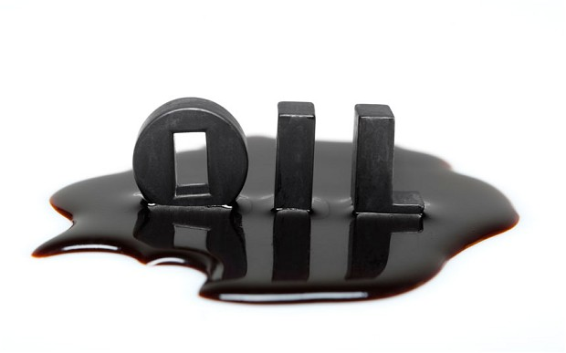
Crude Oil
Crude oil is directly and indirectly used by everyone
Can be processed into petroleum, ethanol and various by products such as kerosene and asphalt
Reserve is limited but subjected to technology advancement
Benchmark for inflation
Notes:
Expand the usage of crude oil
Major Supply and pipe line of oil (Highest producer, Oil producer, Offshore production plant ex Gulf of Mexico)

Slide 30
Crude Oil Conversion
Barrel
1 Barrel = 158.9872 Liter
Price in IDR = (price x IDR) / 158.9872
Example :
Price in IDR / Liter = (36.07 x 13800) / 158.9872
Price in IDR / Liter = Rp 3,130. 85/ Liter
Notes:
The sample price of crude oil is not 100 now. The rate of Rupiah is not updated. Please change the calculation.

Slide 31

ON-LINE CRUDE OIL
Commodity | Contract Size | Margin Requirement | Spread | Rate
Crude Oil | 1,000 Barrel 1 Barrel =159 Litter | $ 2,000/lot | 0.05 | Floating Rate Fix Rate Rp 12.000/USD Rp 14.000/USD
Notes:
Left online only.

Slide 32
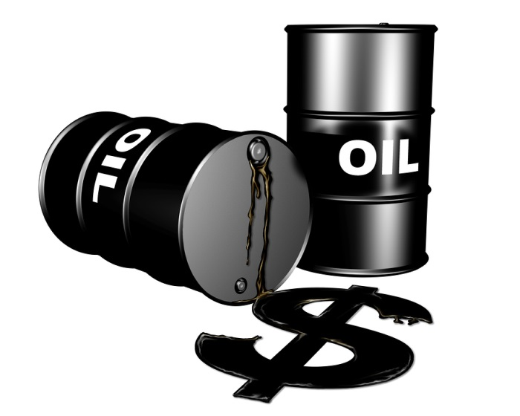
CRUDE OIL GROSS P/L
Gross P/L Calculation
(Liquidation Price – Opening Price) x Contract Size x Lot
Example:
Client A invests USD100,000 with Valbury. With the expectation that Crude Oil will go up, he buys 30 lots at 36.50 in the morning. Several hours later the client liquidates his positions at 47.50. What is his Gross P/L?
Gross P/L = (47.50 – 36.50) x 1000 x 30
= USD 330,000
Net P/L = 330,000 – (30 x $15 x 2)
= USD 329, 100
Notes:
The sample crude oil price is too far from current price, please update it.

Slide 33



CFD PRODUCTS (INDEX)
NASDAQ
DOW JONES
S&P 500

Slide 34
NASDAQ - 100
Began on 31st January 1985 in NASDAQ (National Association of Securities Dealers Automated Quotations) Stock Market.
Traded in Chicago Mercantile Exchange
Debuted together with NASDAQ Financial - 100.
Consist of 100 companies.
Consists of Industrial, Technology, Retail, Telecommunications, Biotechnology, Health Care, Transportation, Media and Service Companies.
All time high was 4,816.35 on December 31, 2000
All time low was 804.64 on October 7, 2001
Notes:
Please check the all time high level.

Slide 35
DOW JONES INDUSTRIAL AVERAGE
Founded on May 26, 1896.
Licensed for the first time on 1997.
The Index is traded in New York Stock Exchange Euronext and NASDAQ QMX
The Futures is traded in Chicago Mercantile Exchange
Part of the Dow Jones Indexes.
Consist of 30 companies.
Cover all industries except Transportation and Utilities
Oldest and single most watched index in the world
All time high was 18,351.36 on December 31, 2015
All time low was 28.48 on August 8, 1896
Notes:
All time high should not in 2007, right? The current level is higher than your ex-all time high price.

Slide 36
S&P (STANDARD AND POOR’S 500)
First introduced on March 4, 1957.
The Index is traded in New York Stock Exchange
The Futures is traded in Chicago Mercantile Exchange
The Options is traded in Chicago Board Options Exchange
Consist of 500 Large Cap companies.
All time high was 2,134.72 on December 31, 2015
All time low was 676.53 on March 9, 2009
Notes:
Same problem, all time high was not in 2007 level for now.

Slide 37
CFD INDEX
CFD Products | Contract Size | Day / Overnight Margin | Spread | Fee
NASDAQ | $ 20.00 per index point | $1,500.00 | 2.5 pt | $15
DOW JONES | $5.00 per index point | $1,500.00 | 10.00 pt | $15
S&P 500 | $50.00 per index point | $1,500.00 | 1.00 pt | $15

Slide 38
Transaction Details
TRANSACTION HOURS:
- 05:00 – 03:15 (WIB) DURING SUMMER
- 06:00 – 04:15 (WIB) DURING WINTER
CONTRACT PERIOD:
- MARCH, JUNE, SEPTEMBER & DECEMBER
- LAST TRANSACTION DAY IS THE 3RD FRIDAY
OF THE MONTH OR 1 WORKING DAY BEFORE
IF THE FRIDAY FALLS ON A HOLIDAY

Slide 39
Trading Rules
Max dealing per Quotation: 30 Lots
Hedging Margin: USD $500 per pair
Fee: USD $30.00 per lot (Settled)
Gap limit:
- Nasdaq: 75.00 point
- Dow Jones: 300 point
- S&P 500: 30.00 point
LO/SO distance from running price:
- Nasdaq: 3.00 point
- Dow Jones: 15 point
- S&P500: 1.50 point

Slide 40
GROSS P/L
Gross P/L Calculation (INDEX)
(Liquidation Price – Open Price) x Contract Size x Lot

Slide 41
INDEX CFD GROSS P/L
Example 1:
Client A has cash equity USD 30,000 in Valbury to speculate on NASDAQ (contract size USD 20.00/point). In the morning he buys 10 lot at 4,365.75 and sells before market close at 4,500.25.
What is his Gross P/L?
Gross P/L = (4,500.25 – 4,365.75) x 20 x 10
= USD 26,900
Notes:
41
Please update the current level, it was too far from now.

Slide 42
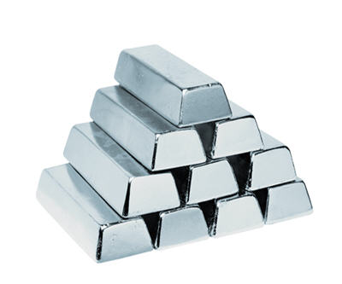
What is Silver?
Silver is one of the most versatile assets metal available.
Used as both of industrial metal and hard assets.
Silver is the whitest, most malleable and most conductive metal available.
Silver is less rare than gold.
Silver has consistently moved in tandem with gold prices.
Commodities : silver , symbols (XAG)
  X : Symbols for precious metals
  AG : Argentums ( silver)

Slide 43
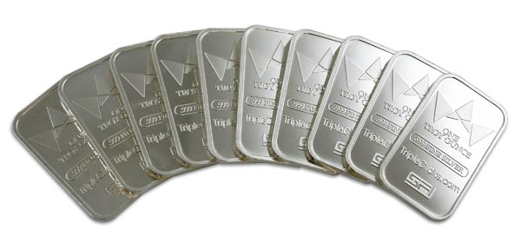
World Silver Markets
New York is the home of futures trading.
Future contract for silver is traded at New York Mercantile Exchange (NYMEX).
Mexico is the biggest production of silver.

Slide 44
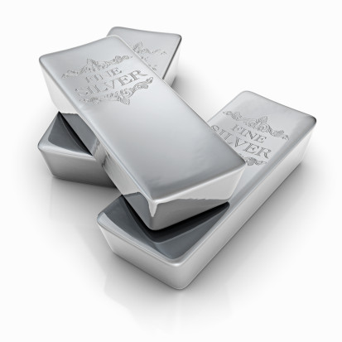
24 Hours Market
Hong Kong Silver Market
Zurich Silver Market
London Silver Market
New York Silver Market

Slide 45
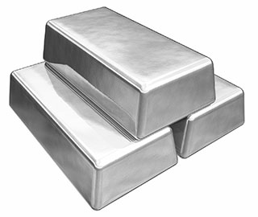
FACTORS THAT INFLUENCE SILVER PRICES
Silver is extracted from ore, usually of copper, gold and zinc.
Demanding from electronic industry (for circuit and switches).
New home sales.
Demand from the film photography.
Have positive relationship with gold.

Slide 46

Trading Hours
Summer Time
Monday: 05:00 WIB - Thursday 04:00 WIB (On the next day)
Friday : 05.00 WIB – 03.00 WIB (On the next day)
Winter Time
Monday 06:00 WIB - Saturday 04:00 WIB (On the next day)

Slide 47
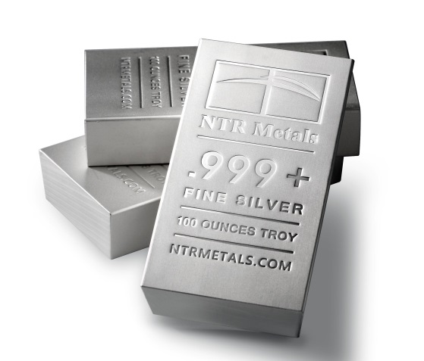
Trading Rules
Contract Size : 5000 Troy ounce
Maintenance Margin: USD 2000 per lot
Spread: USD 0.03
Hedging margin : USD 500 per pair
Fixed rate : Rp. 12,000 / Rp, 14,000
Floating rate
Maximum lot: 20 Lot (Online)
LO/SO: → $0.10 from running price
Notes:
47
47

Slide 48
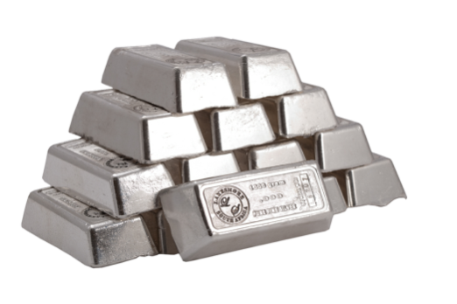
Silver Conversion
1 Troy Ounces = 31.1035 grams
Price in IDR = (price silver/oz x IDR) / 31.1035
Example :
  Price in IDR / grams = (13.94000 x 13,800) / 31.1035
  Price in IDR / grams = Rp 6184,90/ grams
Silver Interest Rate
Silver is spot market
Value days are the same as foreign exchange
Notes:
The silver price is around $13 now, please change.

Slide 49
SILVER GROSS P/L
Gross P/L Calculation
(Sell - Buy) x Contract Size x Lot
Example:
Client A invested USD200,000 with Valbury. With the prediction that price of SILVER would go down, He sold 10 lots at 13.62800 in the morning. Several hours later the client liquidated his position at 13.00000.
What his Gross P/L?
Gross P/L = (13.62800- 13.00000) x 5000 x 10
= USD 31,400
Notes:
49
49
Change the silver current level please.

Slide 50

Tips
Selecting An Investment:
Find an investment which is not using 100% capital, high return, liquid and with acceptable risk
Suits your personality (investor, speculator or invesculator)
Selecting A Broker:
Licensed company
Good background
Low spread & commission
Good service
Trading:
Always control the risk
Always have a plan to enter and exit the market before trading
Always use STOP LOSS

Slide 51
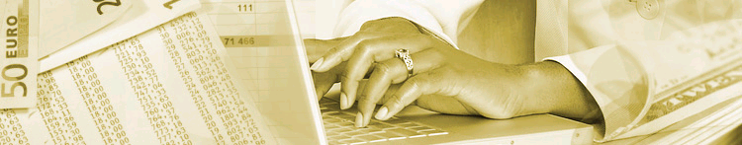
Why Trade With Valbury?
Solid company background
Fast withdrawal of fund
Daily market review (from professional research team)
Full customer service facility (24 hours)
Direct Market Access
High liquidity
No queuing
Using Reuters Terminal

Slide 52
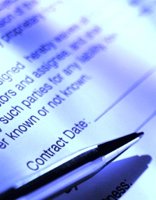
Opening Account Procedure
Sign a trading agreement and choose a personal trading account number provided by PT. Valbury Asia Futures
Online registration via:
www.valburyfutures.co.id
A Photocopy of Personal ID or Passport is required
Deposit an initial margin to segregated bank account authorized by Bappebti under the name of PT. Valbury Asia Futures
Choose your Personal Financial Consultant

Slide 53
PT Valbury Asia Futures
Bank Account Details
IDR Account:
BCA
A/C No. 035-3119068
Name: PT Valbury Asia Futures
USD Account:
BCA
A/C No. 035-3117278
Name: PT Valbury Asia Futures

Slide 54

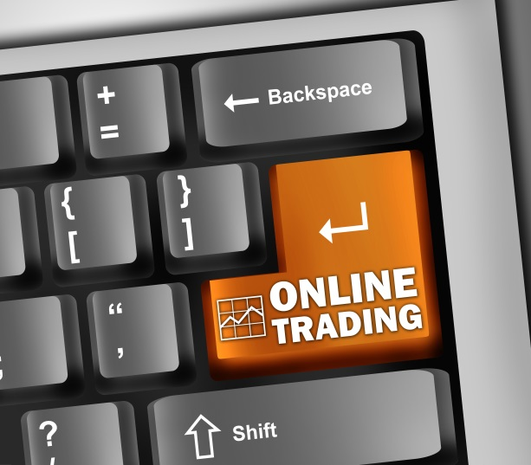
Online Trading (Internet Trading)
Benefits of Online Trading:
Live streaming rates available 24-hours a day
Real-time dealing and execution
Instant forex trade execution and confirmation
Real-time profit and loss analysis
Full access to forex market information at any
given time
Lower transaction costs
Trading from any Internet-based computer
Notes:
Our spread for FX is floating starts from 2 pips

Slide 55
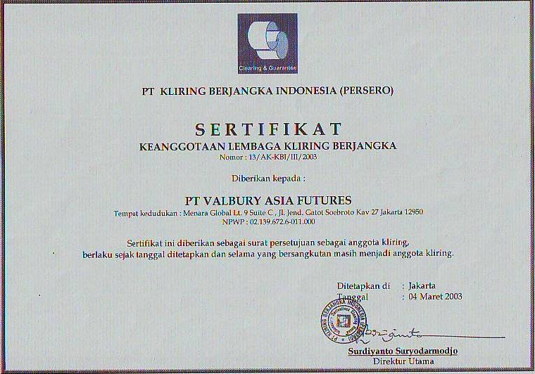

Slide 56
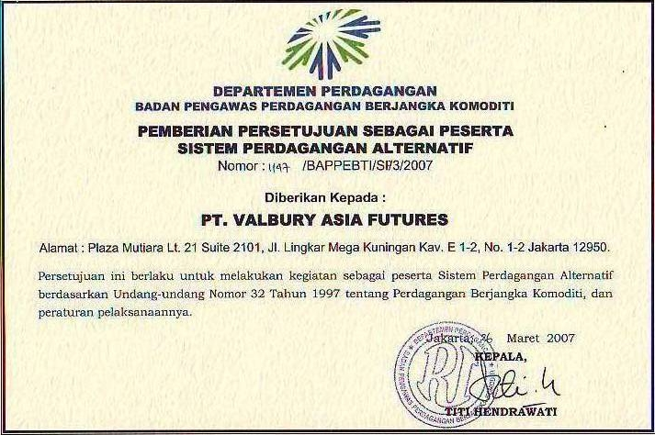

Slide 57
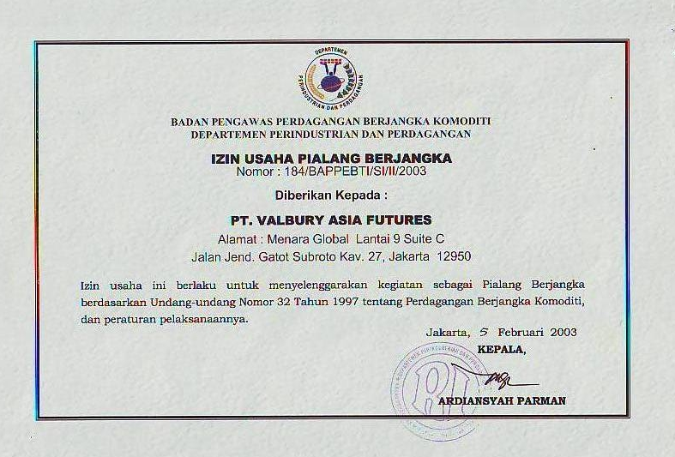

Slide 58
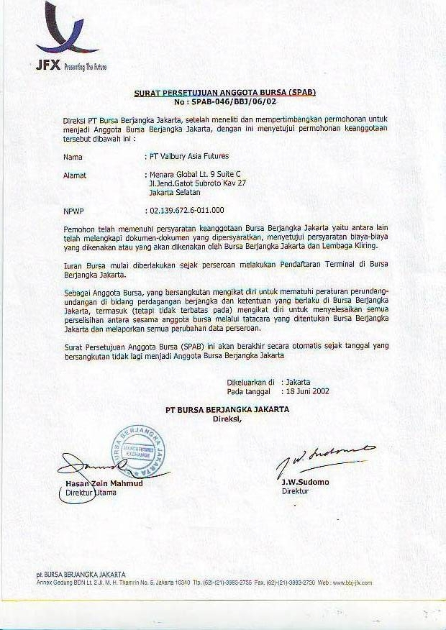

Slide 59




PT. Valbury
Menara Karya 9th Floor
JL. HR. Rasuna Said Block X-5 Kav. 1-2
Jakarta 12950
Telp: 021-25533777
@researchvaf ValburyAsiaFutures
Disclaimer :
Futures Trading carries a higher level of risk and opportunity. If you are interested in Futures Trading, please ensure beforehand that you understand how the Futures market works and that you have and understood the content of the Client”s Agreement and Trading Rules.

