Slide 1

KOL Campaign Brief
#MulaiDiTuntun
#InvestWithGuidance
October, 2025
TUNTUN SEKURITAS INDONESIA
This document is confidential and for parties directly involved in the collaboration. For clarifications, please contact Tuntun Sekuritas Indonesia’s PIC. Any additional information will be provided separately.

Slide 2
Partnership Output - Instagram Reels/ Tik Tok Video/ IG Carousel Photo
Provide the Tuntun team with the draft storyline (STL) and caption in advance for approval.
KOL begins the production process, creating well-produced and original content based on the approval.
KOL posts the approved material on their channel in line with the brief (type of post adjusted according to the agreement stated separately in the contract).
Notes:
The KOL’s content will be re-uploaded on Tuntun’s social media accounts.
The KOL’s content will be boosted with ads during the collaboration period.
Posts will be stitched by other creators to expand talkability around the campaign.
Tuntun shares brief
KOL draft storyline (STL)
Approved (STL)
KOL posting on their channel (with approved caption)
Approved Content
KOL draft content
(based on approval)
This document is confidential and for parties directly involved in the collaboration. For clarifications, please contact Tuntun Sekuritas Indonesia’s PIC. Any additional information will be provided separately.

Slide 3
Campaign Detail
Posts must follow the platform’s standard size.
Review post materials must be submitted in High Resolution.
The comment and like features for photos must be enabled to maximize engagement.
KOL must provide posting insights +7 days after the post goes live.
This document is confidential and for parties directly involved in the collaboration. For clarifications, please contact Tuntun Sekuritas Indonesia’s PIC. Any additional information will be provided separately.

Slide 4
Campaign Framework Flow
STARTER
(Official IG Tuntun)
HERO KOL
(Local)
REACTOR (Foreigner)
Campaign KOL
Review Submission (UGC)
Reward :
Top 3 Views
1st - 1 Smartwatch + Free Balance RDN 250K
2nd - Free Balance RDN 250K
3rd - Free Balance RDN 250K
Tuntun Favourite Winner
1 Smartwatch + Free Balance RDN 250K
KOL Financial Review Apps
Source of information
Indonesian Nationality
KOL stitch HERO KOL.
KOL do stitch content & reaction
Affirm & validate Hero KOL’s points → build trust
Foreigner
Key Point focus on :
Interest Indonesian Stocks Market
Foreigner open account
Mandatory English subtitle in content
This document is confidential and for parties directly involved in the collaboration. For clarifications, please contact Tuntun Sekuritas Indonesia’s PIC. Any additional information will be provided separately.

Slide 5
Campaign Framework Flow
HERO KOL
(Local)
This document is confidential and for parties directly involved in the collaboration. For clarifications, please contact Tuntun Sekuritas Indonesia’s PIC. Any additional information will be provided separately.

Slide 6
Content Structure & Key Message
Opening
Riding on daily character content
Evergreen update
This document is confidential and for parties directly involved in the collaboration. For clarifications, please contact Tuntun Sekuritas Indonesia’s PIC. Any additional information will be provided separately.

Slide 7
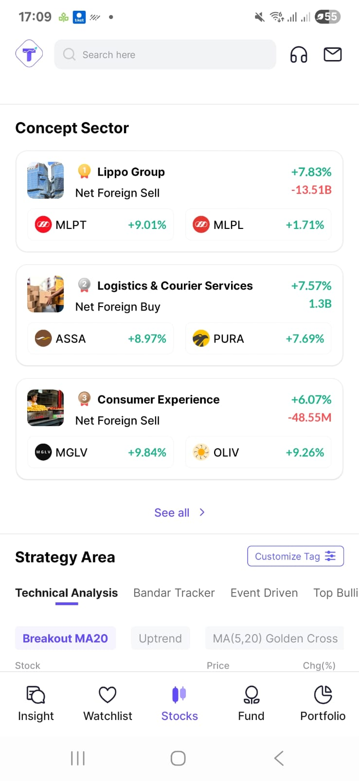
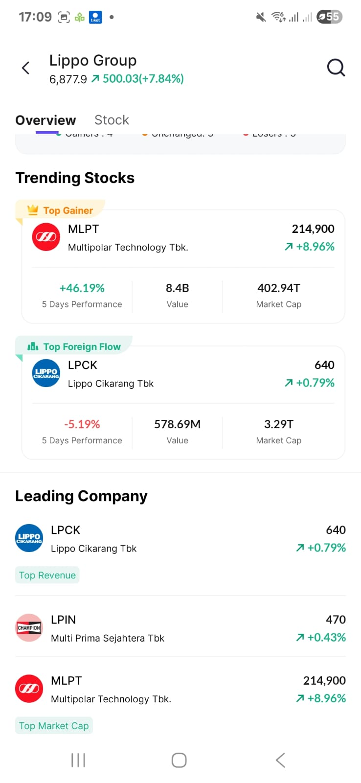
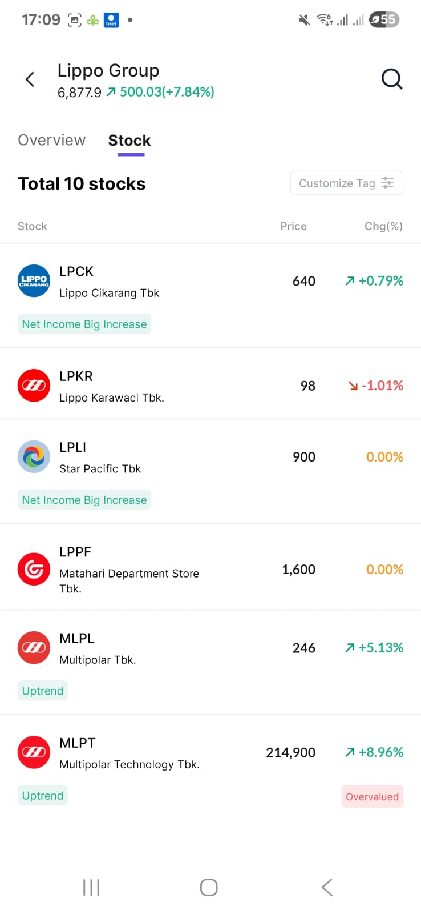
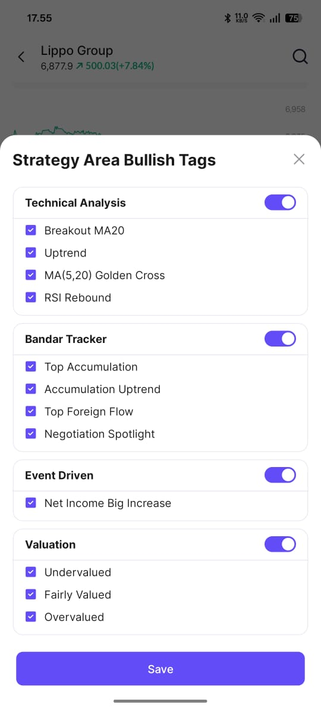
Top 3 Sector at the first page shows:
Top 3 Sectors with Highest Gainers contribution.
Completed with Net Foreign Buy/Sell, Top Stocks with high gain
Helps user to know :
Stocks
Top Gainer
Top Foreign Flow
Leading Company
Top Revenue
Top Market Cap
Top Profit
Helps user to know :
Stocks list under the sectors, Price Change (Gain/Loss)
Automated Strategy Area Bullish Tags

Slide 8
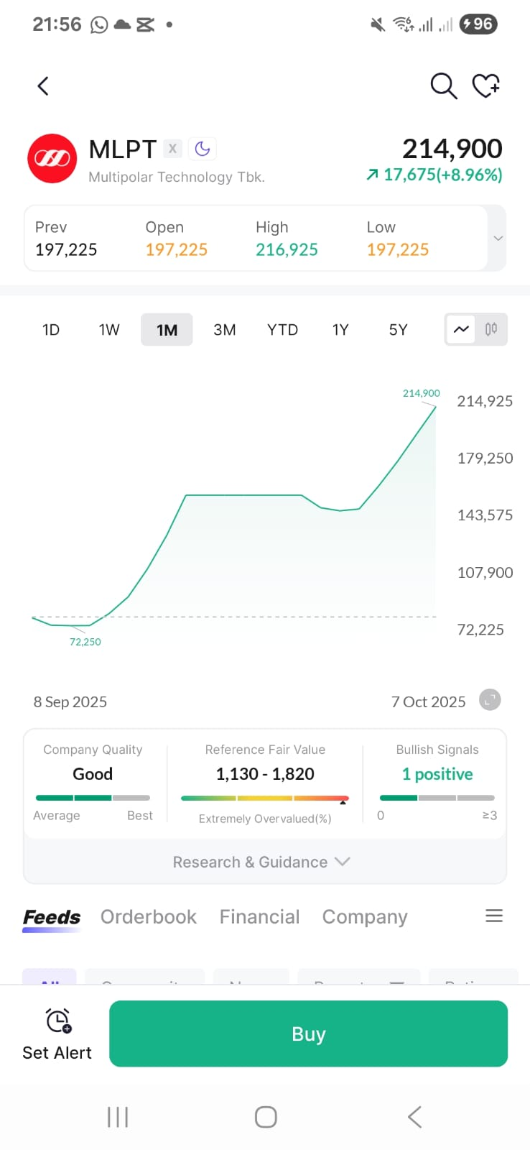
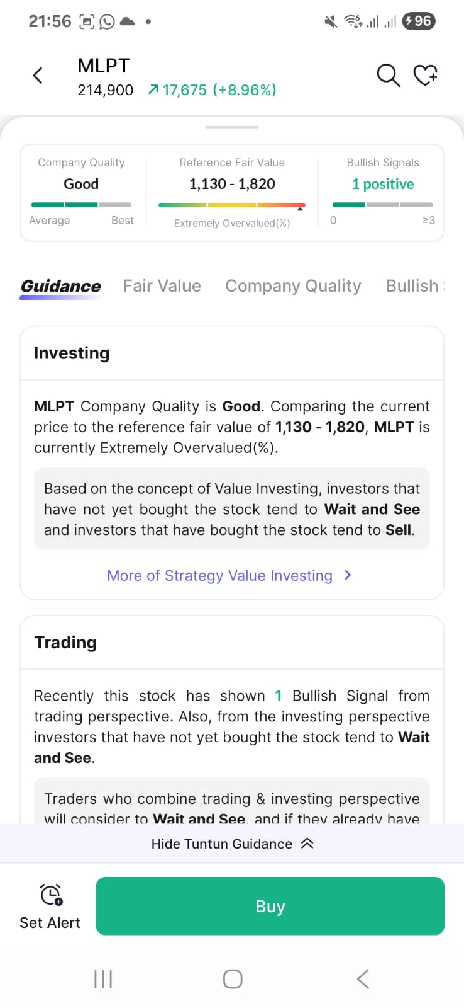
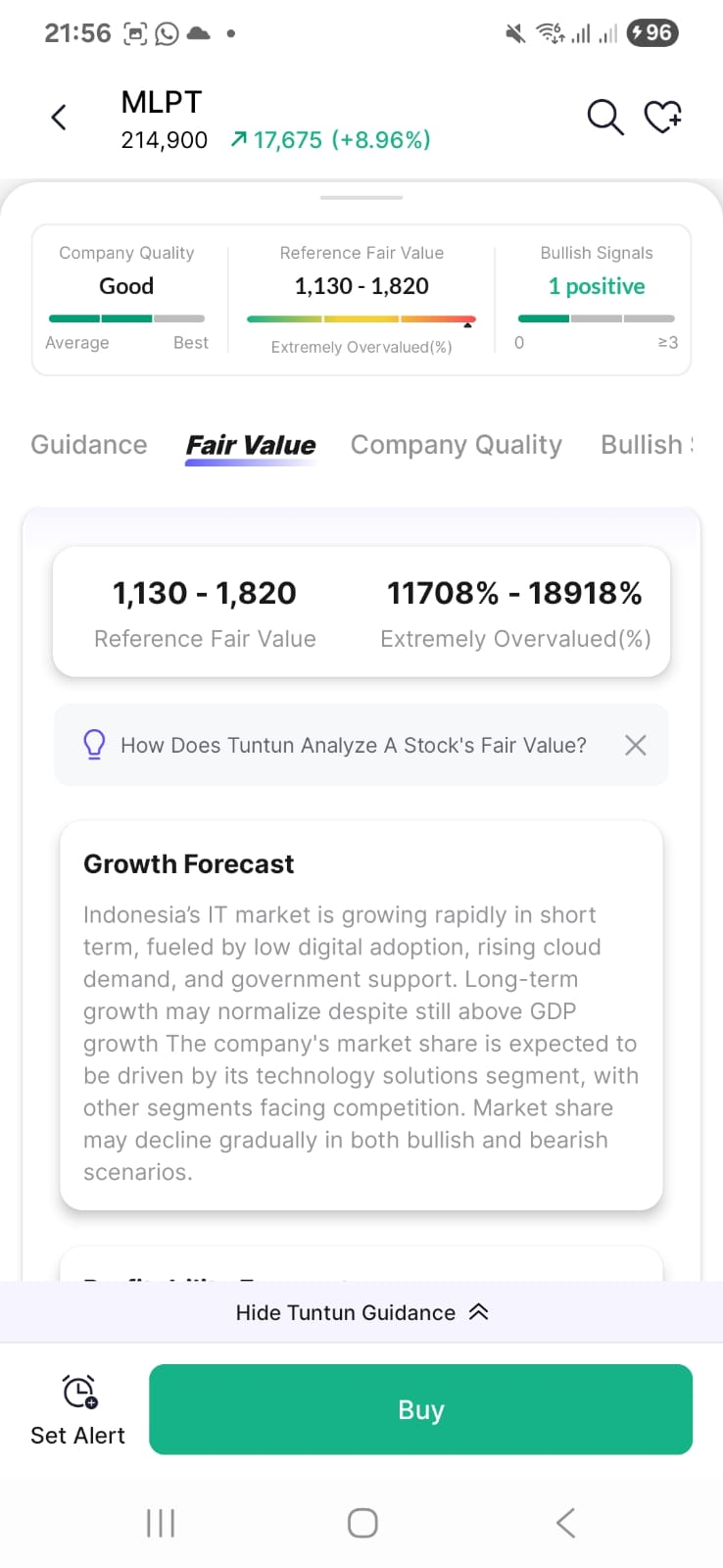
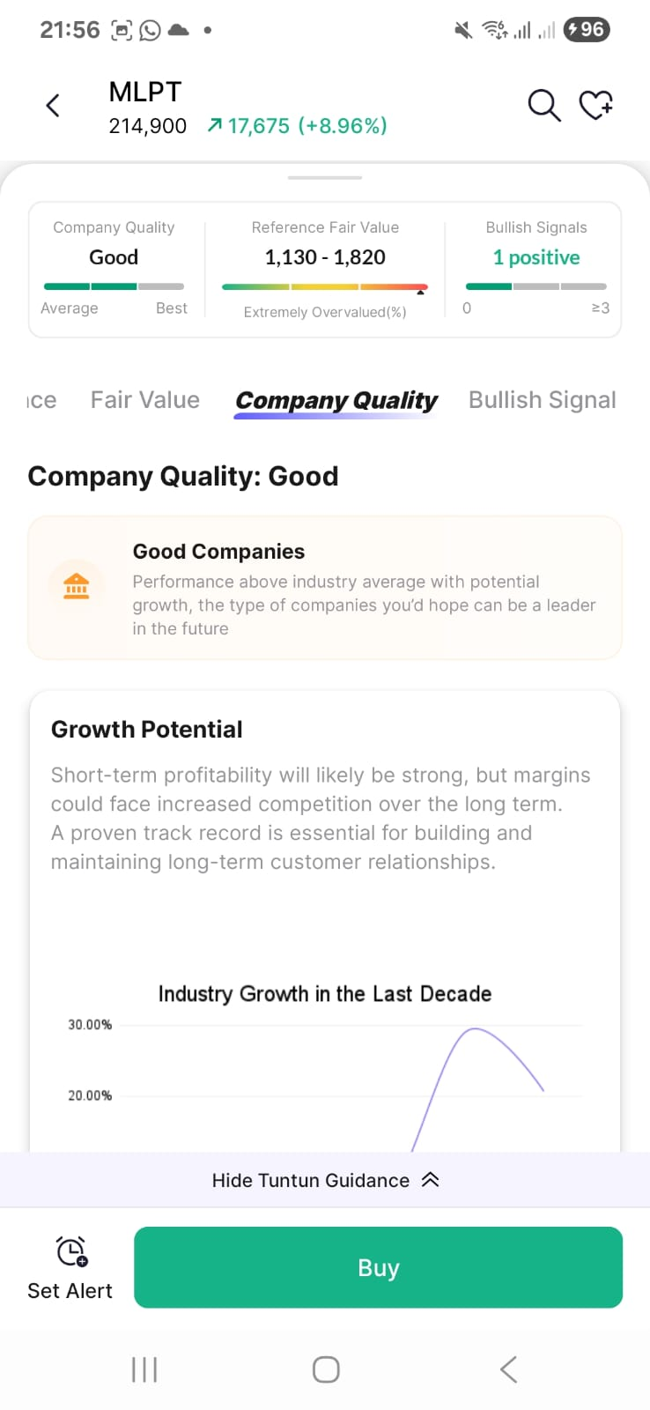
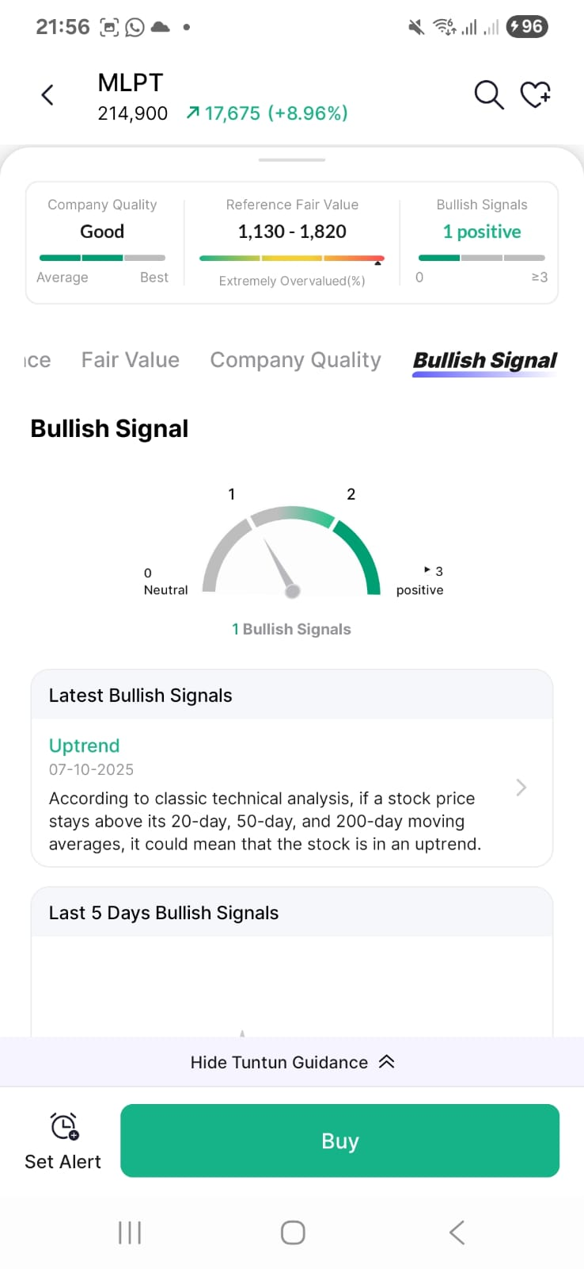
After knowing some stocks under group sectors with a certain remarks from strategy area bullish tag, this feature also link to a “Guidance” features which helps users to get insight results of methodology analyst such as reference fair value, bullish signals, company quality.

Slide 9
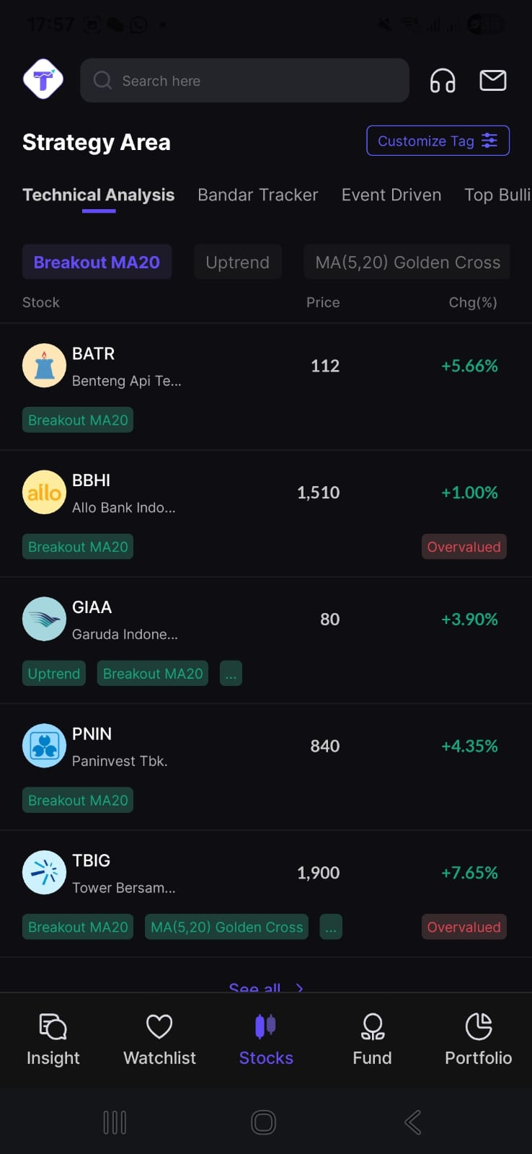
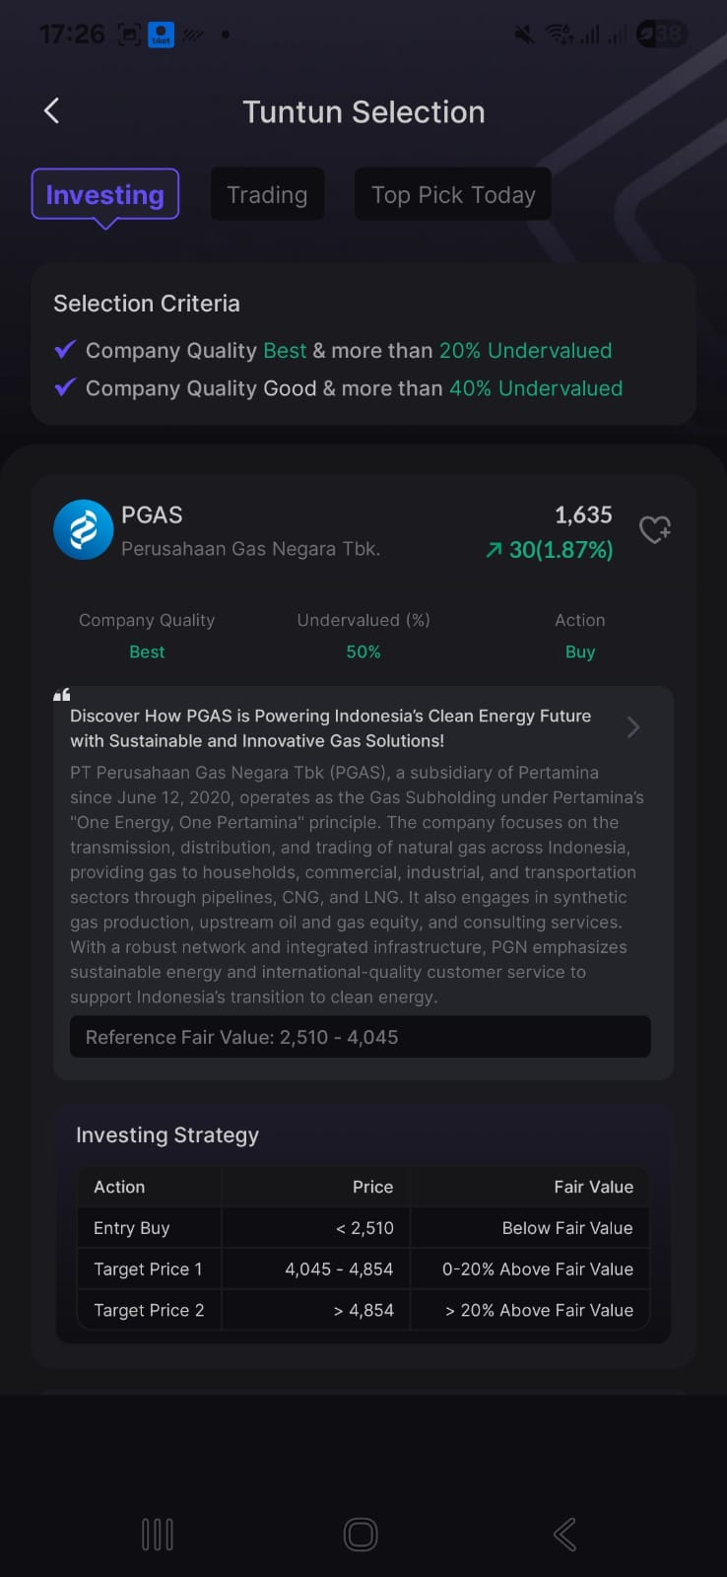
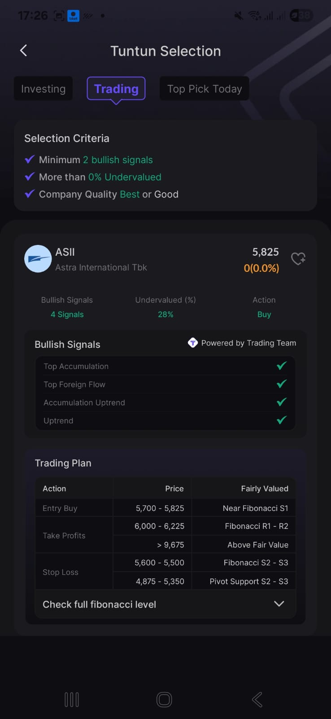
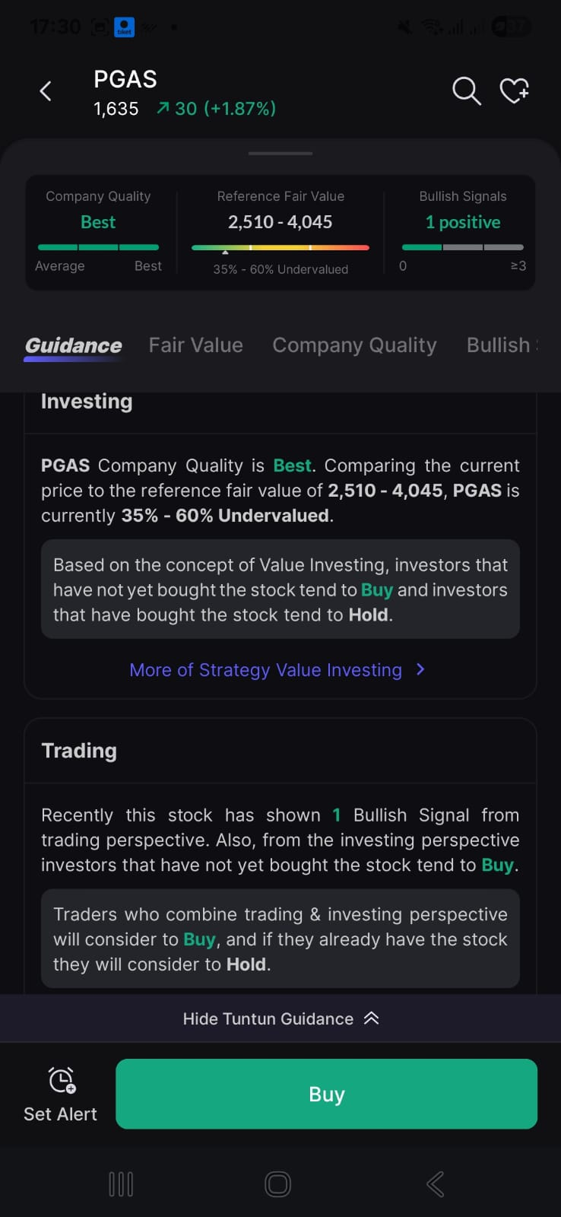
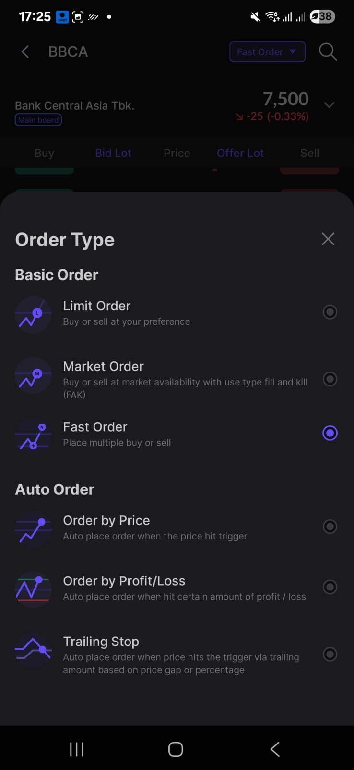
Content Structure & Key Message
Additional Key Message (if it still has a duration):
KOL can highlight another quite interesting feature of Tuntun apps from KOL POV. For example:
Strategy Area
- Showing assorted stocks by technical indicator screener (i.e breakout MA20, Uptrend etc)
Investing Selection
Undervalued
Company Quality
Investing Strategy
Trading Selection:
Trading Plan
Bullish signals
Undervalued
Company quality
Tuntun Guidance
[Proven Top Investor Methodologist & Comprehensive analysis]
Fast Order
Tools which helps advance users to chase the momentum
This document is confidential and for parties directly involved in the collaboration. For clarifications, please contact Tuntun Sekuritas Indonesia’s PIC. Any additional information will be provided separately.

Slide 10
Content Structure & Key Message
Closing
Which sector you’re keeping eyes on? Drop you comment below ya.
This document is confidential and for parties directly involved in the collaboration. For clarifications, please contact Tuntun Sekuritas Indonesia’s PIC. Any additional information will be provided separately.

Slide 11
Campaign Framework Flow
REACTOR KOL
(Foreigner)
This document is confidential and for parties directly involved in the collaboration. For clarifications, please contact Tuntun Sekuritas Indonesia’s PIC. Any additional information will be provided separately.

Slide 12
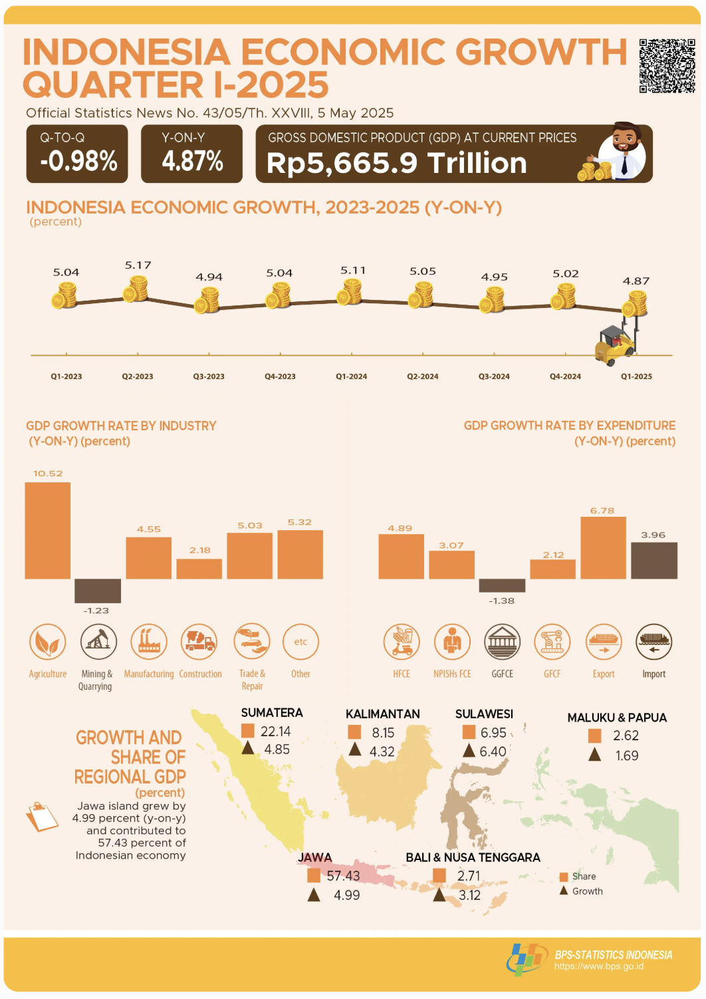
Campaign Framework Flow
Opening:
React positively on KOLs content who talked about Tuntun’s features
Content Options:
A. TOP Reasons Foreigner Investor Needs to Invest in Indonesia (Source LINK = BPS)
Size of the Economy (GDP):
Current prices: IDR 5,665.9 trillion
Constant 2010 prices: IDR 3,264.5 trillion
Economic Growth (YoY):
Indonesia’s economy grew 4.87% compared to Q1 2024.
Fastest-growing sector: Agriculture, Forestry, and Fishing +10.52%.
From the expenditure side: Exports of Goods and Services increased +6.78%.
B. Number of Investors Surpasses 18 Million, Reflecting Indonesia’s Capital Market Stability
This document is confidential and for parties directly involved in the collaboration. For clarifications, please contact Tuntun Sekuritas Indonesia’s PIC. Any additional information will be provided separately.

Slide 13
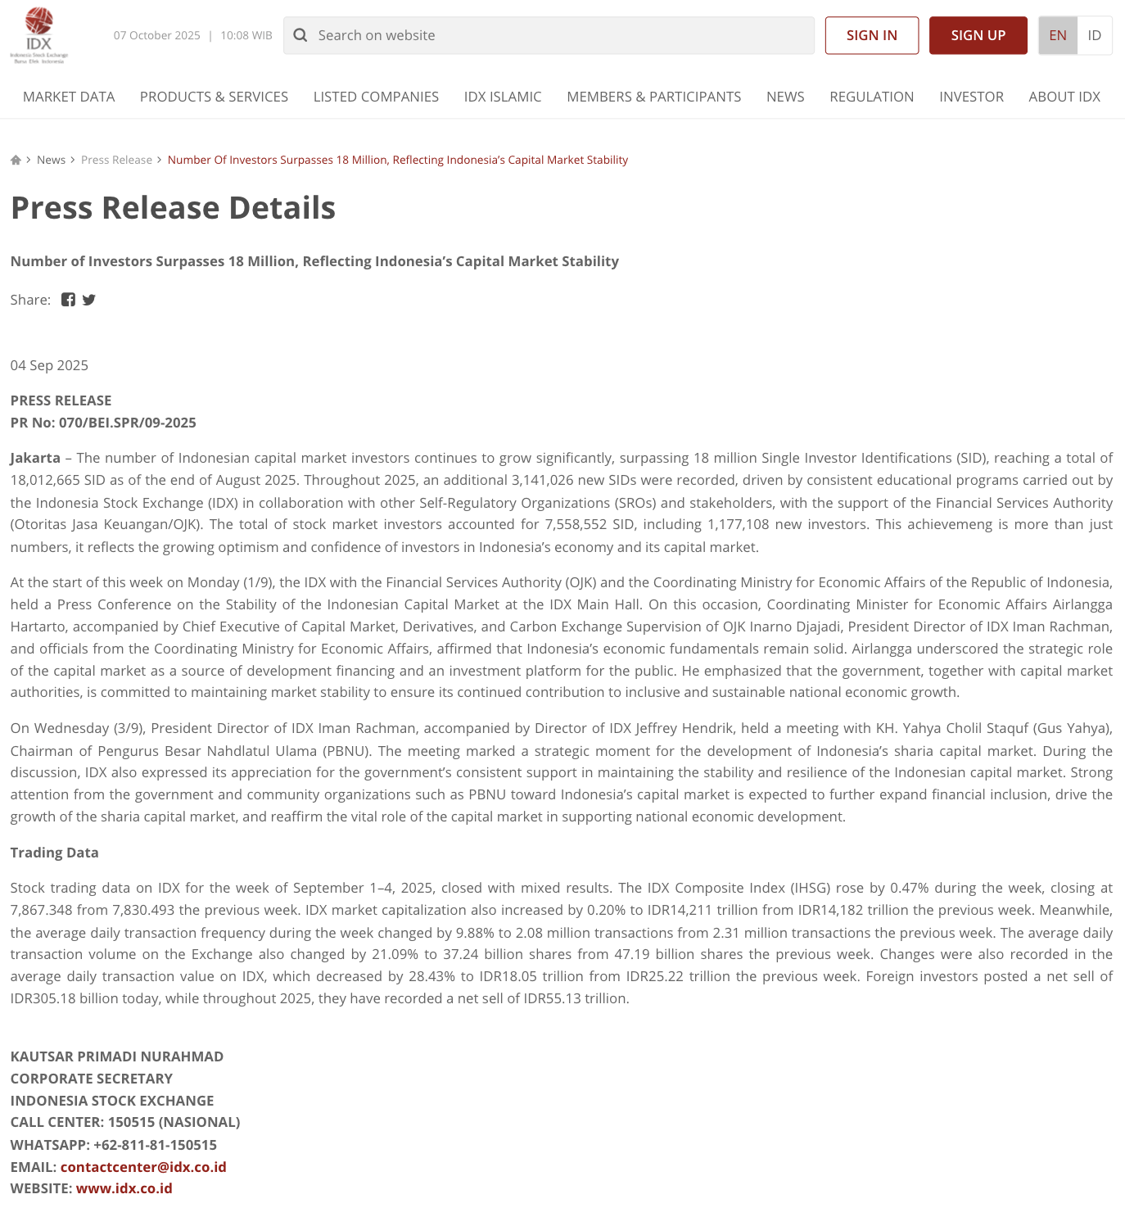
Campaign Framework Flow
Content Options:
B. Number of Investors Surpasses 18 Million, Reflecting Indonesia’s Capital Market Stability
Source >>> LINK
This document is confidential and for parties directly involved in the collaboration. For clarifications, please contact Tuntun Sekuritas Indonesia’s PIC. Any additional information will be provided separately.

Slide 14
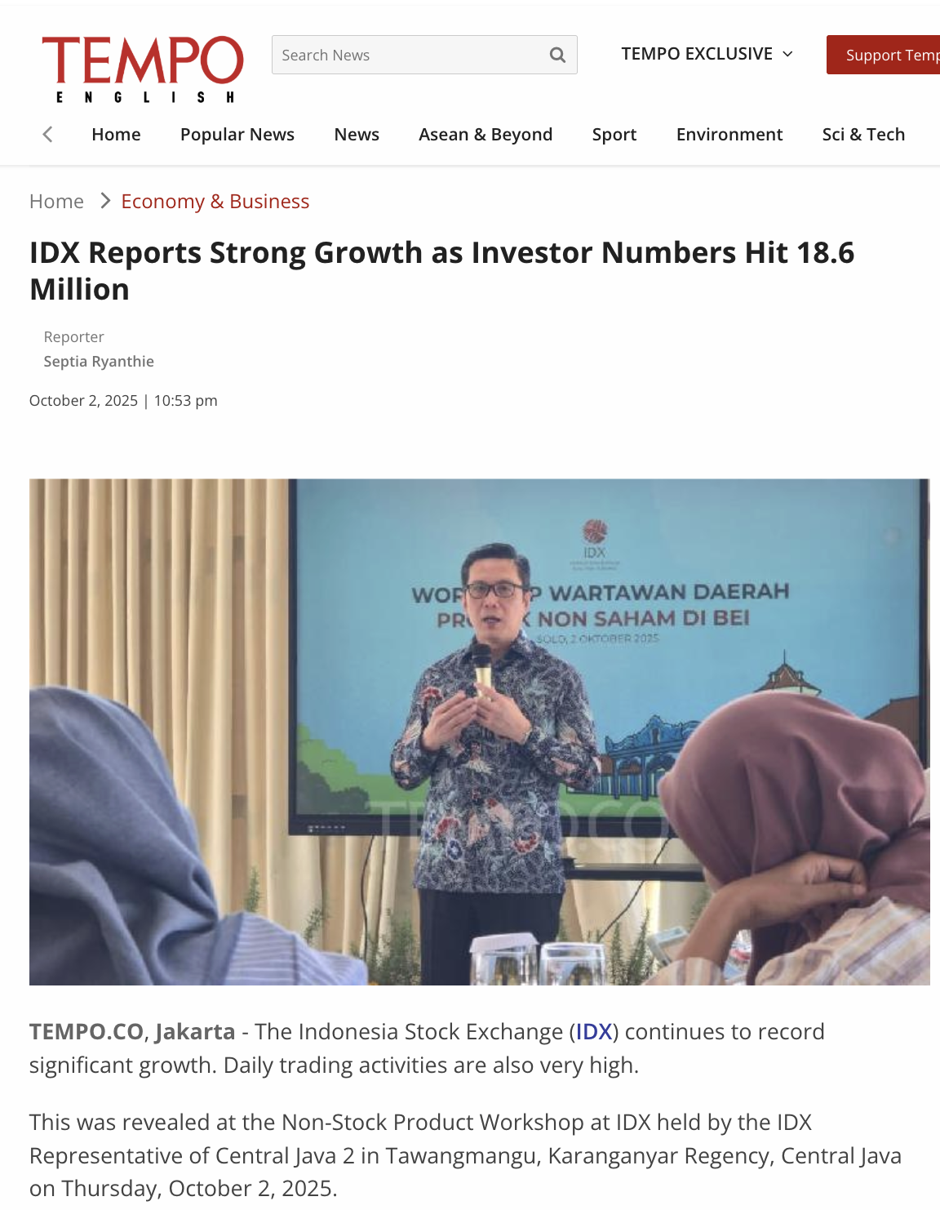
Campaign Framework Flow
Content Options:
B. IDX Reports Strong Growth as Investor Numbers Hit 18.6 Million
Source >>> LINK
This document is confidential and for parties directly involved in the collaboration. For clarifications, please contact Tuntun Sekuritas Indonesia’s PIC. Any additional information will be provided separately.

Slide 15
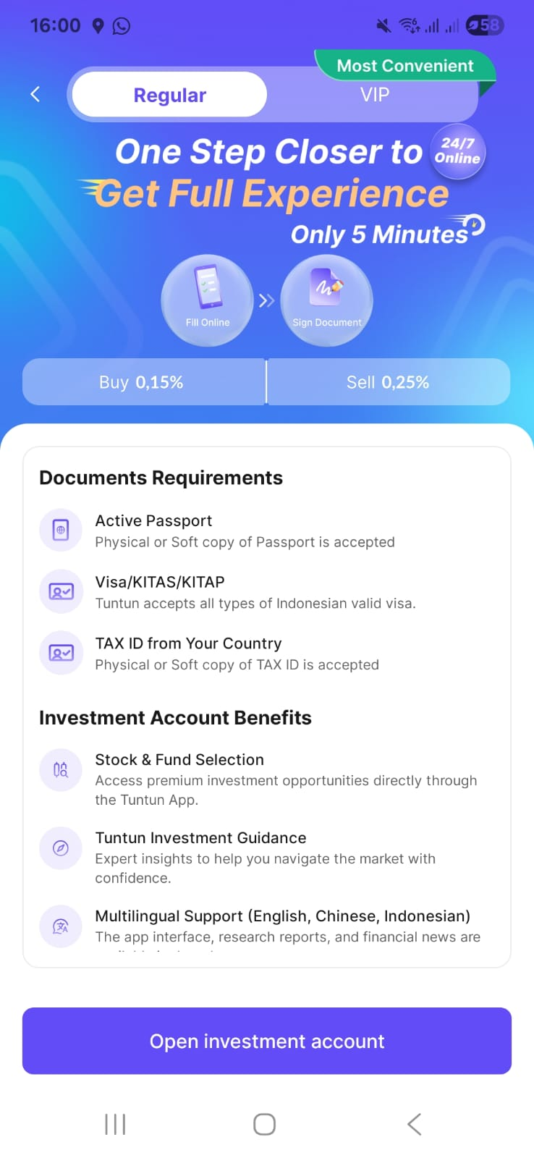
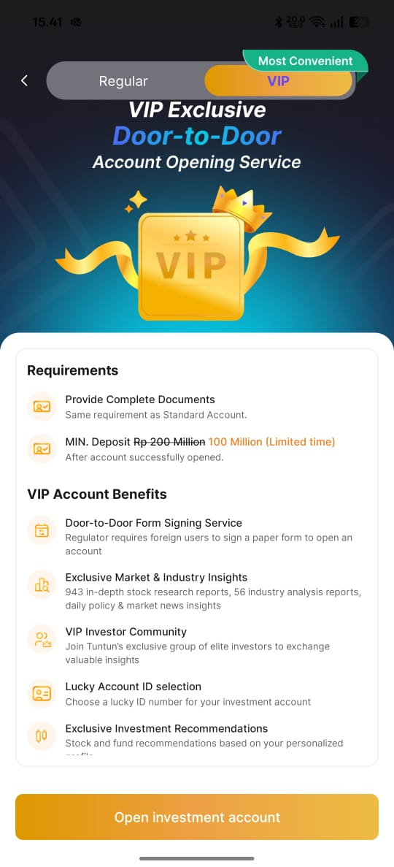
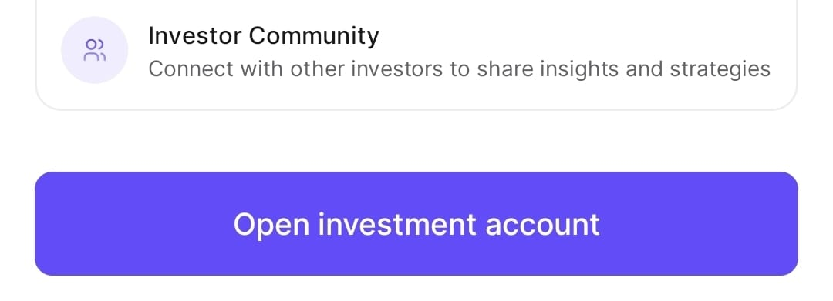
Campaign Framework Flow
Closing:
It’s a good time for foreign investor to do investment in Indonesia
I use Tuntun already
Tell me your comment about Tuntun Sector feature
Open your RDN now, for new users within the period. Check term & condition on Tuntun Apps for more details
Inform Giveaway #DiscoverTuntun, check on IG Official @tuntunsekuritas to get a chance to win Smartwatch & free RDN 250K.
This document is confidential and for parties directly involved in the collaboration. For clarifications, please contact Tuntun Sekuritas Indonesia’s PIC. Any additional information will be provided separately.

Slide 16
Content Guideline
Do’s | Dont’s
Well produced content. High resolution content Original content For creators (non-public accounts), if you want to use an outfit with Tuntun-themed colors in the content, you may use purple, as shown in the background of this page. If that’s not available, you can use neutral colors such as white, beige, gray, or black. If you use background music, it must be copyright-free. The creative process—from storyline to draft post materials—must follow the guideline brief and go through the approval process by Tuntun. Tag & mention @tuntunsekuritas Creator can download, install & open RDN Account Google Play [Android] : https://play.google.com/store/apps/details?id=com.tuntun.tt Apps Store [Apple]: https://apps.apple.com/id/app/tuntun/id6680157617 | Dominant competitor colors such as green, blue, or orange Any logo, attribute, or identity that is clearly associated with a competitor in the content Reposted or re-uploaded content from other parties (not original) Blurred or unclear content The creator must not be involved in any legal issues Content must not contain elements that violate sensitivity related to ethnicity, religion, race, inter-group (SARA) or violate applicable Indonesian law Use of visuals or audio that distract followers while watching, such as clothing with patterns/logos of other brands, overly crowded backgrounds, unclear voice-over pronunciation, unsuitable background music, and so on
This document is confidential and for parties directly involved in the collaboration. For clarifications, please contact Tuntun Sekuritas Indonesia’s PIC. Any additional information will be provided separately.

