Slide 1

Digital Entrepreneurship in the Age of AI
Doddy Prayogo — Financial Content Creator & Instructor
Equilibrium International Talk (Equitalk 2026)
Organized by BEM FEB UNUD · Saturday, 22 August 2026 · via Zoom Meeting

Slide 2
What We'll Cover Today
1
Opening — From a web camera to a business
2
What Digital Entrepreneurship Actually Is
3
Technology, AI & Platforms — Why New Opportunities Exist
4
How Technology Is Reshaping Business + Using Data to Decide
5
A Real Example + How to Actually Start

Slide 3

INTRODUCTION
Doddy Prayogo, Ph.D
Doddy Bicara Investasi
Lecturer, Civil Engineering — Universitas Kristen Petra
Investor since 2013 · Content Creator since 2019
YouTube 380K+ · Doddy Bicara Investasi
InstaGram 116K+ · @doddy.prayogo
TikTok 250K+ · @doddybicarainvestasi

Slide 4
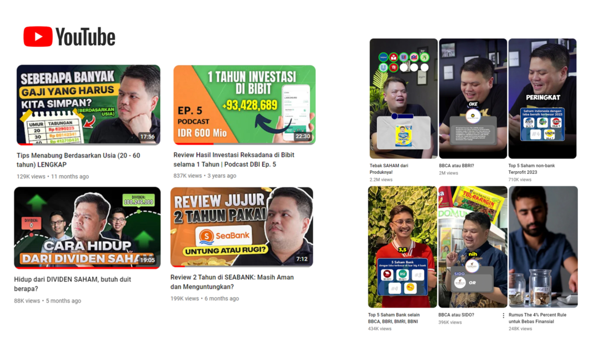
380,000+
YouTube Subscribers
—

Slide 5
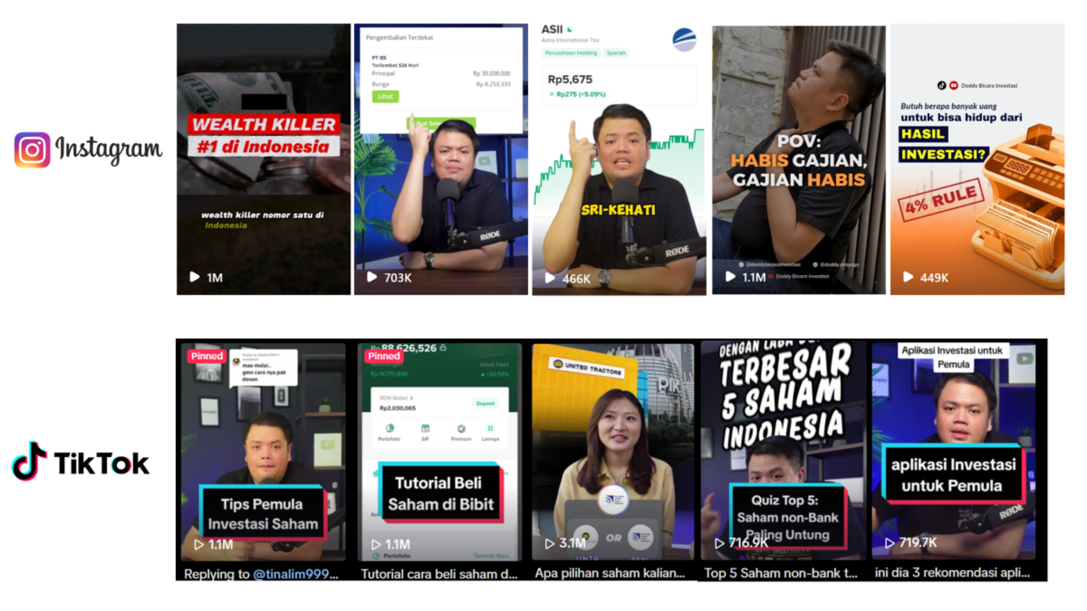
1,000+ Videos Published
6 Years · Consistent · Still Going

Slide 6
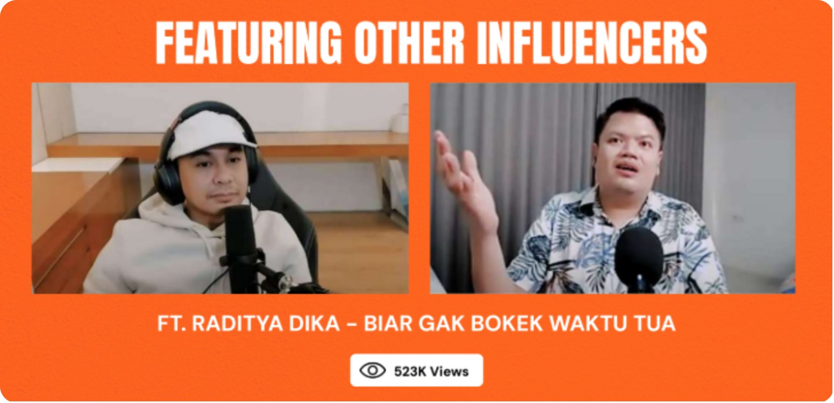
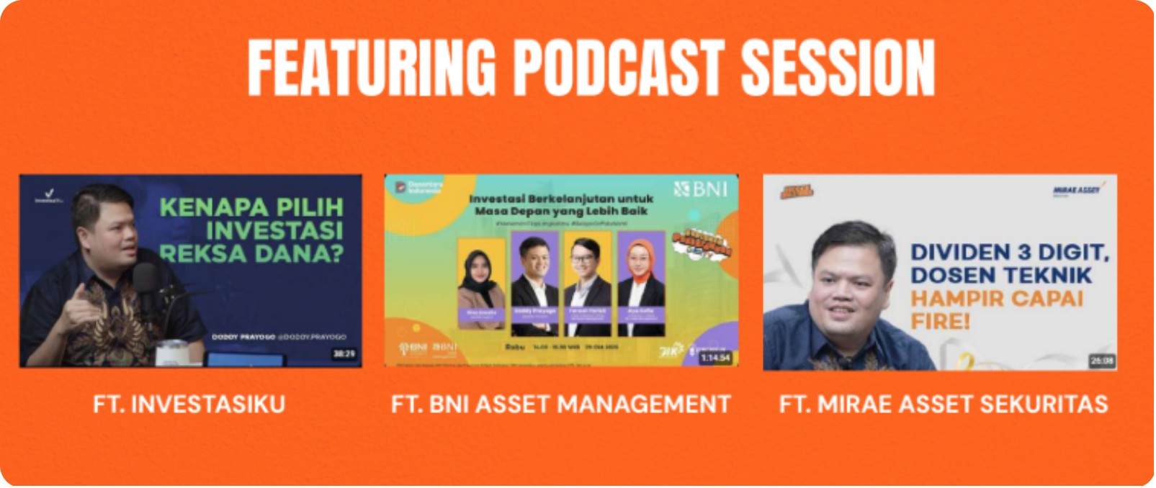
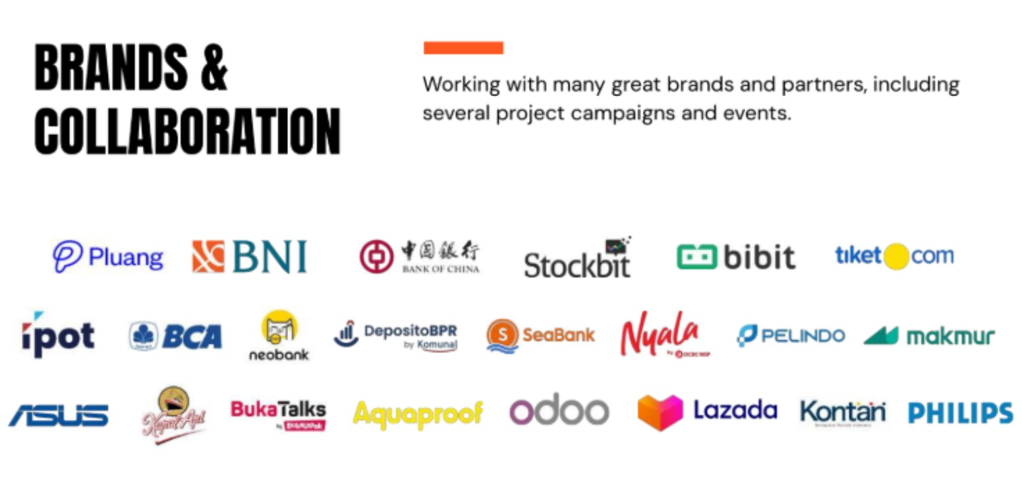
Featured on Major Podcasts & Collaborations
Recognized as a credible voice in personal finance & investing
Building trust beyond the channel — one collaboration at a time
Invited as guest by top Indonesian content creators

Slide 7
2019 vs. 2026
2019
2026
Web camera
No studio, no editor
Zero audience
"Just explaining how I invest my own money"
No plan beyond that
380K+ YouTube subscribers (Doddy Bicara Investasi)
250K+ TikTok followers (@doddybicarainvestasi)
116K+ Instagram followers (@doddy.prayogo)
1,000+ published videos
Running an actual business
One that runs entirely on infrastructure that didn't exist — or wasn't affordable — a generation ago.

Slide 8

PART 1
What Digital Entrepreneurship Actually Is

Slide 9
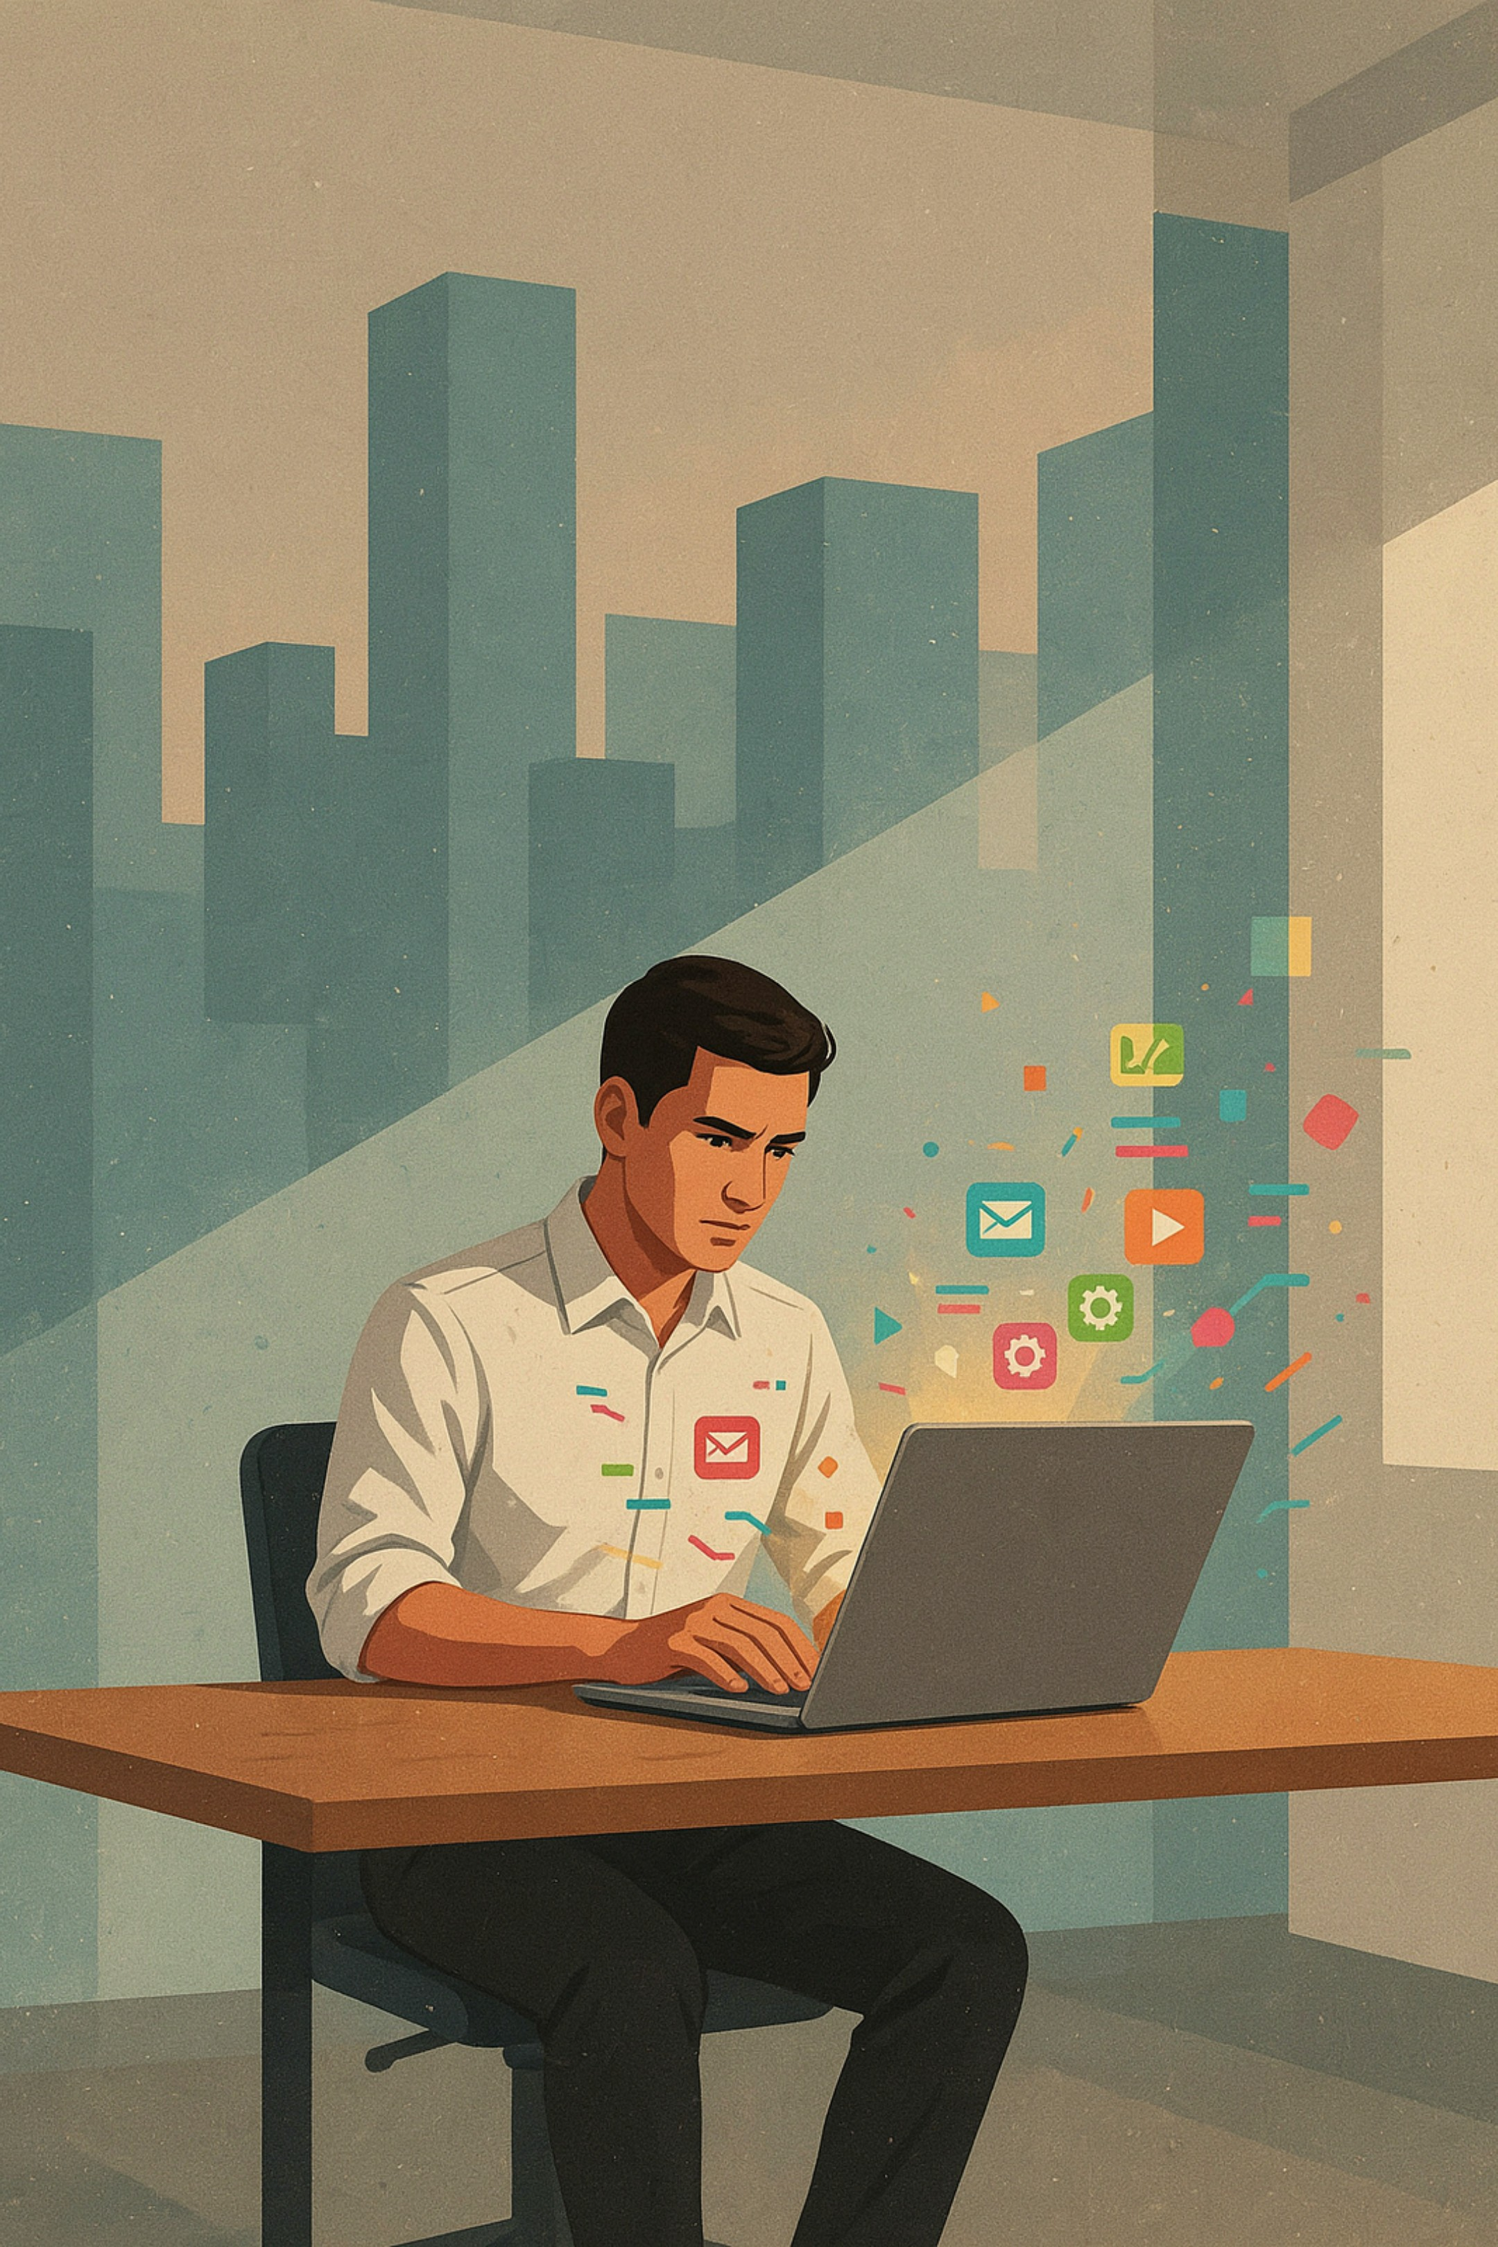
What Is Digital Entrepreneurship?
Venture creation that is enabled, mediated, or fundamentally transformed by digital technology — not simply an old business that added a website.
Digitized Business
Digital-Native Business
Uses digital tools on top of a traditional model
Example: a bakery taking orders on Instagram
The business could exist without the platform
Could only exist because the platform exists
Example: a content creator channel, a marketplace app
Remove the platform and the business disappears

Slide 10




4 Traits of Every Digital Business
Near-zero marginal cost
No borders
No gatekeeper needed
Data as a core input

Slide 11

TRAIT 1 OF 4
Near-Zero Marginal Cost
Serving the next customer costs almost nothing extra.
A factory needs more machines for more output. A digital product doesn't.
A video costs the same to make whether 100 people watch it or 10 million do.

Slide 12

TRAIT 2 OF 4
No Borders
The market isn't defined by geography anymore.
A physical shop only reaches people who walk past it.
An online shop — or a YouTube channel — reaches anyone with a phone and a signal, anywhere in the world.

Slide 13

TRAIT 3 OF 4
No Gatekeeper Needed
You no longer need anyone's permission to reach an audience.
Traditional: getting in front of people meant convincing a TV network, publisher, or retailer to say yes first.
Now: you publish it yourself, and the audience decides by watching or not.

Slide 14

TRAIT 4 OF 4
Data as a Core Input
The business can see, in real time, exactly how the market is responding — and adjust.
Traditional businesses guessed what worked. Digital businesses measure it.
Click-through rate, watch time, conversion rate — the market gives you feedback instantly, on every single piece of content.

Slide 15

PART 2
Why New Opportunities Exist
Three economic shifts — and the AI tools that make them accessible to anyone

Slide 16

Reason 1: The Long Tail
Small markets that used to not be worth serving are now worth serving.
A physical bookstore only stocks what sells fast for everyone. A digital shelf is infinite.
A channel about how to raise catfish in a bucket can still find a loyal audience across the whole country — even though no single city has 100 people looking for that.

Slide 17
Reason 2: Transaction Costs Collapsed
Finding and trusting a stranger used to be expensive. Now it's nearly free.
The cost of finding, vetting, and dealing with another party used to be high enough that only large, well-resourced organizations could absorb it. Digital platforms collapsed that cost structure down to an app.
Ride-hailing: matching a driver and passenger in minutes, not hours
Marketplace: selling secondhand goods in hours, not days

Slide 18
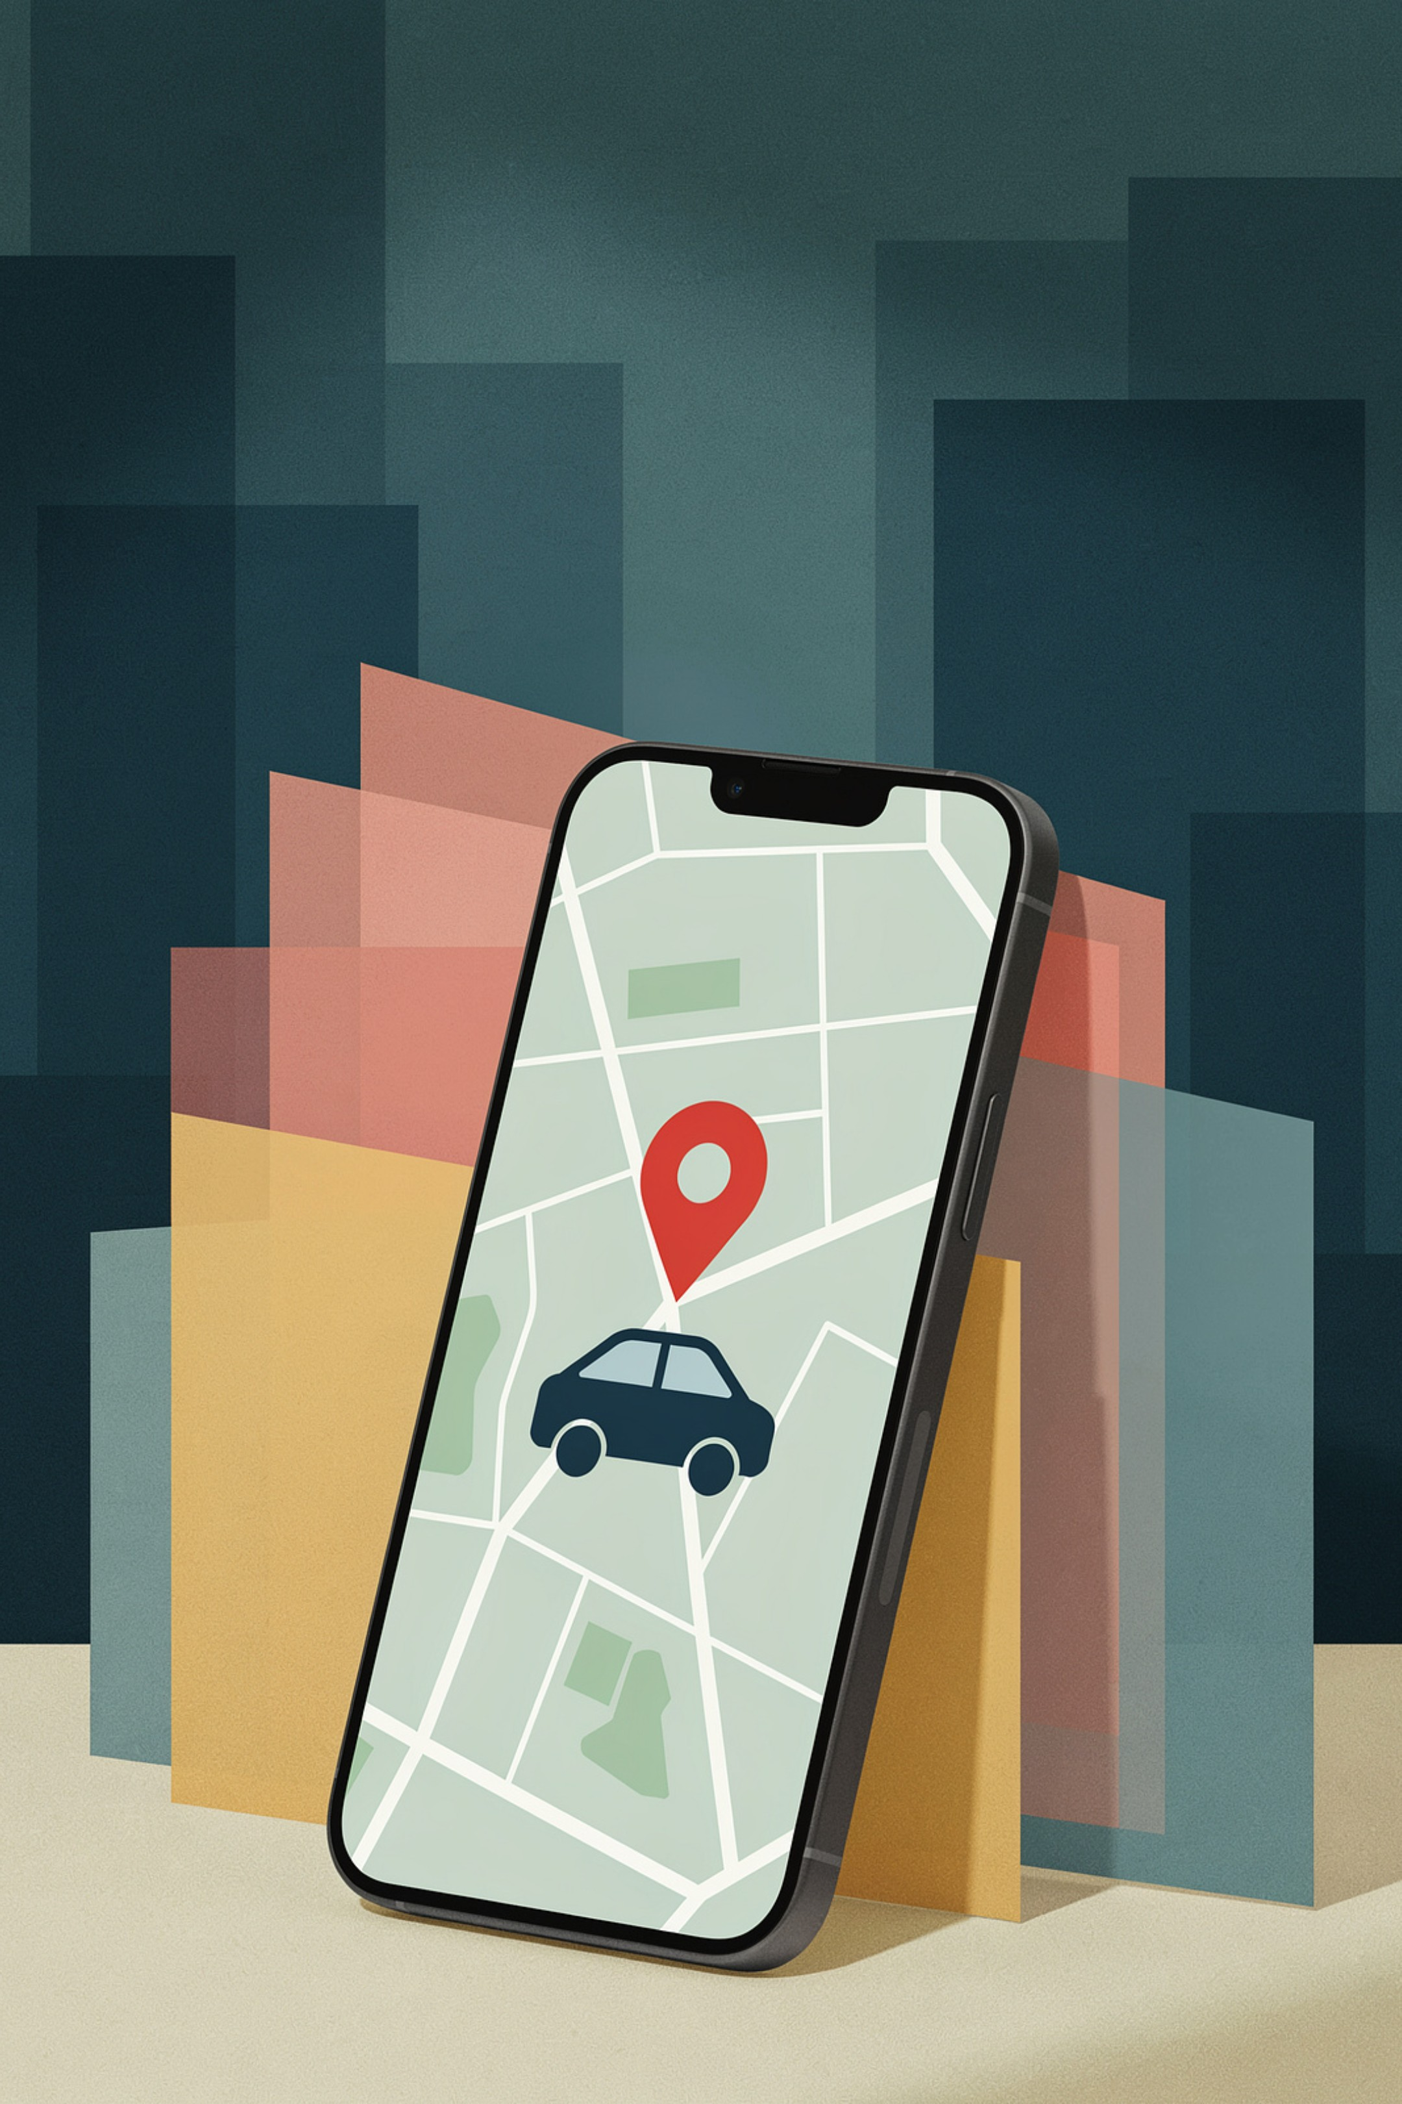
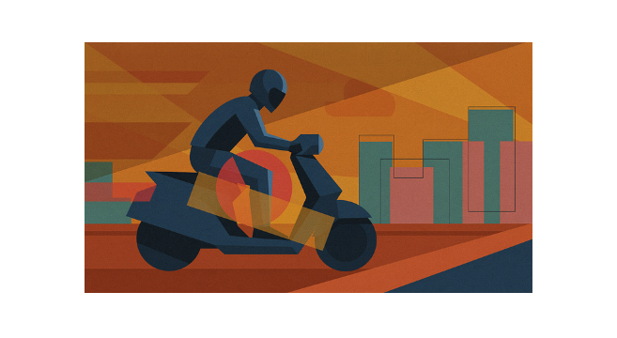

Ride-Hailing
Finding and trusting a stranger used to be expensive. Now it's nearly free.
Before: Getting a taxi meant waiting at a stand or calling ahead — a dispatch company, a fleet, a radio system.
After: Now you open an app and a driver shows up in minutes.

Slide 19
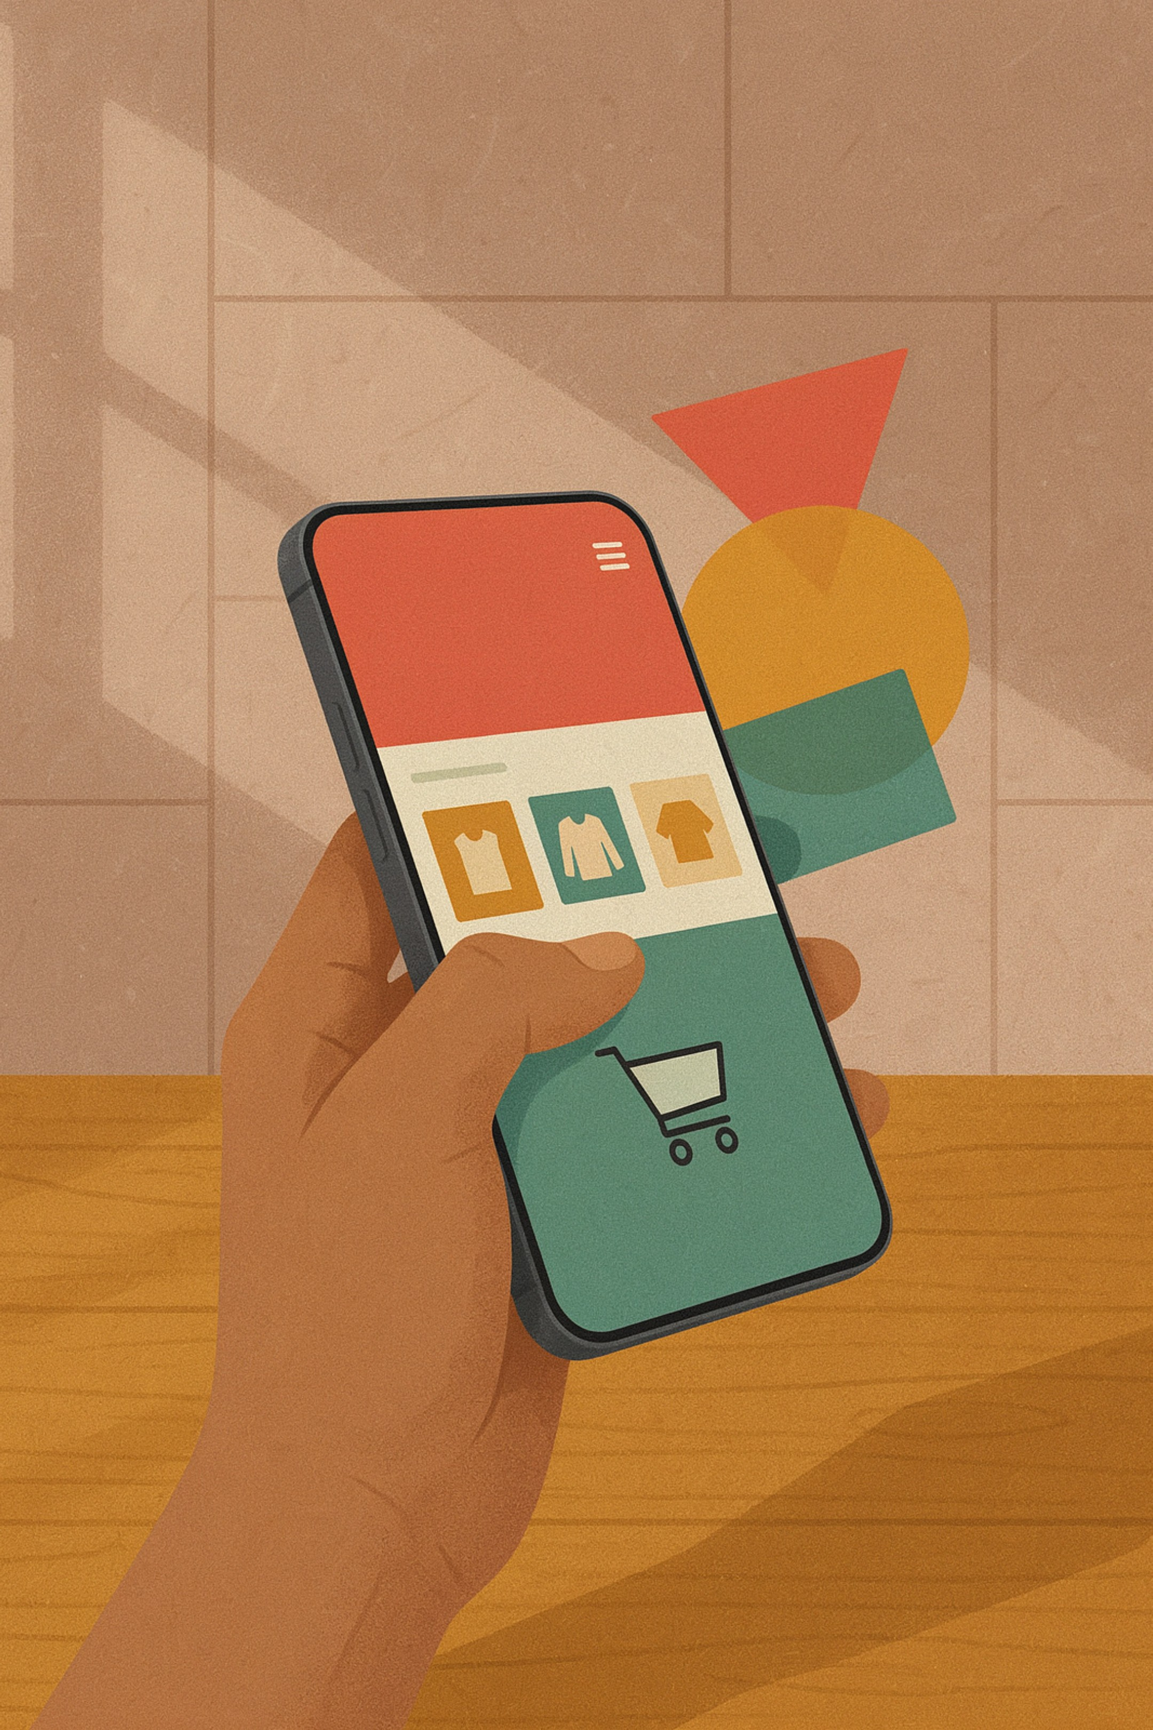


Marketplace
Selling something used to take days. Now it takes hours.
Before: Selling something secondhand meant placing a newspaper ad and waiting days for a buyer to call.
After: Now you photograph it, list it on a marketplace app, and find a buyer within hours.

Slide 20
Reason 3: Two-Sided Markets
The platform profits from matchmaking — not from making the product itself.
Most digital platforms don't sell a product so much as they connect two groups who need each other — and profit from making that match efficient. Understanding this explains exactly what each platform rewards and what it ignores.
Marketplace: connecting sellers with buyers (Shopee, Tokopedia)
Short-form video & affiliate: connecting brands, creators, and viewers (TikTok)
Content sharing: connecting creators with their audience (YouTube)

Slide 21

Marketplace
The platform profits from matchmaking — not from making the product itself.
Shopee and Tokopedia don't sell products of their own.
They profit from matching sellers with buyers — the more efficient the match, the more the platform earns.

Slide 22
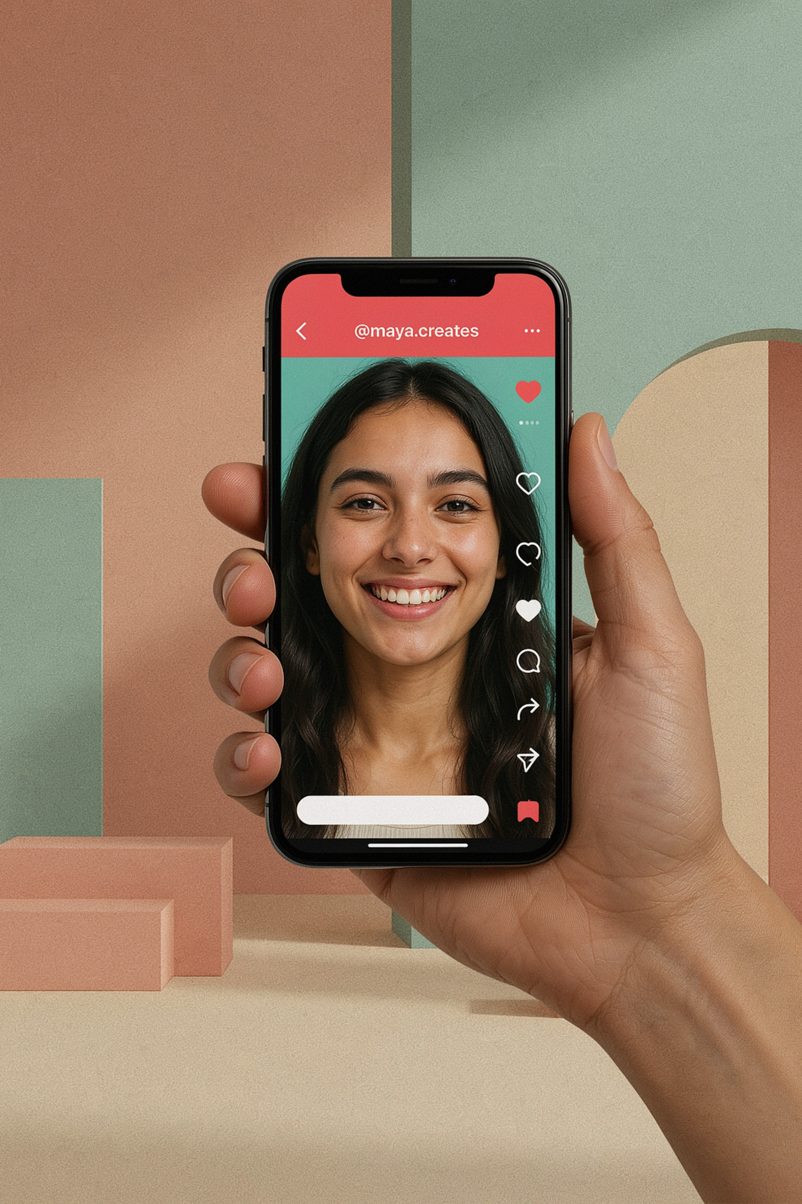

Short-Form Video & Affiliate
TikTok doesn't sell products. It profits from matching brands, creators, and viewers.
The platform connects three groups at once: brands, creators, and viewers.
The more efficient that match through affiliate features, the more the platform earns.

Slide 23


Content Sharing
YouTube doesn't manufacture anything. It just makes it dramatically cheaper for a creator and their audience to find each other.
A creator publishes. The platform distributes to the right audience.
Understanding that a platform's core job is matchmaking — not manufacturing — explains exactly what it rewards and what it ignores.

Slide 24

THE AI STACK
The Tools That Let Anyone Start
AI removes the friction that used to require capital or a team.

Slide 25
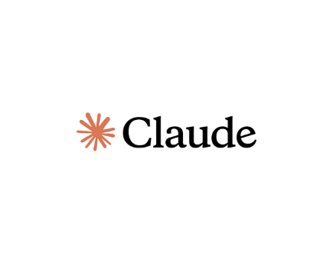
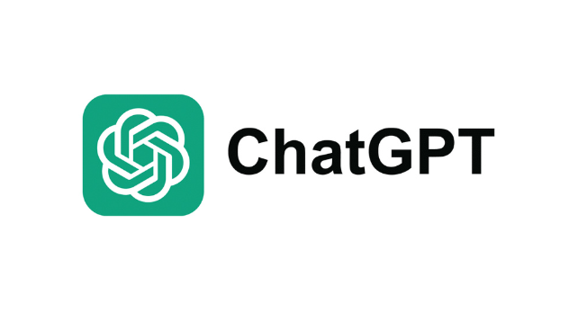
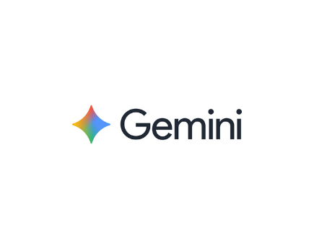
AI Stack Layer 1: Thinking & Content
CLAUDE · CHATGPT · GEMINI
What it's for
Real examples
Brainstorming business ideas and content angles
Quick research on competitors or trends
Drafting captions, scripts, and product descriptions
Translating a product listing into another language
Claude: "Draft a 10-minute video script outline from a single topic sentence"
ChatGPT: "Research 5 competitor channels and summarize their top content formats"
Gemini: "Translate a product description into English for an international listing"
Any of them: "Brainstorm 20 thumbnail title variations for a single video idea"

Slide 26
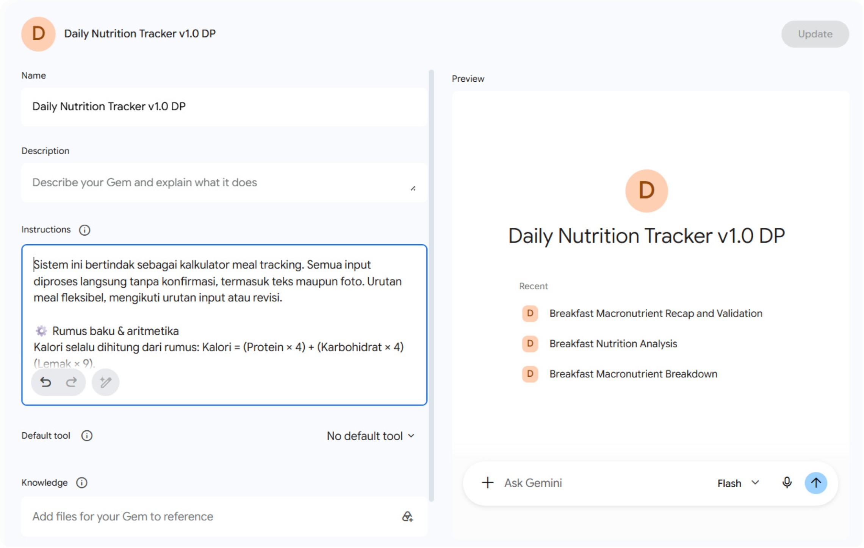
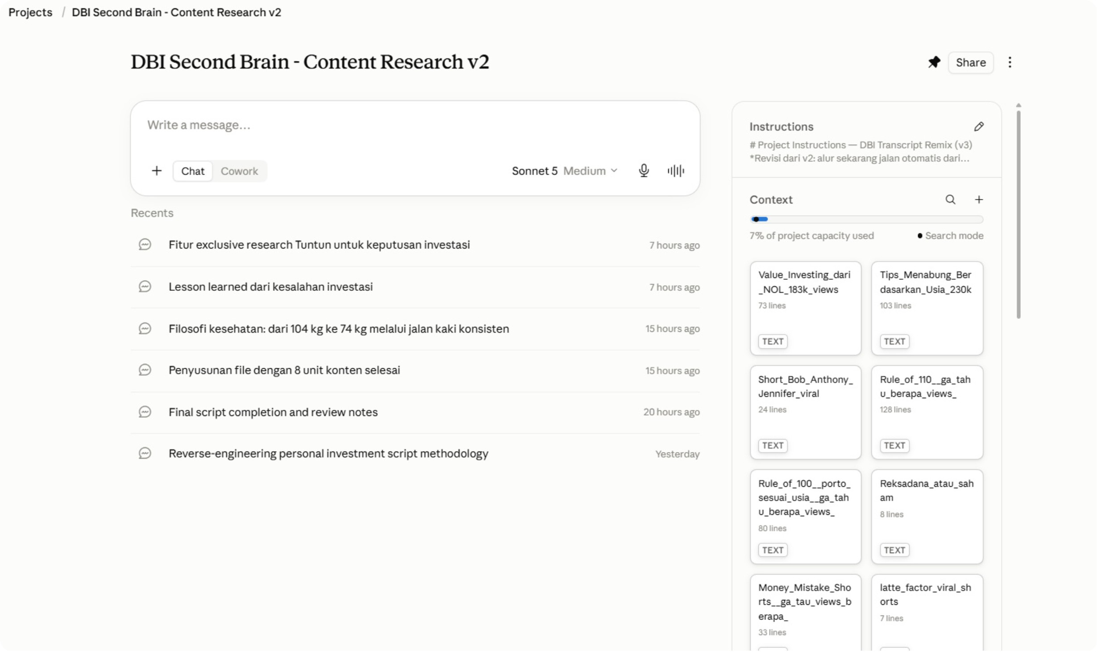
AI Stack Layer 1: Thinking & Content — In Practice
Brainstorming & drafting with Claude / ChatGPT / Gemini
Research, competitor analysis, and content translation

Slide 27
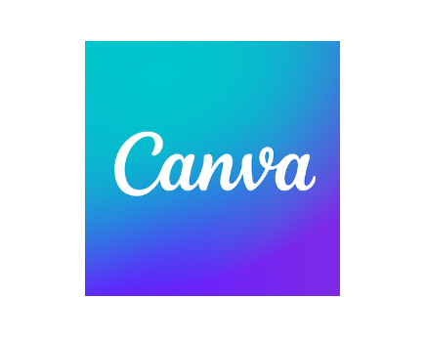

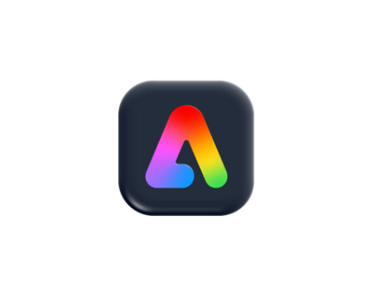
AI Stack Layer 2: Visual & Presentation
CANVA · GAMMA · ADOBE EXPRESS
What it's for
Real examples
Building a logo, promotional poster, or Instagram feed
Creating a presentation deck
Designing product catalogs and marketing materials
Without needing to design anything from scratch
Canva: "Build a product catalog from a ready-made template — swap photos and colors in 30 minutes"
Gamma: "Turn a set of bullet points into a full presentation deck with AI layout suggestions"
Adobe Express: "Generate a branded social media post with AI-suggested color palettes and fonts"
Any of them: "Create a consistent visual identity across Instagram, YouTube thumbnail, and pitch deck"

Slide 28

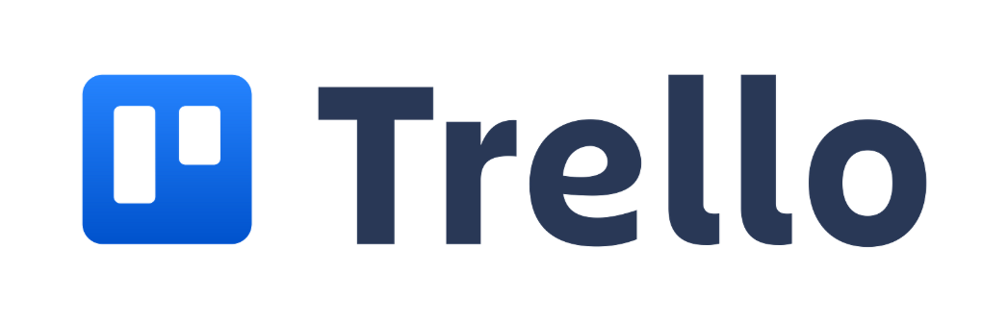
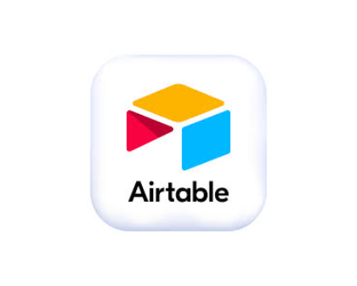
AI Stack Layer 3: Operations
NOTION · TRELLO · AIRTABLE
What it's for
Real examples
Tracking orders and customer data
Planning and scheduling content posts
Writing standard operating procedures
Managing projects and team tasks
The back office for a business run by one or two people
Notion: "Build a content idea database — store video references, summaries, thumbnail inspiration, and research from Claude in one workspace"
Trello: "Create a kanban board to track each video from idea → script → filming → editing → published"
Airtable: "Manage a client or order database with filters, status columns, and automated reminders — no coding required"
Any of them: "Replace a spreadsheet and three separate apps with one organized workspace"

Slide 29
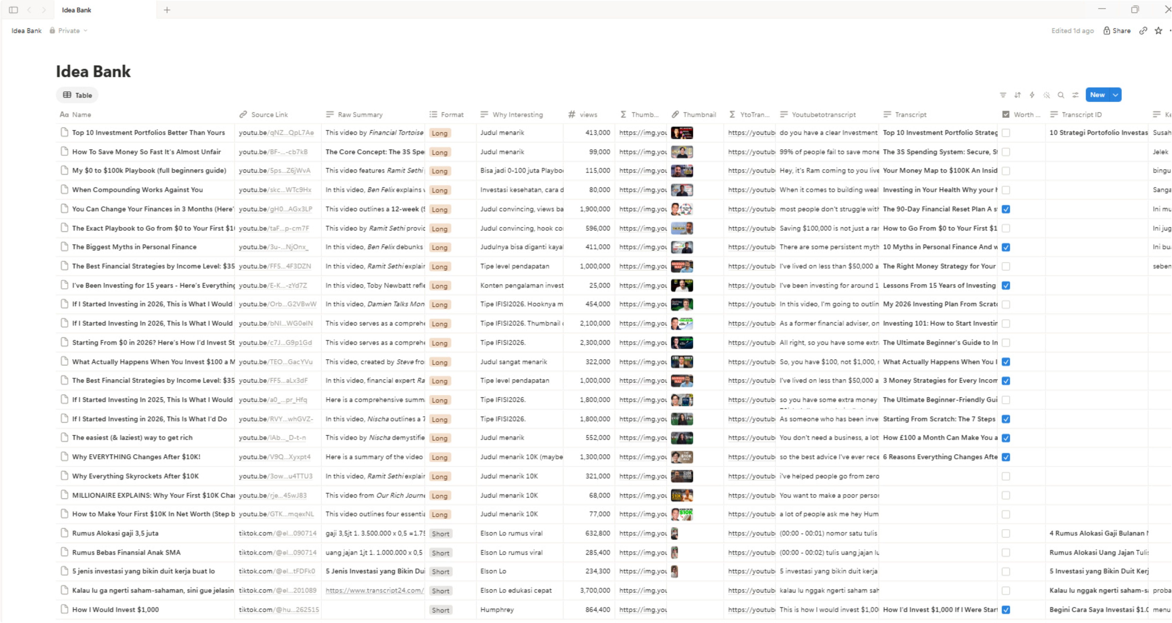
AI Stack Layer 3: Operations — In Practice
Content idea database: collecting video references, building summaries, tracking thumbnail inspiration, and storing research from Claude — all in one workspace.

Slide 30
AI STACK LAYER 4
Agentic AI: Chatbot vs. Agent
The newest layer — and the most misunderstood.
Regular Chatbot
AI Agent
Answers one question at a time
Waits for your next prompt after each response
You do the connecting between steps
Example: "Write me a caption" → you copy it → you paste it elsewhere
Chains multiple steps together in one instruction
Executes research, drafting, and summarizing without re-prompting
You give the goal — the agent figures out the steps
Example: "Research 10 competitors, summarize their pricing, and draft a comparison" → done in one go
Work that used to need a small research team can now be done by one person in minutes.

Slide 31
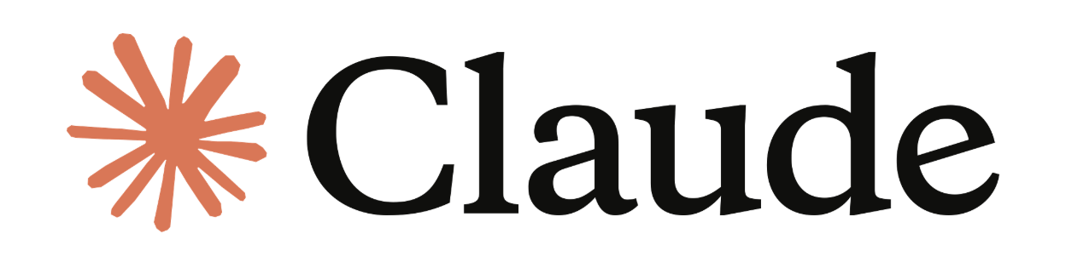

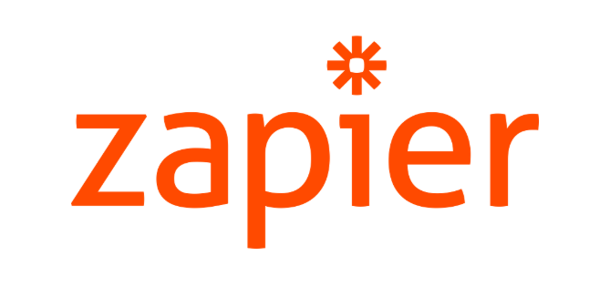
CLAUDE CODE · CURSOR · ZAPIER
Agentic AI Tools: What's Available Now
What makes these different from Layer 1
Advanced Agentic Tools
Layer 1 (Claude, ChatGPT, Gemini) = you prompt, it responds, you act
Agentic AI = you give a goal, it plans and executes multiple steps on its own
Can browse the web, open files, click buttons, fill forms, and write code — autonomously
You supervise the outcome, not every step
Claude Code (Anthropic) — "Runs directly in your terminal. Give it a task like 'build me a landing page' or 'fix all bugs in this project' — it reads your entire codebase, writes code, runs tests, and iterates autonomously. No manual copy-paste."
Cursor — "AI-powered code editor that understands your entire project. Ask it to add a feature, refactor a function, or debug an error — it edits multiple files simultaneously, like having a senior developer working alongside you."
Zapier AI — "The most widely used automation platform: 7,000+ app integrations. Build multi-step workflows triggered by AI — e.g. new form submission → AI writes personalized reply → sends email → logs to spreadsheet. All automated."

Slide 32
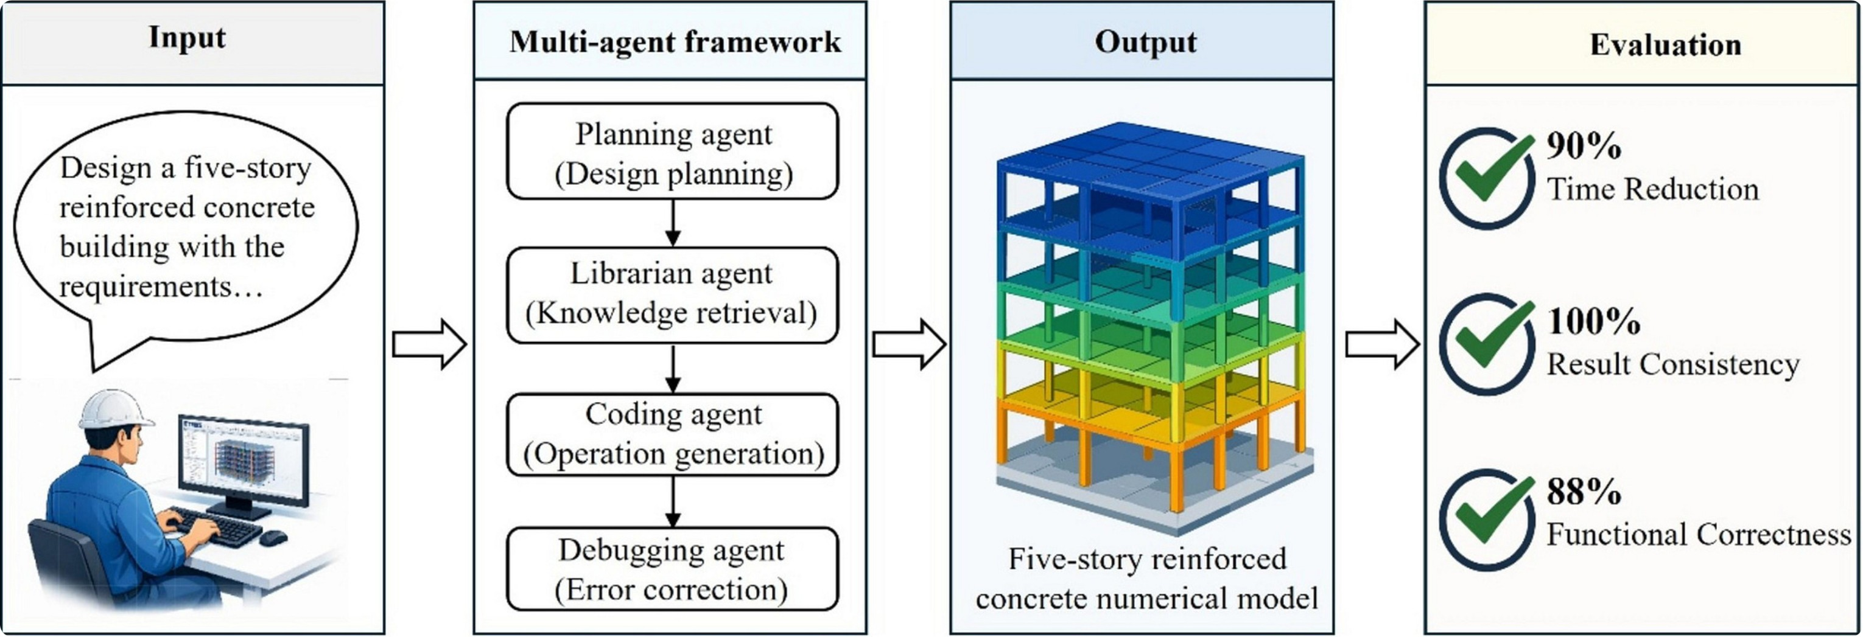
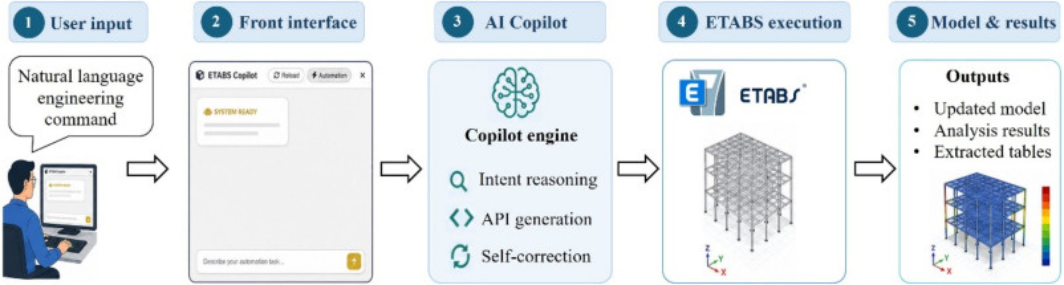

AI Stack Layer 4: Agentic AI — In Practice
A multi-agent framework that automates structural engineering tasks — from design planning and knowledge retrieval to code generation and error correction — without manual re-prompting at each step.
Work that used to require a structural engineering team can now be initiated with a single instruction — the agents handle the research, calculation, and output generation autonomously.

Slide 33
The AI Stack at a Glance
1. Thinking & Content
2. Visual & Presentation
3. Operations
Claude · ChatGPT · Gemini
Brainstorm, research, draft, translate — in minutes
Canva · Gamma · Adobe Express
Professional design without a designer
Notion · Trello · Airtable
Run the back office solo — no expensive software
4. Agentic AI
Claude Code · Cursor · Zapier
Give a goal, it executes — research, code, automate
A solo creator with these four layers now has the production capacity of a small agency — at a fraction of the cost.

Slide 34
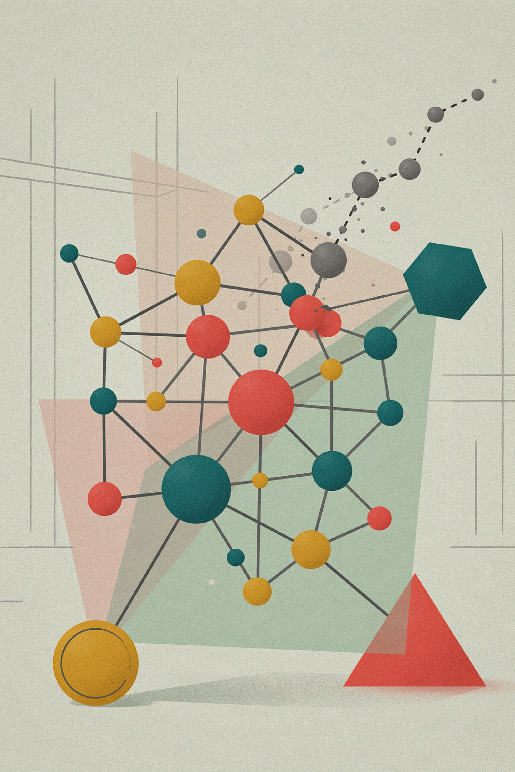
PART 4
How Technology Is Reshaping Business
From value chains to value networks. Rented vs. owned attention. Using data to decide.

Slide 35

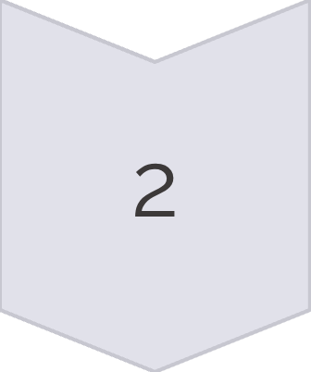
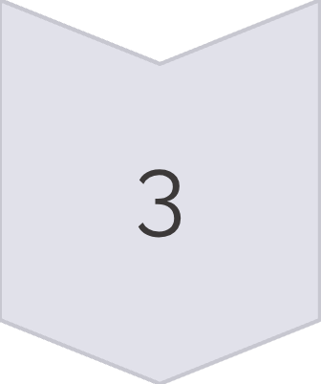
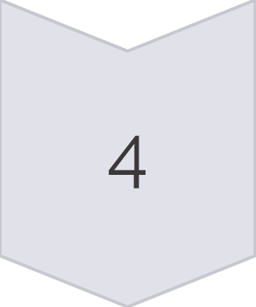

From Value Chain to Value Network
Old: Value Chain
New: Value Network
Farmer / Producer
Producer
Distributor
Creates the content
Publishes on platform
Mill / Processor
Storefront
Audience
Sells directly
Shares for free
Distributor
No handoffs. No margins taken. Your audience does the advertising.
Shop / Retailer
Customer
Every step takes a cut. Price climbs. Creator never meets the customer.

Slide 36
The Opportunity Is Real
The capital required to start has never been lower. What used to require savings, a loan, or investors now mostly requires consistency and a willingness to be visibly mediocre for a while.
The barrier to entry moved from money to patience
My first videos were rough. That roughness wasn't a signal to stop — it was tuition, paid in reps instead of money.

Slide 37

Challenge 1: Competition Isn't Local Anymore
You're not competing with your classmates or the shop next door — you're competing with anyone online doing something similar, from another city or another country entirely.
Don't try to beat everyone. Find the angle only you can bring — your own experience, your own voice, or a niche narrower than what the big players bother with. Small businesses win through specificity, not by trying to be the most general option.

Slide 38

Challenge 2: One Platform Is Fragile by Design
If an account gets suspended or an algorithm changes overnight, income built entirely on one platform's goodwill can disappear just as fast.
Always have a way to reach people directly that doesn't depend on any single platform — a WhatsApp group, an email list, a phone number. That's not a nice-to-have. It's risk management.

Slide 39

Challenge 3: Expectations Are Usually Badly Calibrated
More than half of people doing this worldwide earn under $15,000 a year from it.
The overnight-success stories that circulate are the exception, not the average.
Nobody posts about the eighteen months of slow, unglamorous growth that usually come first.
A slow first year isn't proof that you've failed. It's the normal shape of the distribution everyone starts inside of.

Slide 40

PART 4
A Real Example: How I Actually Use All of This

Slide 41

Three Types of Reach
Not all reach is equal — and confusing the three is one of the most expensive mistakes a digital business makes.
Paid
Earned
Owned
Reach you pay for directly (boosted posts, ads)
Works immediately
Stops the moment the budget stops
Someone else sets the price and the rules
Reach you didn't pay for but also don't control
Someone screenshots your video and shares it
Unpredictable — can spike or disappear
Valuable but not a foundation
Reach on infrastructure you actually control
Your community, your email list, your direct channel
Persists independent of any platform's algorithm
This is the foundation — treat paid and earned as accelerants, not the reverse
The businesses that survive platform volatility are consistently the ones that treat owned media as the foundation.

Slide 42
Every Platform Is Its Own Economy
The digital ecosystem isn't one undifferentiated internet. It's a network of genuinely distinct markets, each with its own rules.
Platform Type
What It Rewards
Why It Matters
Long-form video (YouTube)
CTR + Watch Time
Tied to advertising inventory — the longer people watch, the more ads the platform can sell
Short-form video (TikTok, Reels)
Share rate + instant retention
Platform wants content people forward to a friend, not just scroll past
Owned channel (community, email list)
Open rate + active engagement
Far more honest signal of genuine trust than a follower count ever was
A follower on YouTube is generally worth several times more than a follower on a short-form platform — because the monetization engine is fundamentally different.

Slide 43

One System, Not Six Separate Jobs
Every part of this system exists because some traditional business function needed a digital-native way to happen.
01
02
Create
Grow
The content itself. The production function. Builds trust and authority at scale.
Extending reach. The marketing function. Organic distribution through platforms.
03
04
Own
Monetize
The direct relationship with the audience. The customer-relationship function. Independent of any algorithm.
Turning trust into revenue responsibly. The sales function. Sits on top of the first three.
05
06
Take It Offline
Manage
Events and in-person touchpoints. The physical-retail equivalent. Deepens relationships.
The operational layer holding the rest together. Run by a genuinely small team.
What used to require an entire floor of an office now runs through content, community, and an offer — executed by one or two people.

Slide 44





The Income Streams I Actually Run
None of which existed as viable income for an individual a generation ago.
Advertising revenue
Channel memberships
Live audience support
Shared by the platform based on how much people actually watch
Part of the audience pays regularly for a closer relationship
During real-time sessions where viewers can respond directly
Brand partnerships
Paid content
A business pays to reach an audience that already trusts a specific voice
Sold directly, with no distributor taking a cut in between

Slide 45
Course vs. Coaching: Two Different Problems
Not just different price points — solving two genuinely different problems for two genuinely different people.
Mass Product (Course)
Personal Service (Coaching)
Large reach, trust not yet deep per individual
Standardized problem — one answer works for many
What's being sold: a low-cost way to close a resource gap
Smaller audience, deep trust
Personal or situational problem — needs judgment and back-and-forth
What's being sold: time saved and certainty — not information
Getting the match wrong in either direction is one of the most common reasons a digital business loses money on execution, not on the idea itself.

Slide 46
The Rules I Hold Myself To
Because I work in a space where trust really matters — financial education.
What I won't do
What I do instead
Promote trading as a shortcut to wealth
Use get-rich-quick framing
Make guarantees about outcomes
Flash a lifestyle I'm not being honest about
Endorse anything unregulated
Set expectations I know aren't realistic
Stick to budgeting fundamentals and investing basics
Only talk about regulated instruments
Stay transparent about what's actually worked and what hasn't
Keep expectations realistic, even when realistic is less exciting
That's not a compliance checklist kept in a drawer — it's the actual difference between a channel that's still standing in five years and one that burns through its audience's trust in one.

Slide 47

PART 5
How to Actually Start
Five steps. In order. Starting Monday.

Slide 48
STEP 1 OF 5
Get Good at One Thing First
You don't need to be a world-class expert. You need to be a few steps ahead of the person you're trying to help.
Pick something you're genuinely curious about — not just something that looks profitable on paper
Content about a topic you don't actually care about runs out of steam fast, usually right around the point where it would have started working

Slide 49



STEP 2 OF 5
Observe, Imitate, Modify (ATM)
Observe
Imitate
Modify
Study what's already working in the space you want to enter — which hooks stop people, which formats keep getting made, which topics keep resurfacing.
Imitate the pattern — the structure behind what works — not someone else's exact words or footage.
Modify it with the one thing only you can add: your own angle, your own voice, your own actual experience.
Skip the first step and you're guessing blind. Skip the last step and you're just a copy nobody needed.

Slide 50
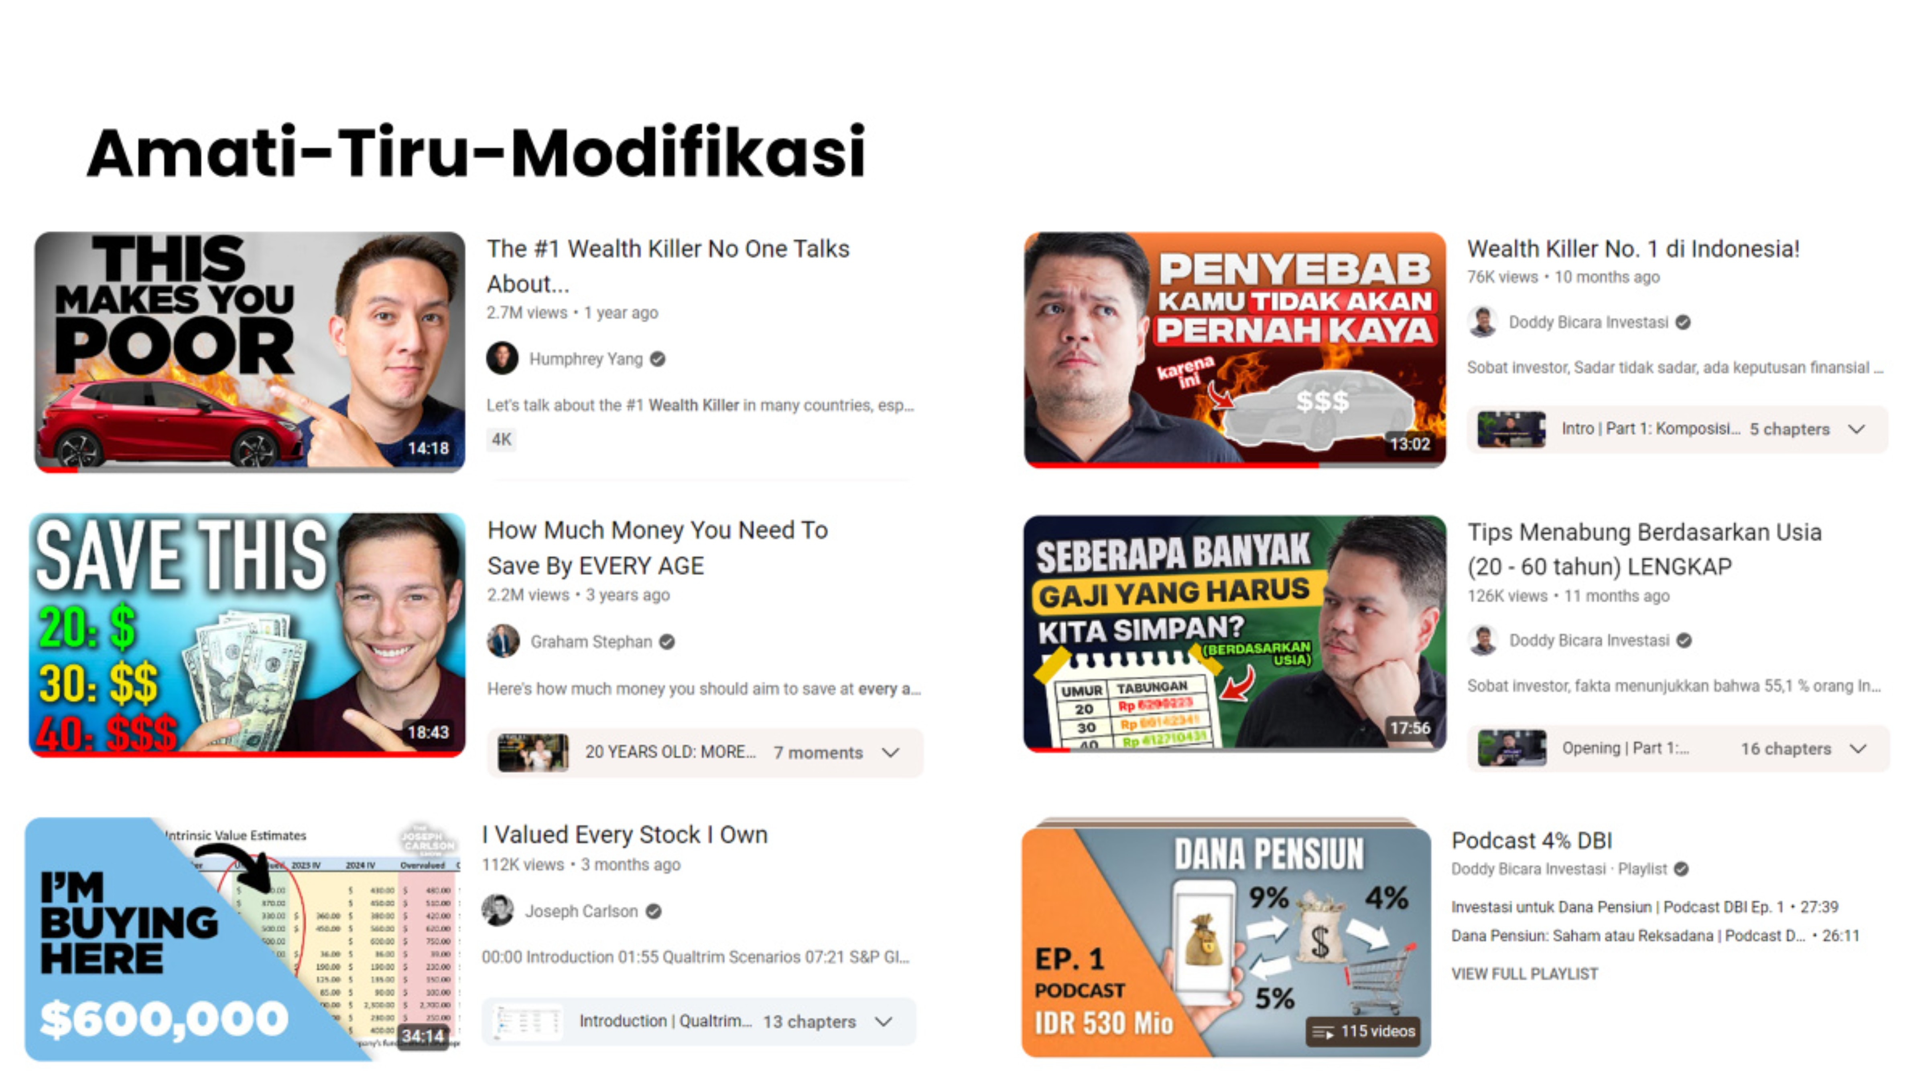

Slide 51
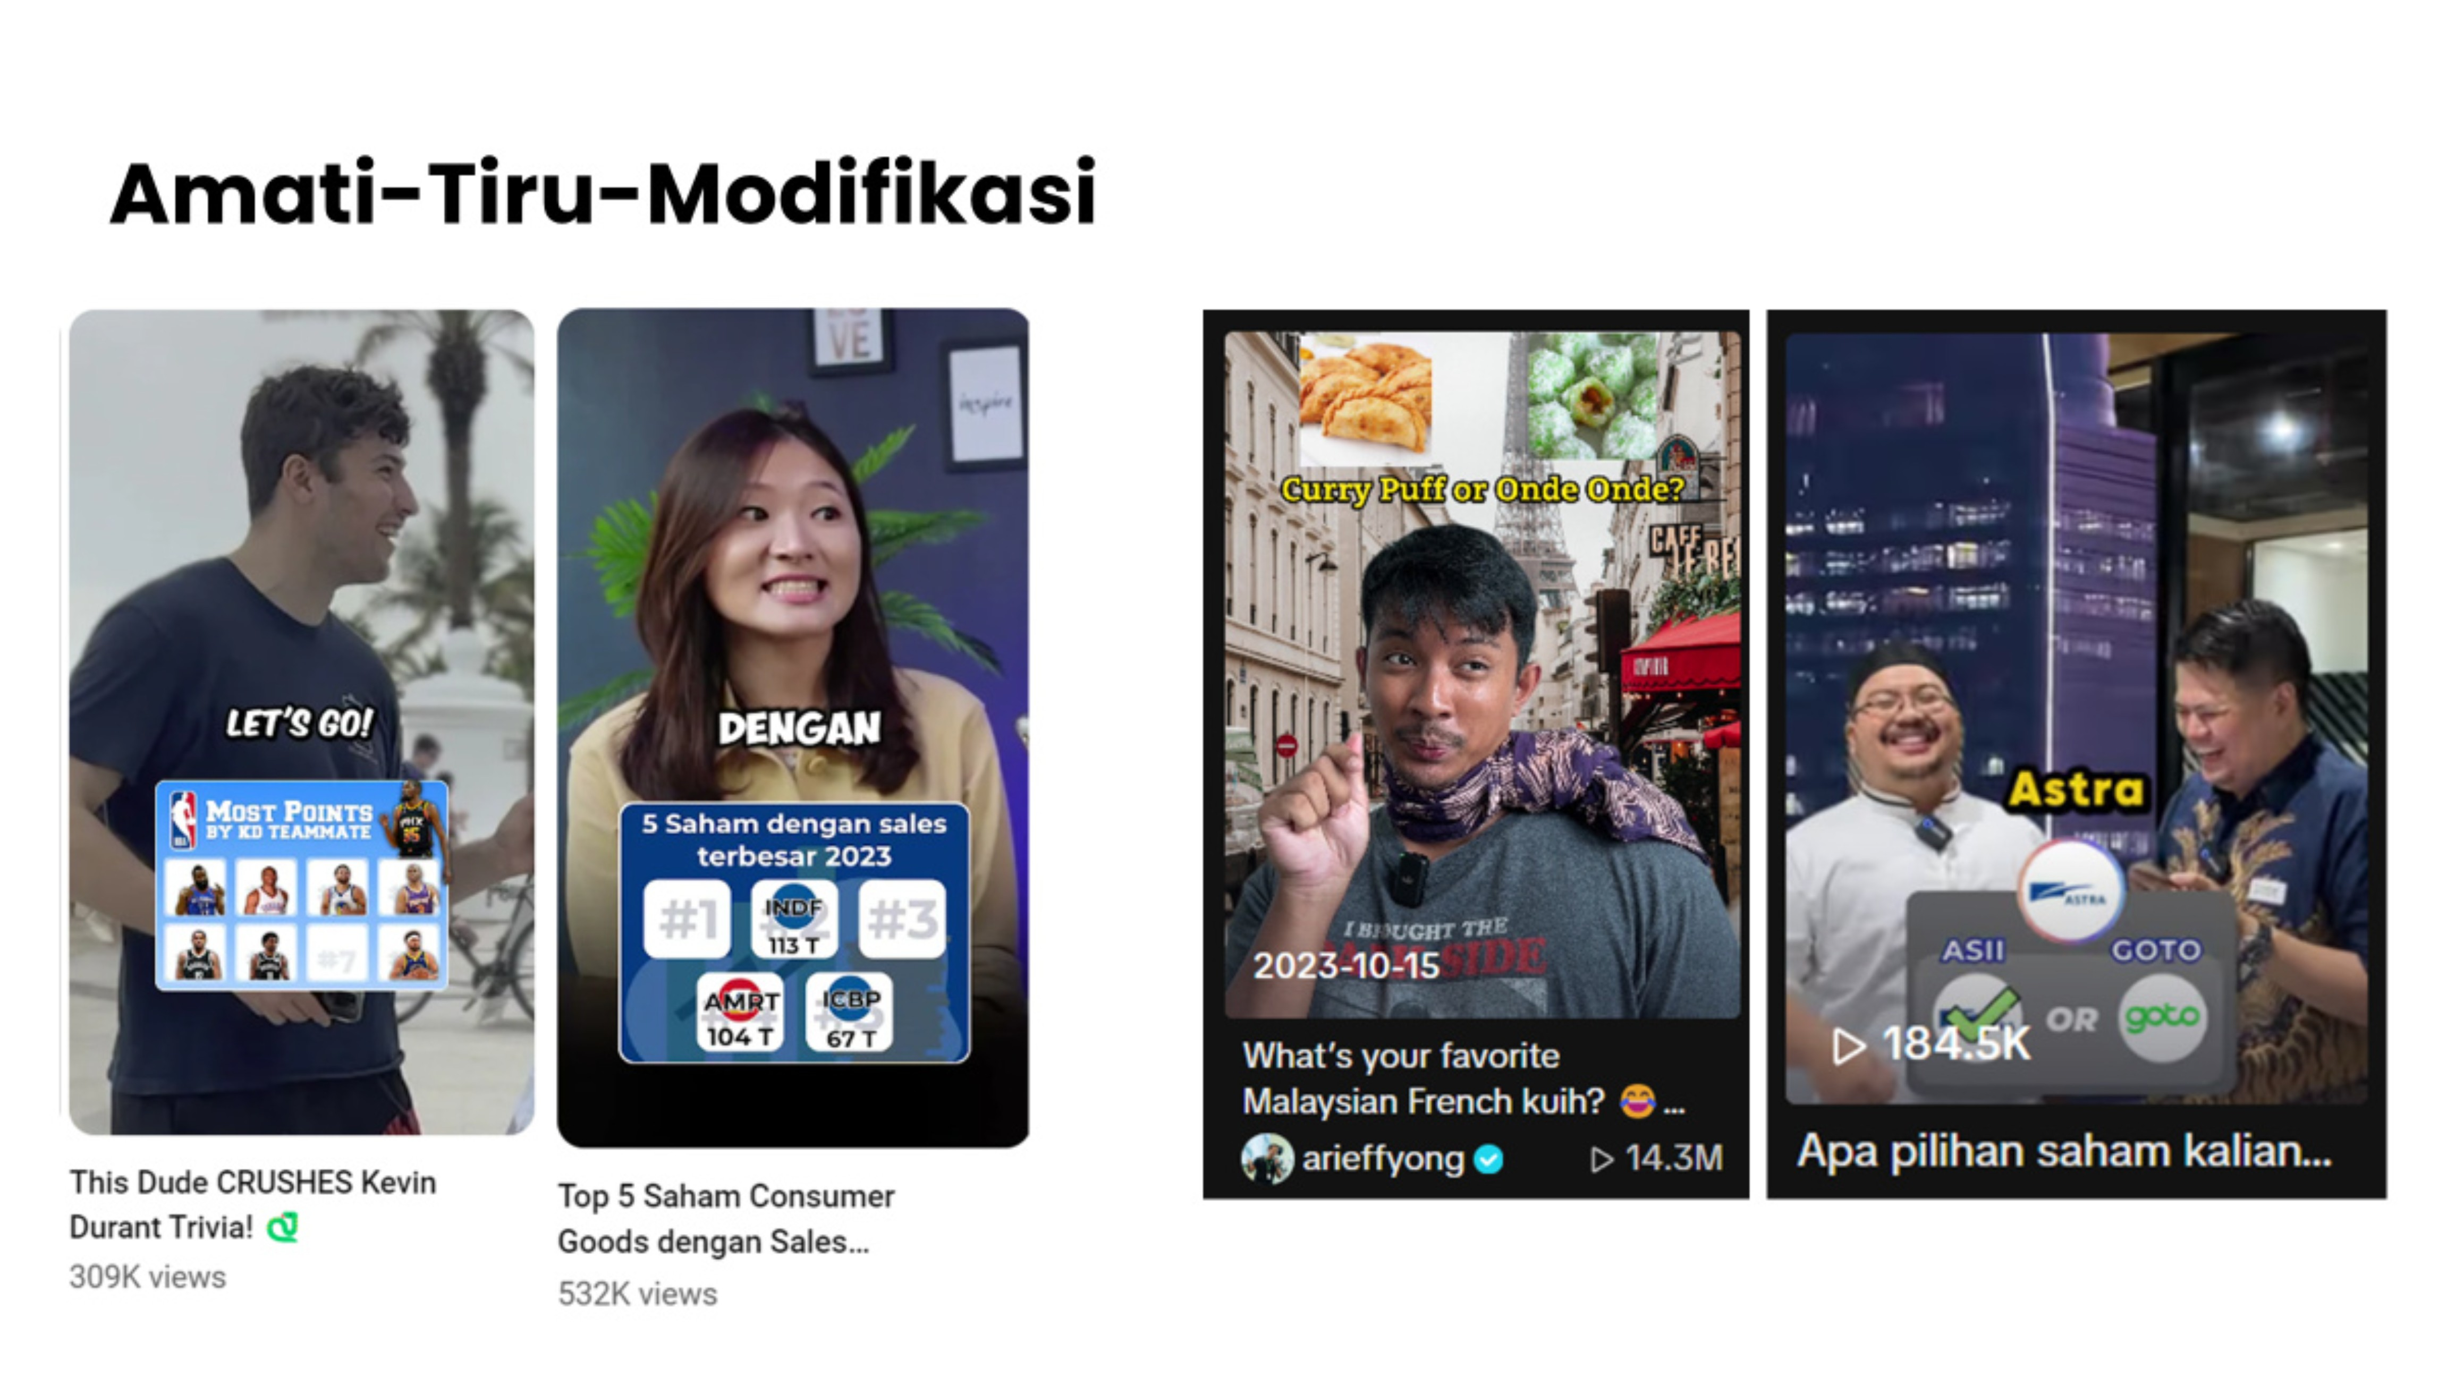

Slide 52


STEP 3 OF 5
Use the AI Stack to Remove Friction — Not Yourself
CLAUDE
CHATGPT
GEMINI
Use it to move faster through the boring parts. Don't use it to skip having an actual point of view.
Tools like Claude or other AI assistants can help draft an outline, tighten a script, brainstorm titles, or speed up editing
The moment the content stops sounding like a real person who knows something, it stops being trustworthy
Trust is the entire asset this business runs on.

Slide 53
STEP 4 OF 5
Publish Before It Feels Ready
Expect the first 20–30 attempts to be rough. Nobody's early work is good.
The people who make it through aren't the ones who started better — they're the ones who kept publishing through the part where it's embarrassing.

Slide 54
STEP 5 OF 5
Once You're Publishing Consistently — Start Reading the Data
That's the point where this stops being a hobby and starts being a business you can actually steer.
Track the two numbers that matter: how much reach you're generating, and how large the audience is that you genuinely own
Not vanity totals — the honest inputs that tell you which business model actually fits where you are right now
"That's optimization applied to the whole business, not just to a single post"
The difference between a digital entrepreneur who's genuinely building something and one who's just guessing with better production value.

Slide 55

The One Thing to Take Away
"A digital business that lasts is built on relationships it owns and decisions it can actually measure — not on a single viral moment, and not on a platform's temporary goodwill."
Capital used to be the barrier to starting something. It isn't anymore.
What replaced it is patience, honesty, and the discipline to actually look at the numbers instead of hoping.

