Slide 1

OUJI SEIYAKU INDONESIA

Slide 2


Ouji Seiyaku Indonesia
Ouji Seiyaku is a Fast Moving Consumer Goods (FMCG) Company under Whealthfields Lohmann group. Our focus is on delivering effective cleaning products that also offers convenience. Ouji protects you and your family.
OUJI SEIYAKU INDONESIA

Slide 3
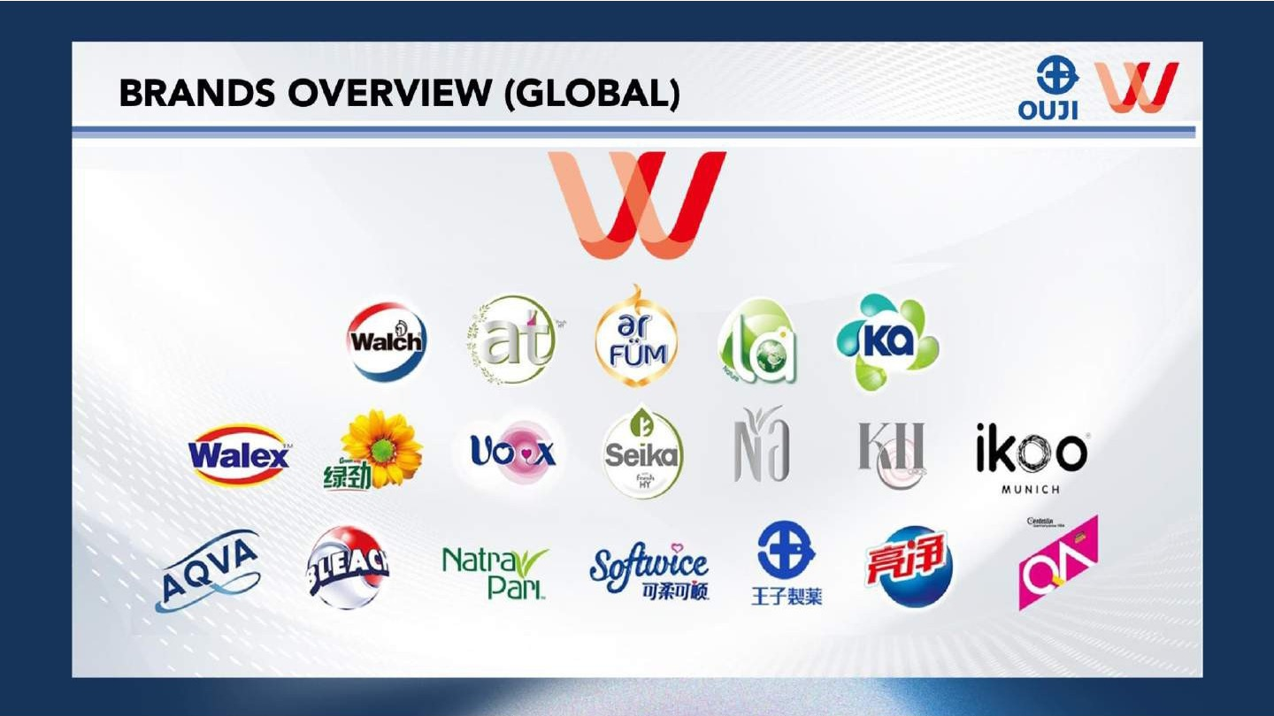
OUJI SEIYAKU INDONESIA

Slide 4
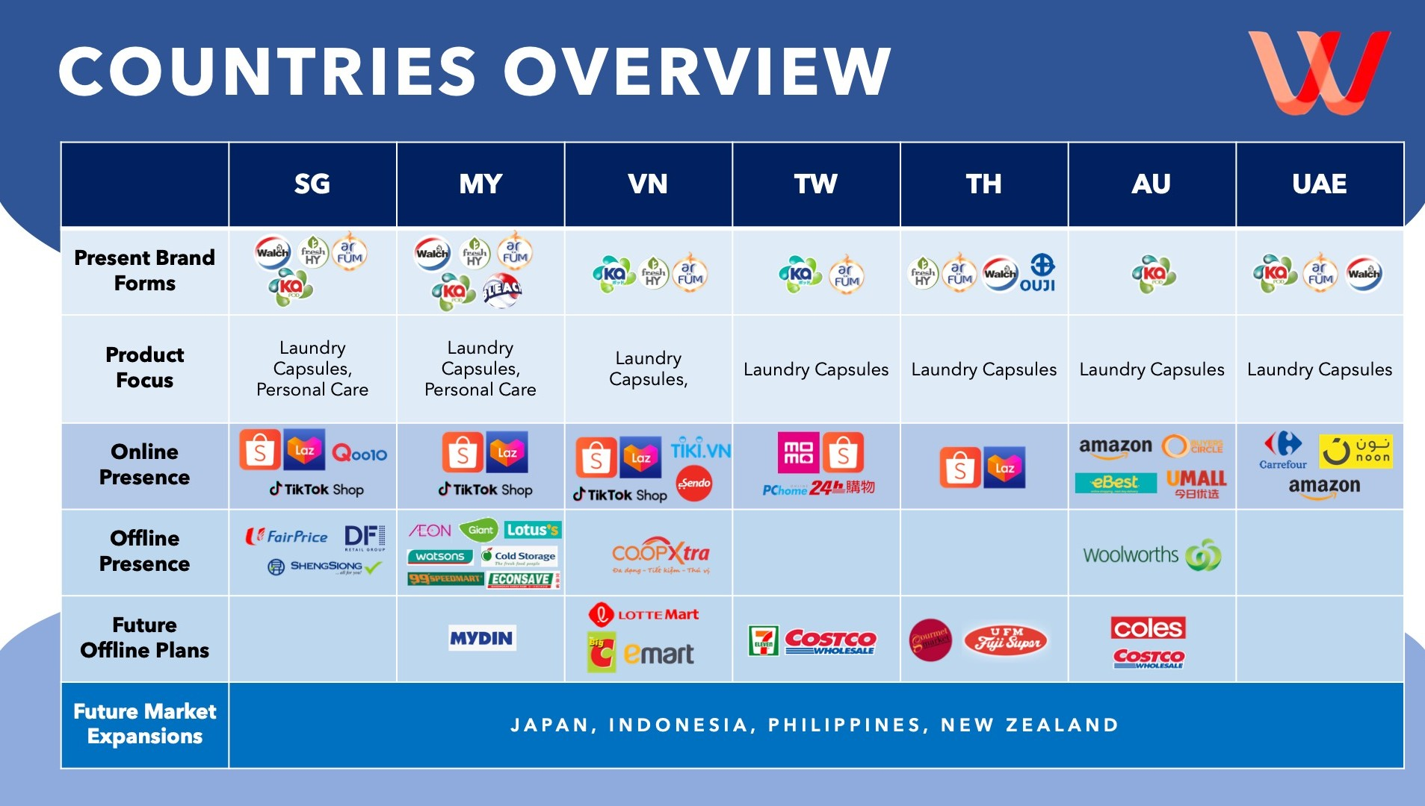
OUJI SEIYAKU INDONESIA

Slide 5
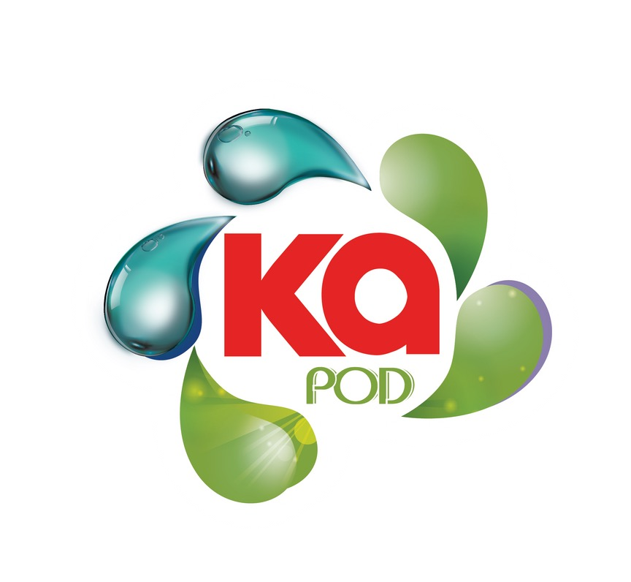

OUR BRANDS
A more powerful and effective wash, with every Ka capsules
Laundry Care Expert for keeping your clothes smelling fresh up to 16 weeks
4in1 Detergent Capsule with 10x Cleaning Power + Kill 99.9% Germs. Ka is our superior concentrated laundry formula capsule.
Suitable for indoor drying, its compact size makes it easy to use and even easier to transport, to deliver a fuss-free laundry experience with every spin.
Seeks to make laundry a hassle-free experience
ar FÜM products promise up to 16 weeks of long-lasting fragrance from wash till wear, ensuring your clothes smell great all day long.
Deeply cleans and removes stains
OUJI SEIYAKU INDONESIA

Slide 6

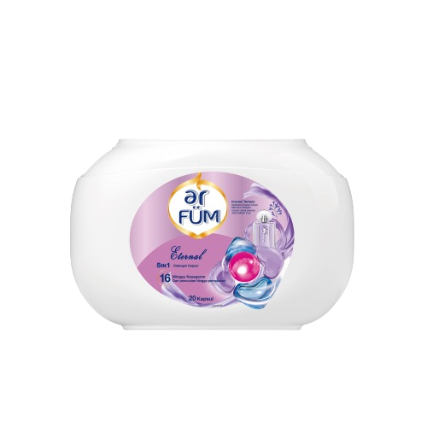
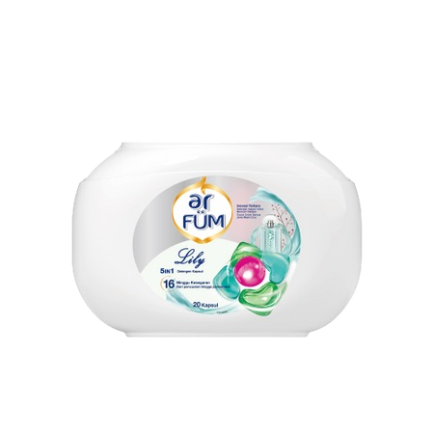
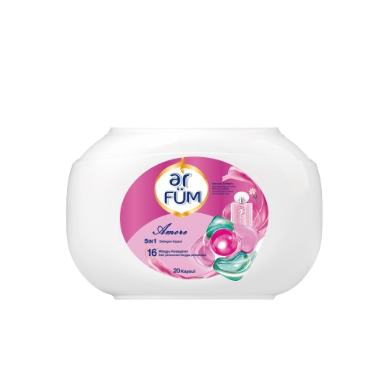
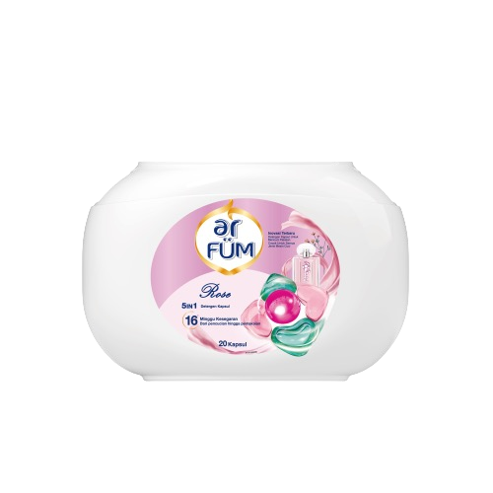

ar Füm
SKU
ETERNAL
AMORE
ROSE
LILY
Brand Tone of Voice
Make laundry a hassle-free experience
Keep your clothes smelling fresh up to 16 weeks and to feel fresh and fragrant all day
Focuses more on fragrance
USP
Provides 16-weeks of freshness, from wash to wear
Acts as a 5in1 Detergent Capsule: detergent, softener, perfume, color protection, & stain removal.
OUJI SEIYAKU INDONESIA

Slide 7
ar Füm Platform
Instagram :
https://www.instagram.com/arfum.id?igsh=MXFhcXdyaDR3MTYz
Tiktokshop : https://vt.tiktok.com/ZS2vPcKY9/?page=Mall
Shopee Store : https://shopee.co.id/arfum.id
Tokopedia Store : https://www.tokopedia.com/ar-fum
Lazada store : https://www.lazada.co.id/shop/ar-fum-store
OUJI SEIYAKU INDONESIA

Slide 8
ar Füm
Melakukan Proses Pencucian baju menggunakan ar FUM detergent Kapsul
Menghighlight informasi:
Sudah Menjadi produk detergent kapsul nomor 1 di Rakuten Jepang
Non SLS dan Non Paraben
Sudah 5x Ultra Concentrated makanya bisa 9X kekuatan membersihkan
Wangi seperti Parfume karena ada 3 layer notes (Top notes, Hearth notes, Base notes)
Simpel karena sudah 5 in 1 : Detergent Concentrate, Pewangi, Color Protectant (Bisa menjaga warna baju), Laundry Sanitiser (Membunuh Kuman), Pelembut & Deodorize (anti bau apek)
Efisien karena tidak perlu takar menakar, jadi gausah ditambahkan apa-apa lagi
Ada 4 Variant wangi : Eternal, Rose, Lily, Amore
1 Kapsul bisa untuk 3-6kg pakaian kotor
Pembungkusnya terbuat dari plant based gel dimana dia akan otomatis larut di dalam air saat terkena air, tapi saat tidak terkena air aman yaa
Bisa penjemuran di dalam ruangan karena sudah ada deodorizer (anti bau apek)
OUJI SEIYAKU INDONESIA

Slide 9
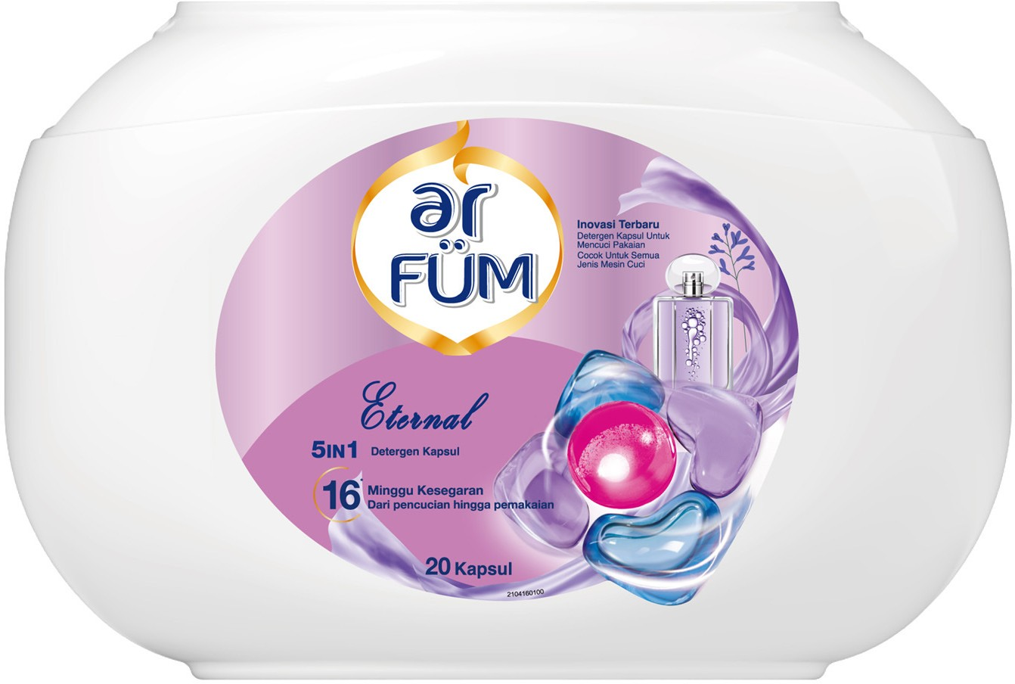
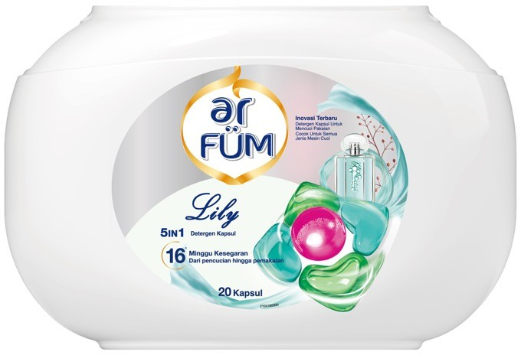
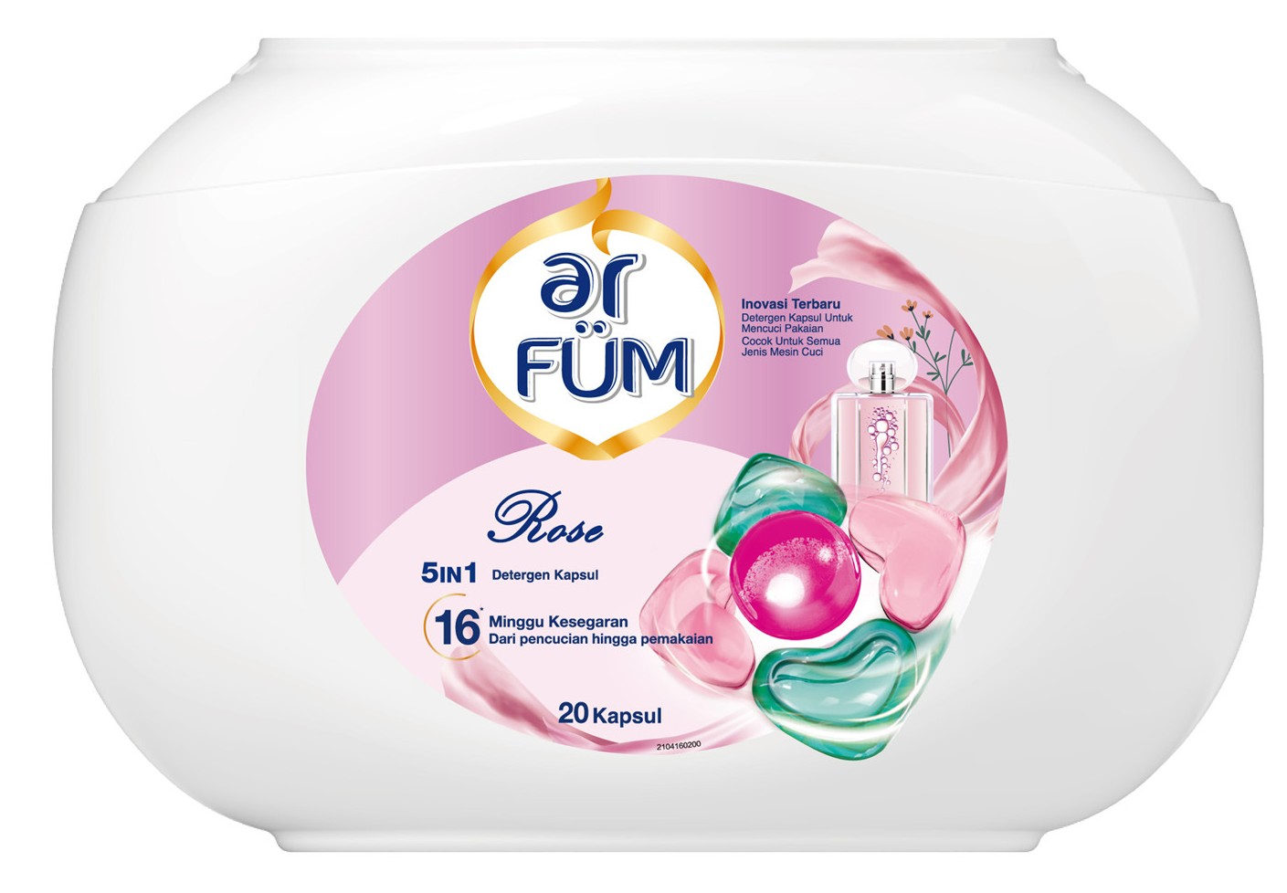
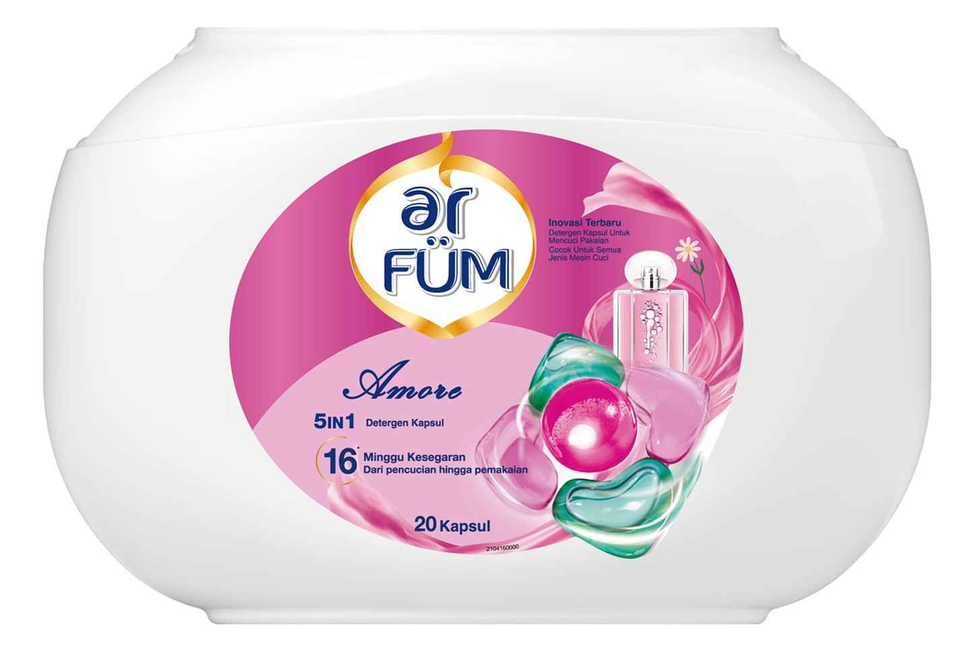
Highlight tiap Variant (highlight sesuai varian yang didapat):
Eternal : Aldehydic Dimana digunakan juga untuk parfum Channel nomor 5
2. Lily : Aquatic Dimana digunakan juga untuk parfum Dolce Gabbana
3. Rose : Amber Dimana digunakan untuk parfume Christian Dior Ambre Nuit
4. Amore : Bergamot Dimana digunakan untuk parfume Jo Malone London Oud & Bergamot Cologne Intense
OUJI SEIYAKU INDONESIA

Slide 10

PRODUCT INFORMATION
OUJI SEIYAKU INDONESIA

Slide 11
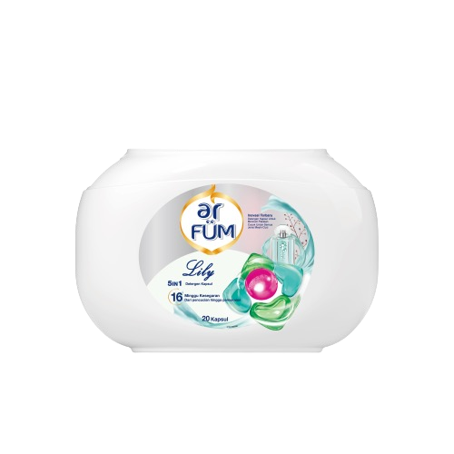
PRODUCT BENEFITS & USP
AR FÜM 5IN1 LAUNDRY CAPSULES
16 Weeks of Long-Lasting Fragrance
Advanced Microscent Technology via Collaboration with Firmenich
(Top 4 Fragrance House globally whose clientele includes YSL, Jo Malone, Gucci
& Valentino)
1st in Market 5in1 Laundry Capsule
Strong Cleaning Power – Leaves Long Lasting Fragrance Laundry Sanitiser – Scent Booster – Softener
Plant-based
0% Chlorine, Parabens, Phosphate, Phthalates, Optical brighteners
(Image for reference only)
9x Cleaning Power
Recyclable Tubs Suitable for Active Wear
Suitable for Indoor Drying
1 capsule (<7kg Washing Load per dosage)
Reference: Internal R&D

Slide 12
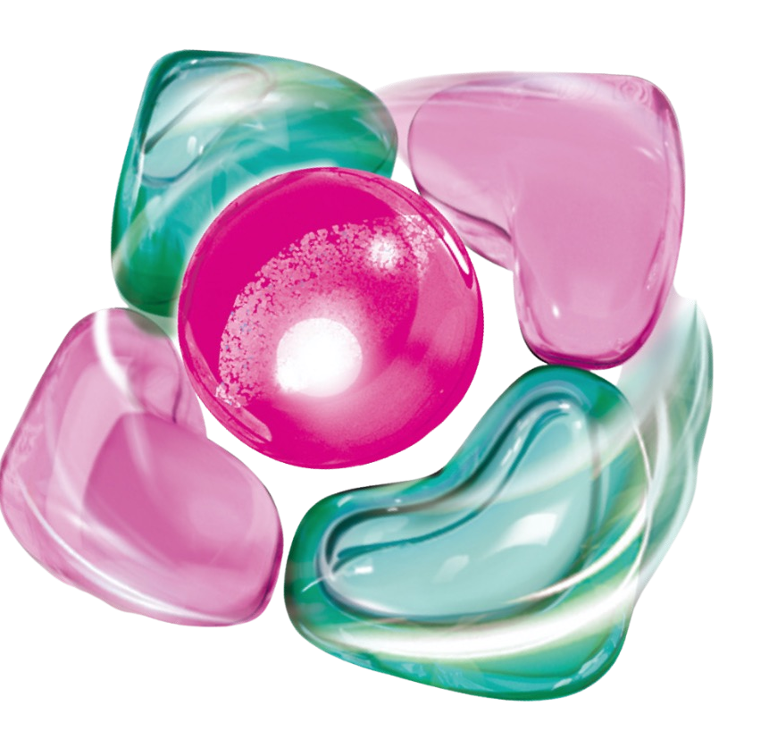
PRODUCT BENEFITS & USP
AR FÜM 5IN1 LAUNDRY CAPSULES
Detergent Concentrate
Laundry Sanitiser
Scent Booster
Colour Protectant
Deodoriser & Softener

Slide 13
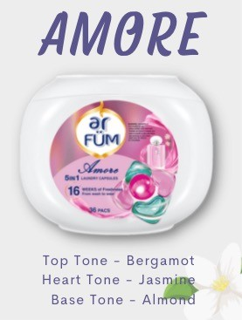
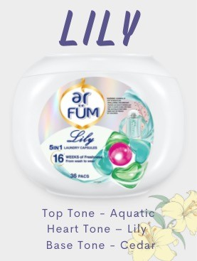
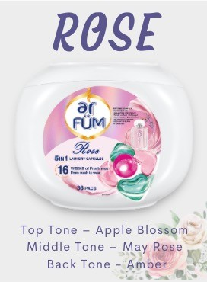
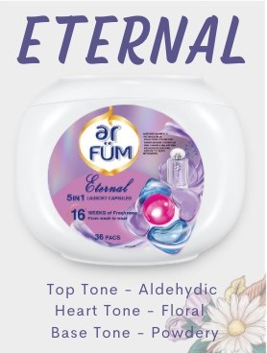
PRODUCT BENEFITS & USP
AR FÜM 5IN1 LAUNDRY CAPSULES

Slide 14
PRODUCT BENEFITS & USP
AR FÜM 5IN1 LAUNDRY CAPSULES
Product Description:
ar FÜM 5in1 Laundry Capsules keep your clothes smelling fresh with 16 weeks of long-lasting fragrance, ar FÜM 5in1 Laundry Capsules!
From Japanese formulation with plant-based ingredients, it combines detergent concentrate, laundry sanitiser, scent booster, colour
protectant, deodorant & softener in 1 single capsule. Wash up to 6kg of laundry with just a toss of capsule into the empty washing machine
drum. Available in 4 variants – Amore, Lily, Rose & Eternal
(Image for reference only)
Search Keyword:
ar FÜM, Laundry Capules, Capsules, Detergent, Disinfectant, Laundry Sanitiser, Scent Booster, Softener, Laundry
Reference: Internal R&D

Slide 15
PRODUCT DETAILS
AR FÜM 5IN1 LAUNDRY CAPSULES
Item | Description
 | Long - 40 characters (incl. space) | Short - 20 characters (incl. space)
Product Naming | ar FÜM 5in1 Laundry Capsules 36's | ar FÜM Laundry Capsules
Variants | Lily Amore Rose Eternal
 | Gross | Net
Weight / Bottle | 1 tub of 340g | 1 tub of 240g
Country of Origin | Made in China
Storage | Store in a cool and dry place.
Best Before Date | 60 months from manufacturing
 | Product
Packing Size | 20pcs/ Tub
Dimension | 152mmL x 122mmW x 108mmH
RSP Pricing (Inc. GST) | Rp. 178.999 / Tub | Rp. 178.999 / Tub
Lily
Amore
Rose
Eternal
Reference: Internal R&D

Slide 16
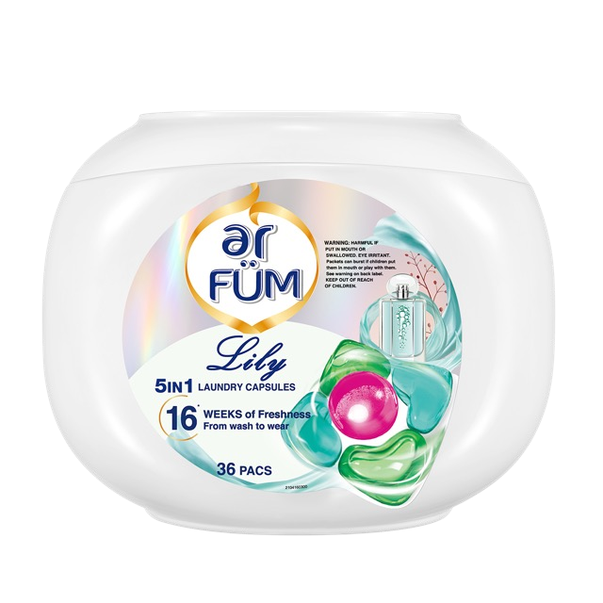
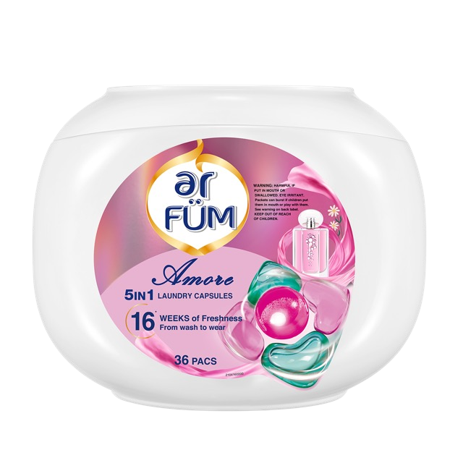
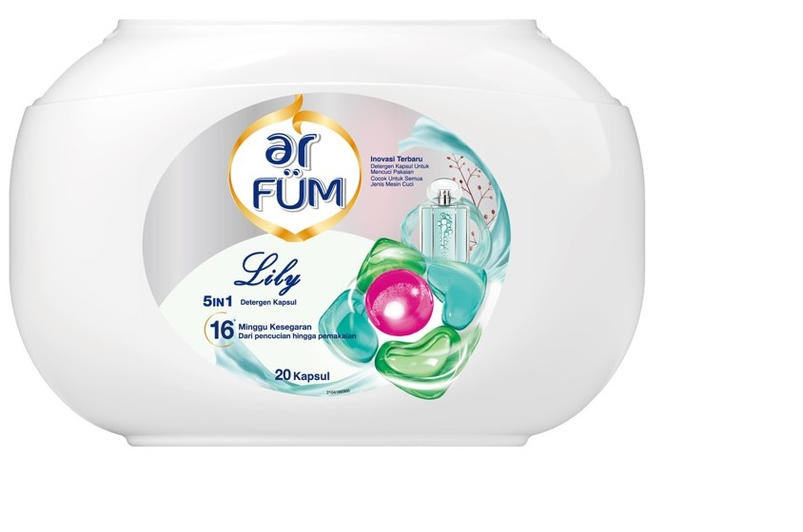
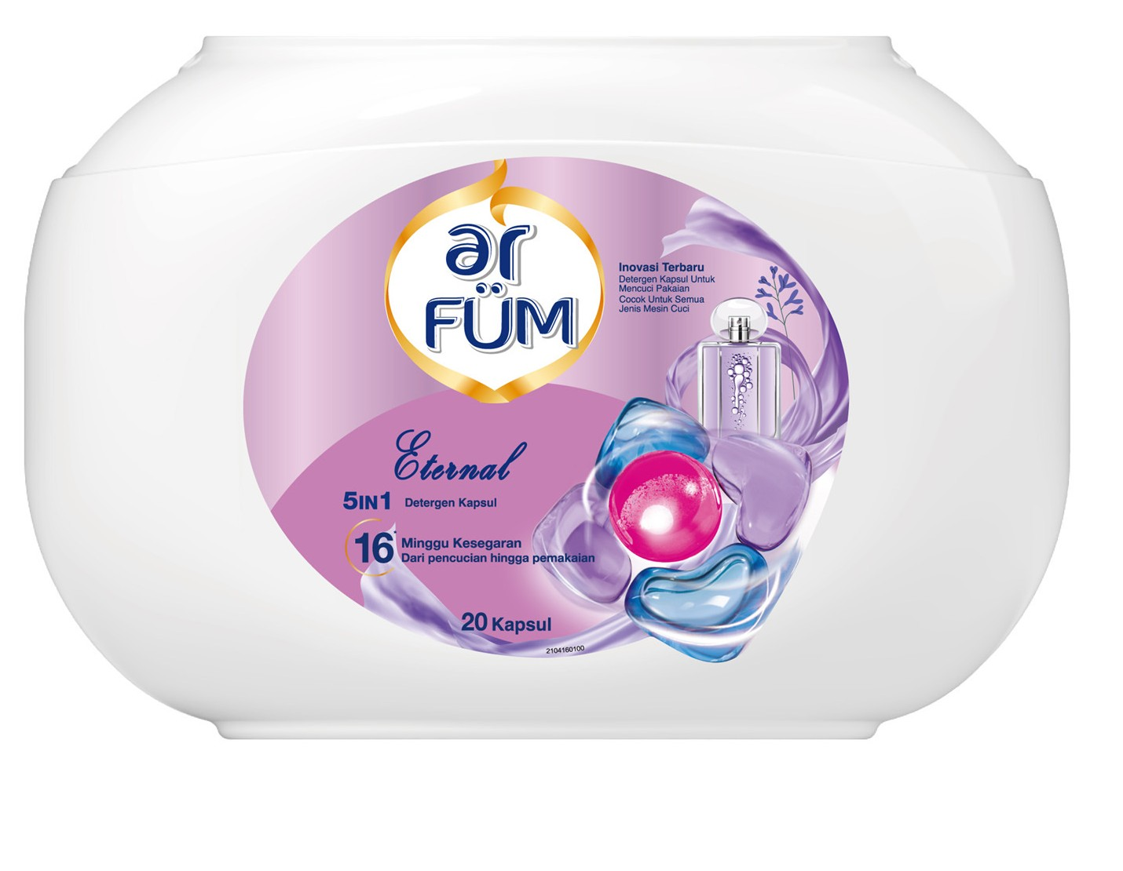
PRODUCT DETAILS
AR FÜM 5IN1 LAUNDRY CAPSULES
 | AR FÜM LAUNDRY CAPSULES
 | 108mm 152 mm (Image for reference only)
Pack Size: | ar FÜM 5in1 Laundry Capsules RSP (20pcs): Rp. 178.999
Reference: Internal R&D

Slide 17
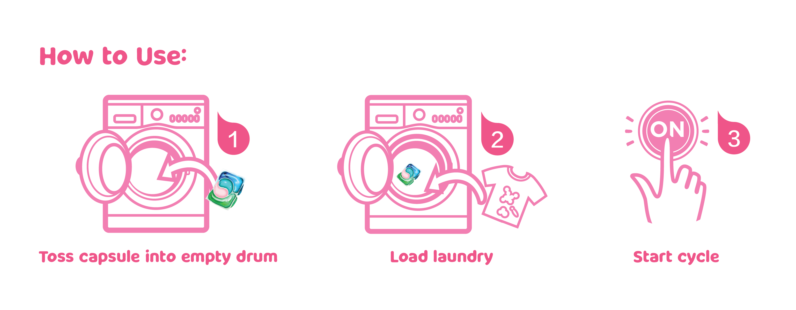
PRODUCT DETAILS
AR FÜM 5IN1 LAUNDRY CAPSULES
Bahan Aktif:
Total surfaktan 63.44%
(Image for reference only)
Reference: Internal R&D

Slide 18
THANK YOU!
OUJI SEIYAKU INDONESIA

