Slide 1



#LebihBaikIndosat
Brief Guideline
Corporate Communications
© Indosat Ooredoo Hutchison 2026 - www.ioh.co.id

Slide 2

Financial Results

Slide 3


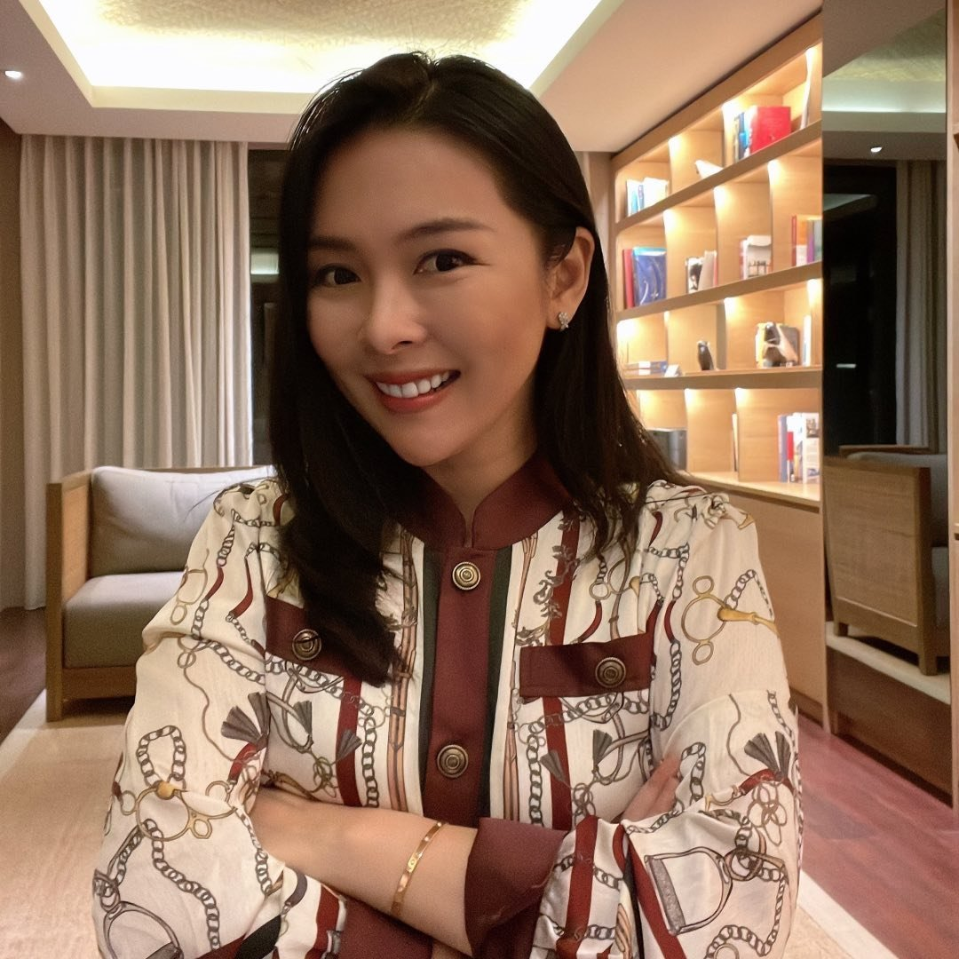






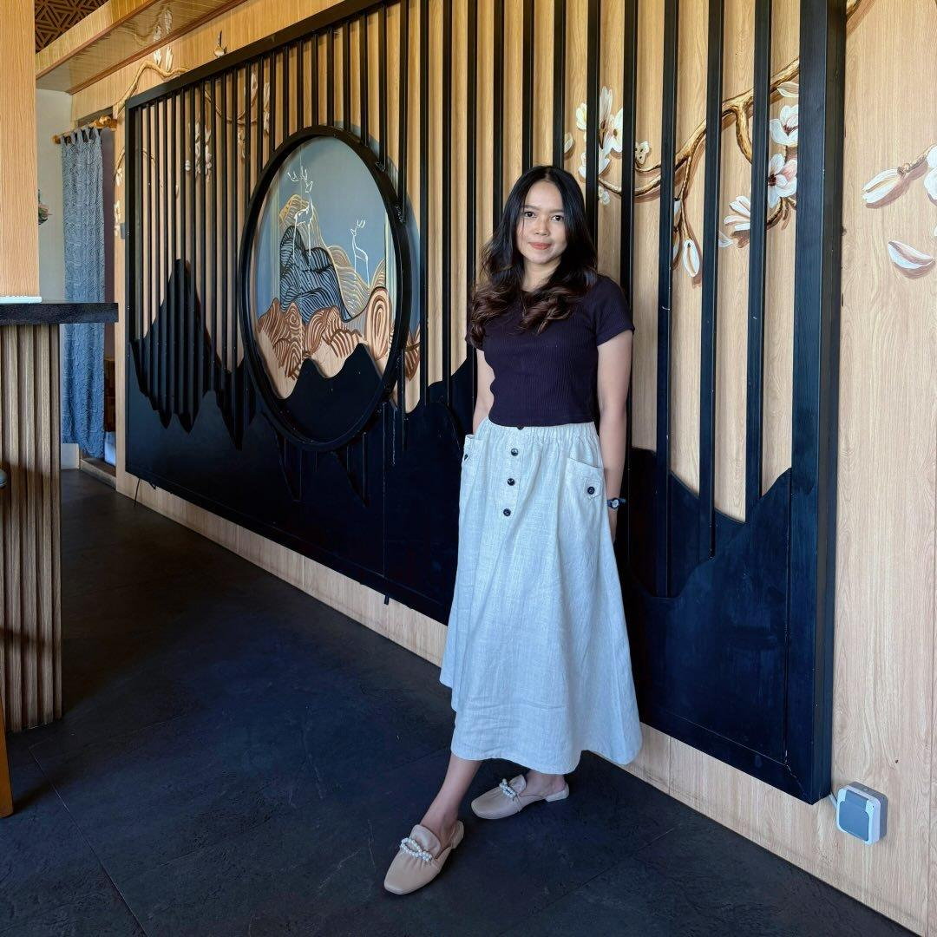



Influencer and KoL Amplification Plan
OBJECTIVE
INFORM
REACT
PASSION POINT
Finance
Creators with strong credibility in finance related content, including investment education, stock market discussion, personal finance tips, and recommendations that help investors or future investors.
Ellen May
Followers: 612K
Investor
DoddyBicaraInvestasi
Followers: 245K
Stock market educator
Adrian Maulana
Followers: 799K
Finance Educator
Koko Cuan Lagi
Followers: 192K
Financial & Investment Creator
TASK
Strengthen market confidence in company’s fundamental
Highlight Indosat’s financial performance (12% revenue)
Indosat’s dividend distribution IDR 111 per share
Recommend retail investor to buy Indosat’s stock market
Raymond Iriantho
Followers: 158K
Financial Creator
Pandeka Perkasa
Followers: 131K
Stock market educator
Christie
Followers: 25.1K
Gen Z Finance Creator
Ervina
Followers: 108K
Stock market enthusiast
PLATFORM
Finanza
Followers: 64.5K
Stock market educator
TIERING
10 Makro
15 Mikro
PERIODE
11-15 Mei 2026
© Indosat Ooredoo Hutchison 2025 - www.ioh.co.id
Notes:
Financial & Investment Content Creator

Slide 4
Brief & Guideline

Slide 5
Case Gugatan Kuota Hangus

Slide 6
Unbranded KOL Amplification Plan
Choosing the right package is not always about buying the biggest quota, but about finding the most relevant option for how they use the internet.
Objective
EDUCATE
PASSION POINT
Moms
Lifestyle Enthusiast
Business Owner
Content Angle
“Beli kuota jangan asal banyak, tapi yang paling sesuai sama kebutuhan. Karena penggunaan kuota yang lebih bijak bisa bantu kita menikmati koneksi yang lebih optimal, sekaligus lebih hemat.”
TASK
Educate audience that data quota is closely connected to network capacity, where fair and responsible usage helps maintain a better connectivity
Encourage wise spending by reminding audiences to purchase data packages based on their needs and usage habit
PLATFORM
TIERING
20 Mikro
PERIODE
14-15 Mei 2026
© Indosat Ooredoo Hutchison 2025 - www.ioh.co.id

Slide 7



Thank you!
© Indosat Ooredoo Hutchison 2025 - www.ioh.co.id

